Slide 1
Generativni AI model CPU vs. GPU na primjeru Stable Diffusion
Predavač:
dr. sc. Ivor Milošević
Sveučilište u Zagrebu
Sveučilišni računski centar - Srce

Slide 2
GPU vs CPU setup 1/2
“CPU”
AMD EPYC 7543P 32-Core Processor
12vCPU jezgri
24GB 3000/MT RAM
ESXi
“GPU”
AMD EPYC 7713P 64-Core Processor
16vCPU jezgri
12GB 3000/MT RAM
1 Nvidia A100 40GB
KVM
Parametri generiranja:
Frontend: Easy Diffusion
Model: JuggernautXL_v7Rundiffusion
Sampler: DPM++ 2 Ancestral (Karras)
Image Size: 1024x768pix + various
Inference Steps: 10,20,30,40,50,100
Image Quality: 95
Guidance Scale: 8.4
LoRA: None
VAE: None
FIFE: GFPGAN v1.4

Slide 3
GPU vs CPU setup 2/2
Prompt:
a cinematic realistic photograph of an astronaut riding a futuristic motorcycle on Mars with heavy thunderstorm approaching in the background and alien flying saucer emerging from the cloud
Negative prompt:
(worst quality, greyscale), ac_neg2, zip2d_neg, ziprealism_neg, watermark, username, signature, text, bad anatomy, bad hands, text, error, missing fingers, extra digit, fewer digits, cropped, jpeg artifacts, bad feet, extra fingers, mutated hands, poorly drawn hands, bad proportions, extra limbs, disfigured, bad anatomy, gross proportions, malformed limbs, missing arms, missing legs, extra arms, extra legs, mutated hands, fused fingers, too many fingers, long neck

Slide 4
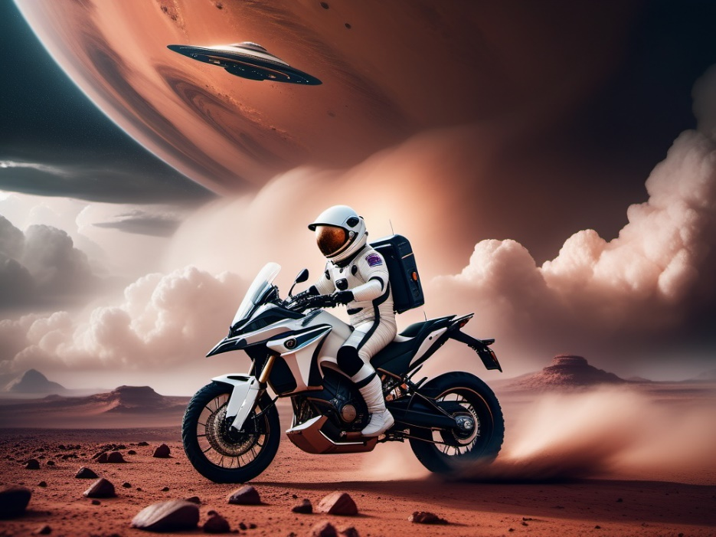
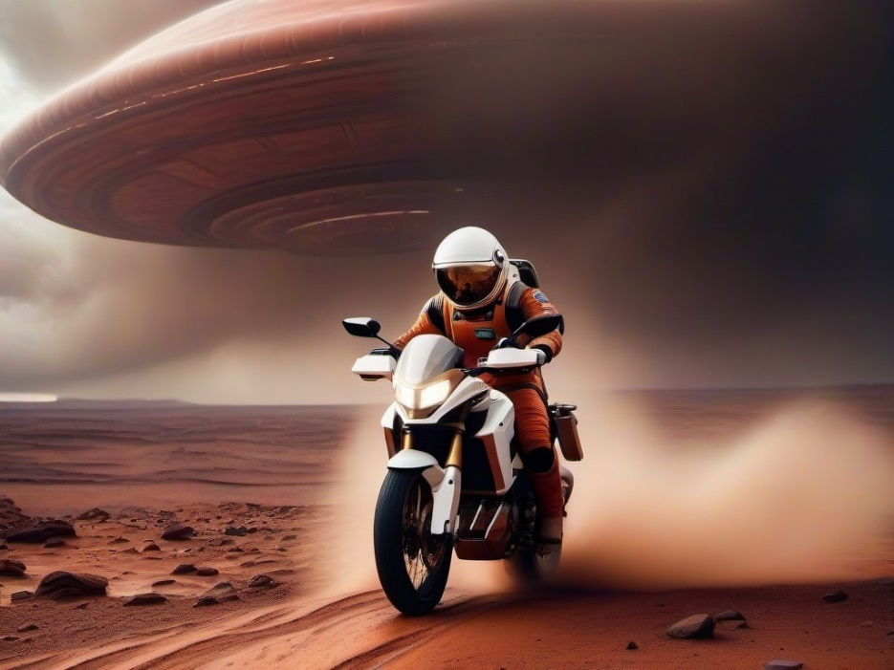
GPU vs CPU rezultati 1/2

Slide 5
GPU vs CPU rezultati 2/2

Slide 6
Generativni AI model CPU vs. GPU na primjeru Stable Diffusion

