Slide 1
Intro Slide Title 1
Artificial Intelligence in Education: Making Students Matter
Professor Denise Whitelock
Director Institute of Educational Technology
The Open University
Denise.whitelock@open.ac.uk

Slide 2

Slide Title 6
Shaping the Future of Learning with AI:
Feedback , Practice, Personalized Learning
Students at the Centre
Lessons learnt with AI
Vision
Generative AI
21st Century skills
This Photo by Unknown Author is licensed under CC BY-SA-NC

Slide 3

Digital Ecosystem at the Institute of Educational Technology
Research
Teaching
Quality Enhancement and Innovation
This Photo by Unknown Author is licensed under CC BY-SA

Slide 4
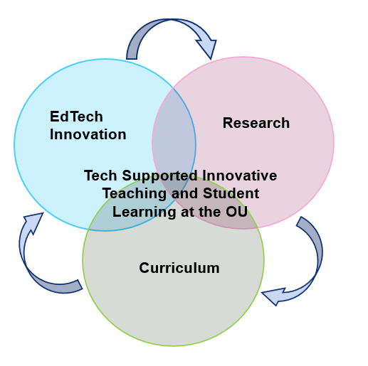
IET Innovation through pedagogically driven technology
Research - drives internal and external innovation, supported by KE work.
Innovative Curriculum – instantiates and tests research outcomes.
Innovation in EdTech – evaluates and feeds innovative curriculum and offers opportunities for Research proposals for further funding.

Slide 5

Students
Matter
Assessment
Feedback
Practice
Learning
This Photo by Unknown Author is licensed under CC BY-NC

Slide 6
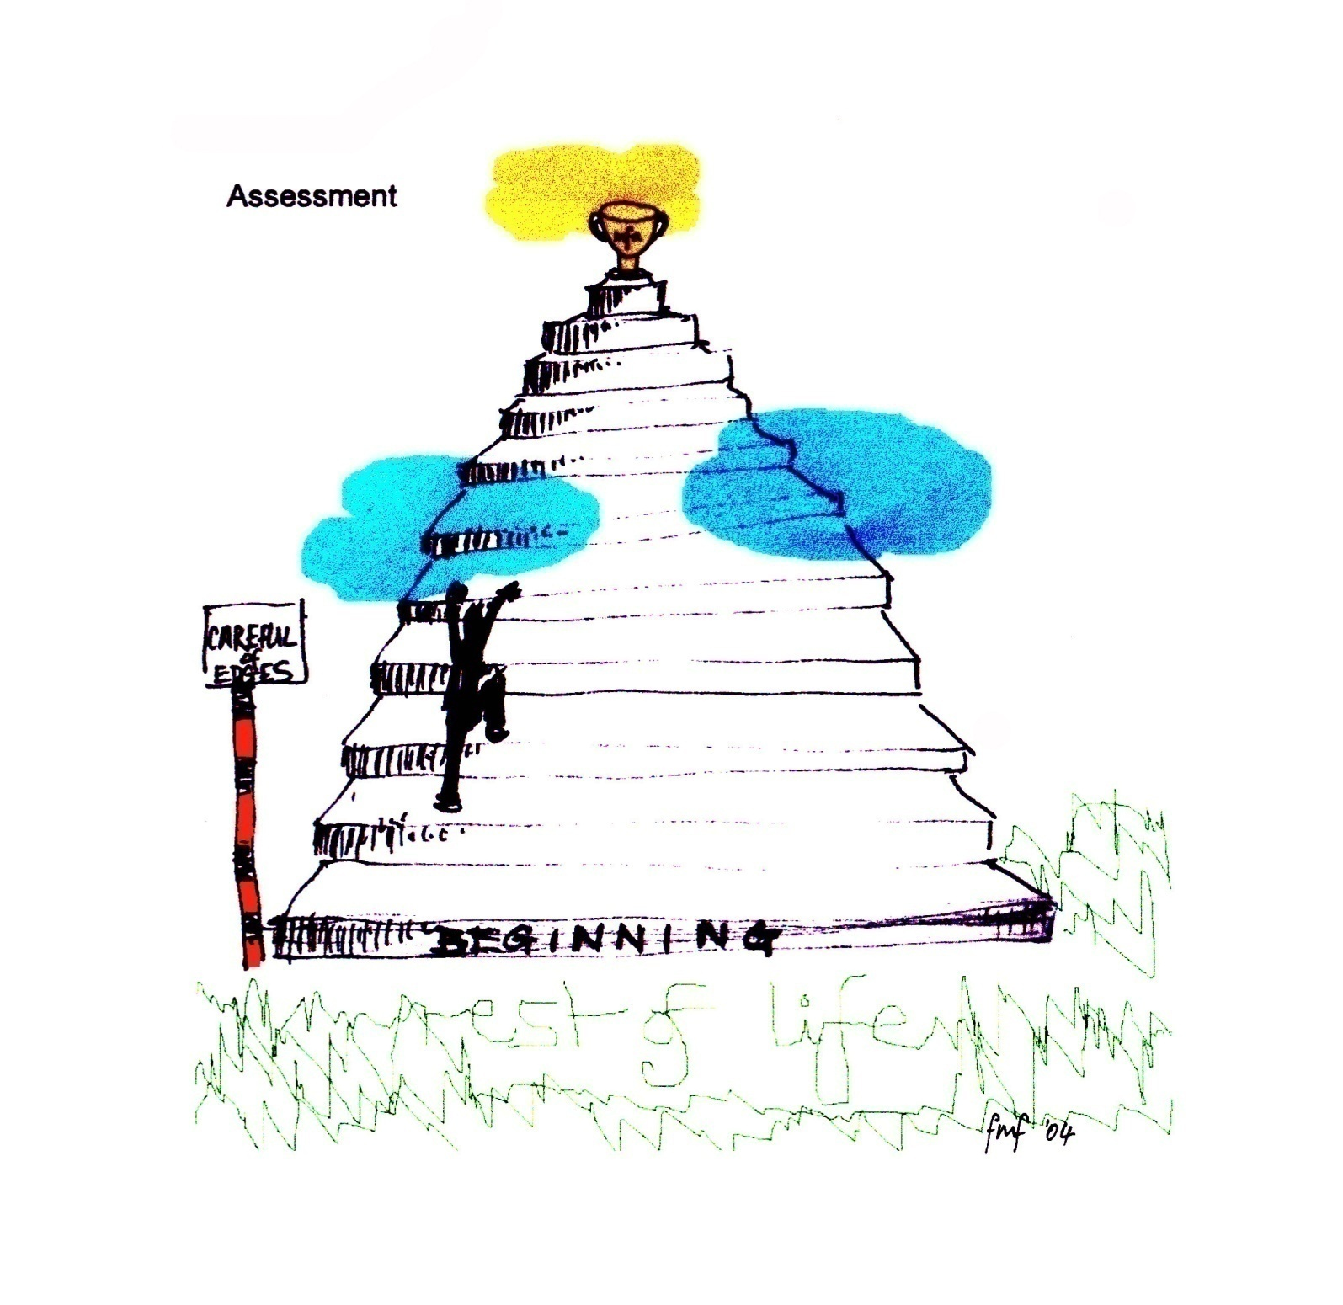
Students
Students Feelings about Assessments

Slide 7
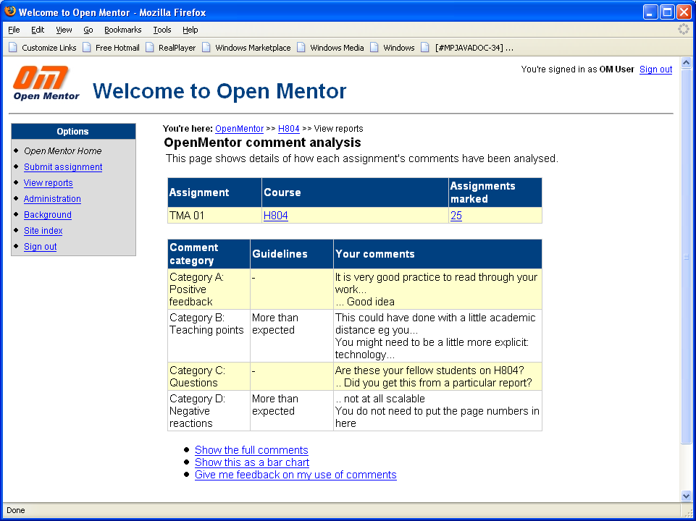

Slide 8
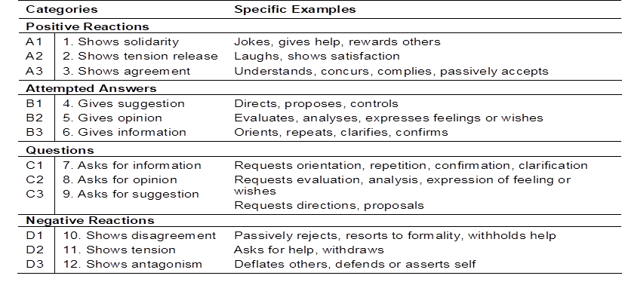
Coding Teachers feedback comments with Bales categories

Slide 9
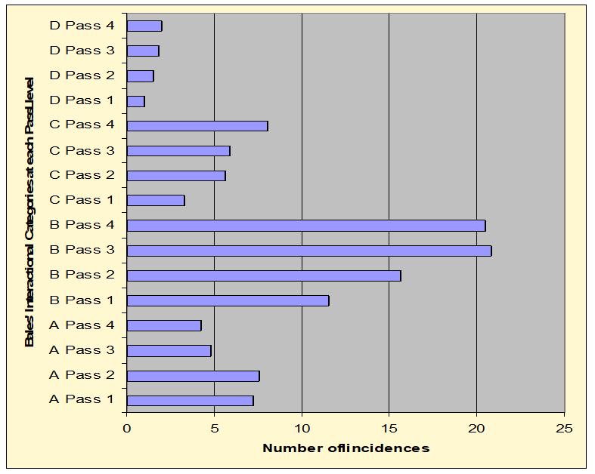
Teachers
Identifying trends: H801

Slide 10
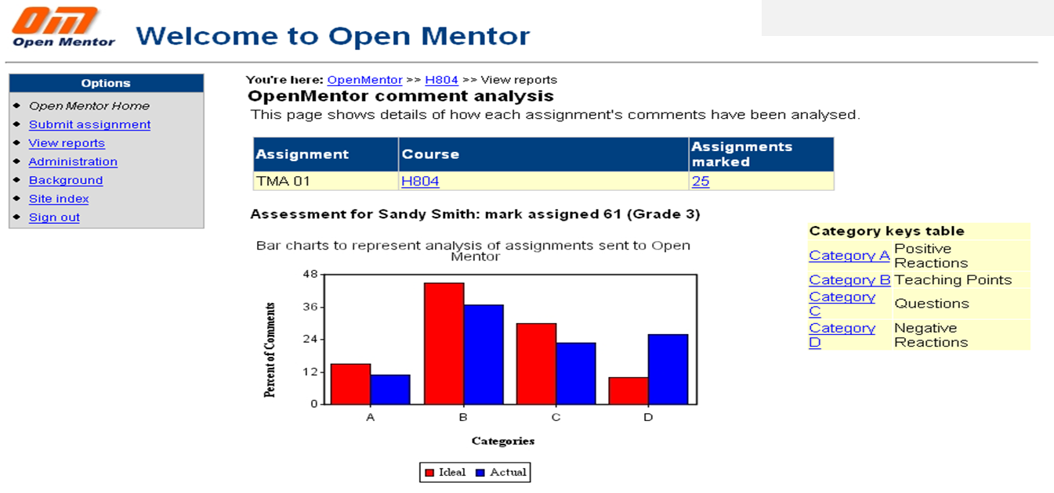
AI supporting tutors feedback to students
Initial build by OU with JISC funding
Employed by Southampton University and Kings College London with JISC funding for technology transfer

Slide 11

Lessons Learnt from AI Feedback systems
This Photo by Unknown Author is licensed under CC BY

Slide 12
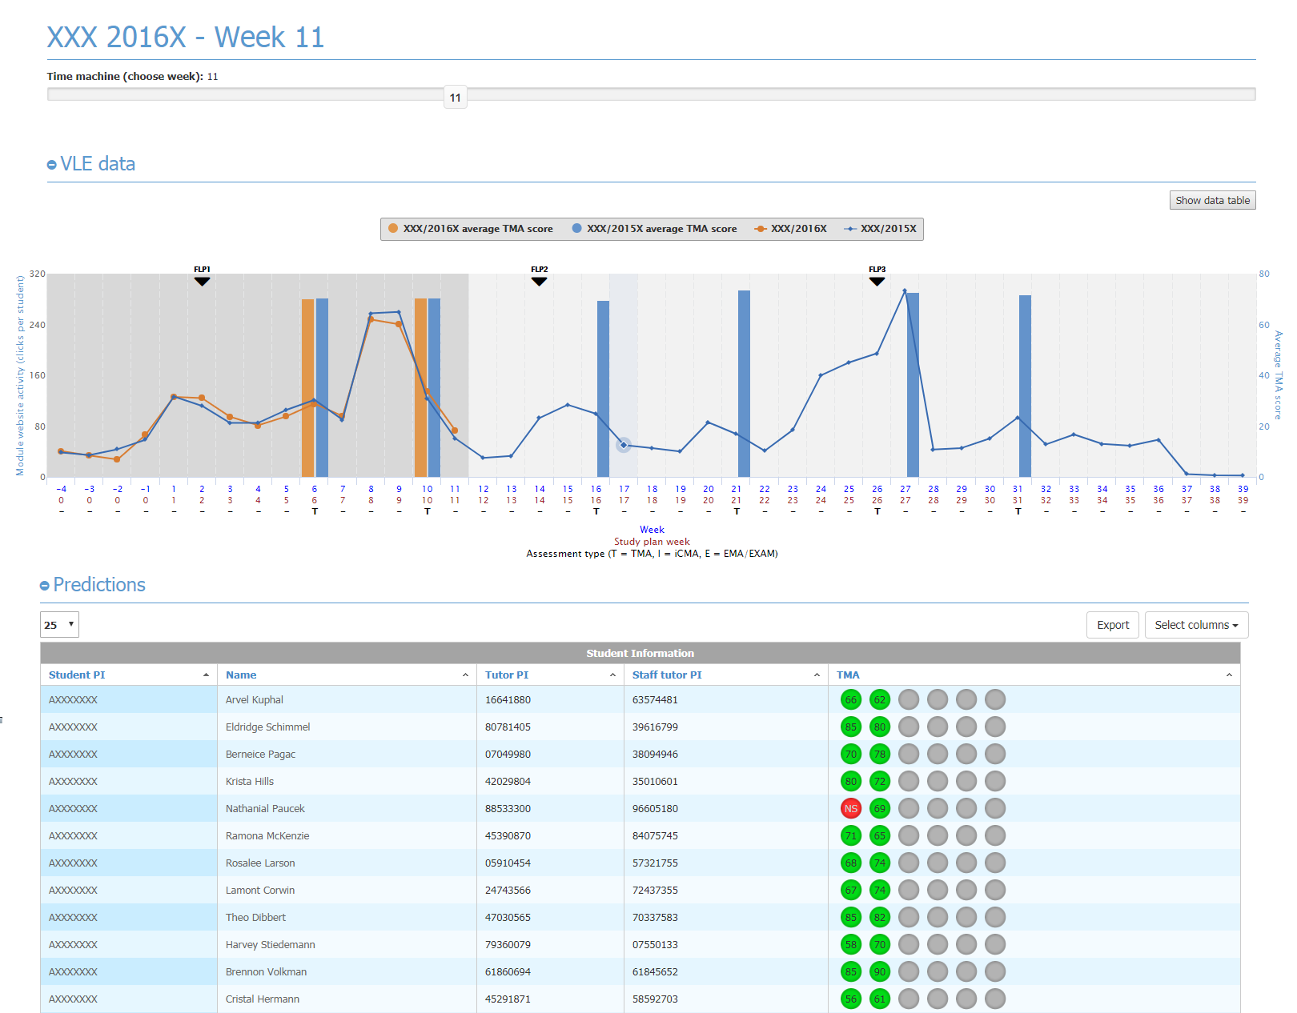
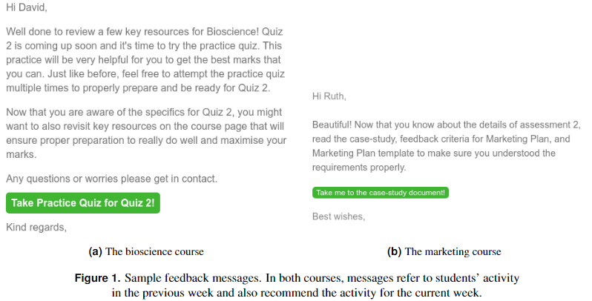
AI and feedback to tutors and students
AI and feedback to tutors supporting student success
AI and personalised feedback direct to the student
OU Analyse
Simple non predictive automated messaging from UNISA
Demonstrated early engagement with feedback is positively associated with passing
Herodotou, C.; Rienties, Bart; Boroowa, Avinash; Zdrahal, Zdenek and Hlosta, Martin (2019). A large-scale implementation of Predictive Learning Analytics in Higher Education: the teachers' role and perspective. Educational Technology Research and Development, 67(5) pp. 1273–1306. [OPEN ACCESS]
Iraj, H., Fudge, A., Khan, H., Faulkner, M., Pardo, A., & Kovanović, V. (2021). Narrowing the Feedback Gap: Examining Student Engagement with Personalized and Actionable Feedback Messages. Journal of Learning Analytics, 8(3), 101-116. https://doi.org/10.18608/jla.2021.7184

Slide 13

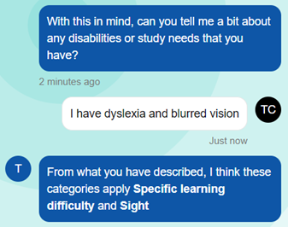

Leading OU Accessibility: SEGA and Admins project
Taylor a virtual assistant to support students disclosing disabilities
Students talk to ‘Taylor’ through either text or speech.
Trial of 134 students, 65% preferred Taylor to existing form-based process.
Taylor has now been embedded into OU systems across the four nations Over 30 conversations with new students completed in the first two weeks
Notes:
How old is the oldest OU graduate? (Clifford Dadson got a BA Open Degree in Arts in 2013 aged 93)

Slide 14
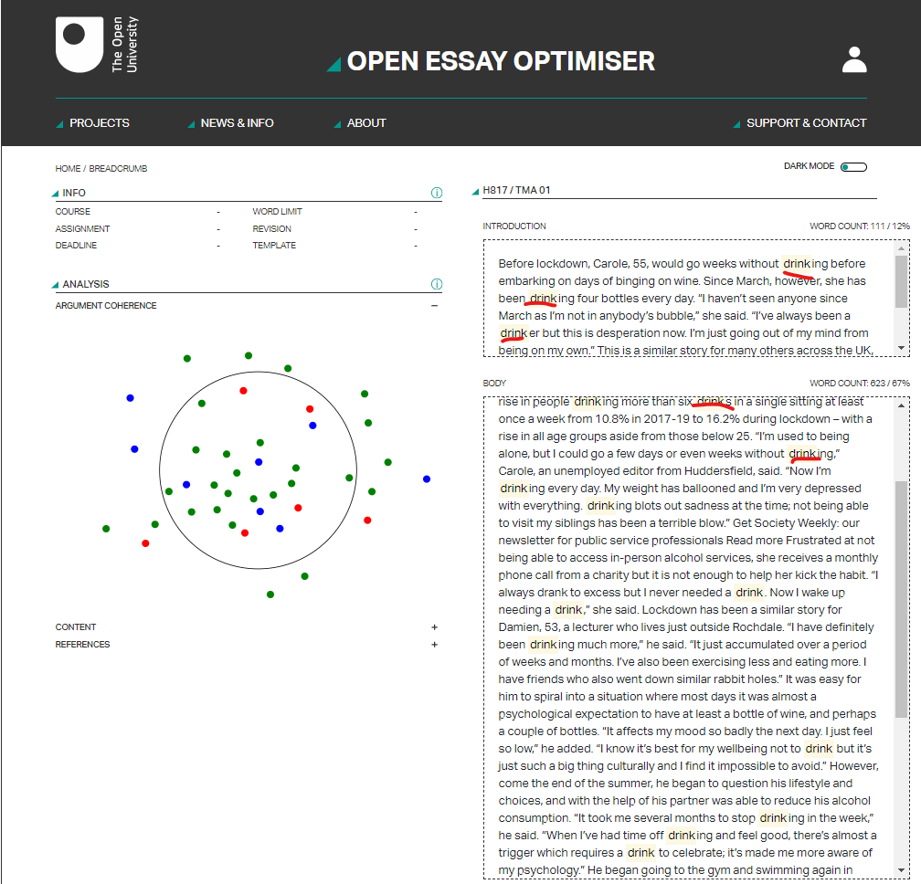

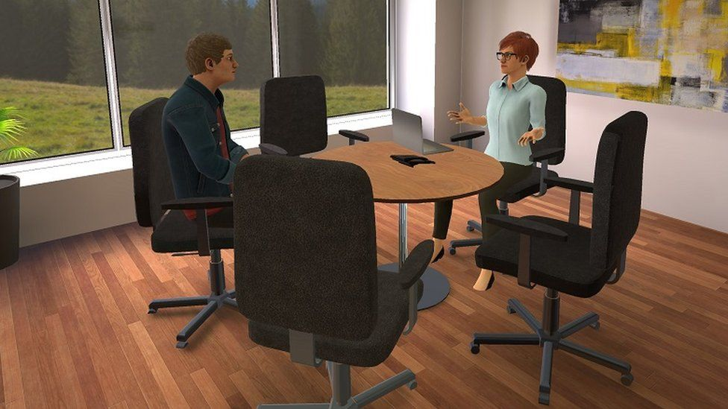
Ed Tech supporting student feedback during Practice
Problem: No feedback during practice
Solution: AI offering teaching as practice feedback
AI and VR practicing job interviews
Summarisation through different visualisations
Using Key words and key phrases
Mean grade for overall module for students in cohort who used Open Essayist (64.2) and students previous cohort (53.7) p0.4
Sandwell College in West Bromwich Preferred by students who felt they could be themselves with an avatar. Rerun of ELIZA!
Whitelock, D., Twiner, A., Richardson, J.T.E., Field, D. & Pulman, S. (2018). What does a ‘good’ essay look like? Rainbow diagrams representing essay quality. In: E. Ras & A. Guerrero Roldan (Eds.) Technology Enhanced Assessment (TEA2017). Communications in Computer and Information Science, Springer, Cham, 829, 1-12.
Coherence related to mark awarded now available with Open Essay Optimiser Whitelock et al (2022)
Reduce Plagiarism - FEEDBACK FIRST

Slide 15

Researchers
Short text for illustration of Rainbow Diagrams

Slide 16
Researchers
Sentence graph of short text

Slide 17
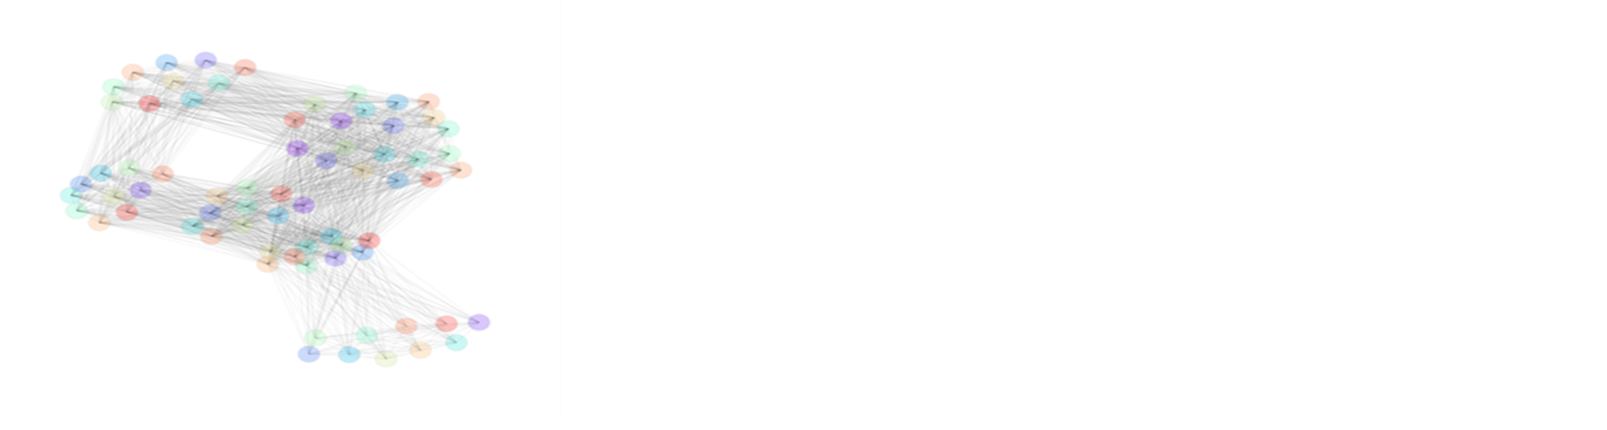
Researchers
Pretend essay: 10 identical paragraphs

Slide 18

Researchers
Pretend essay: 50 identical sentences

Slide 19
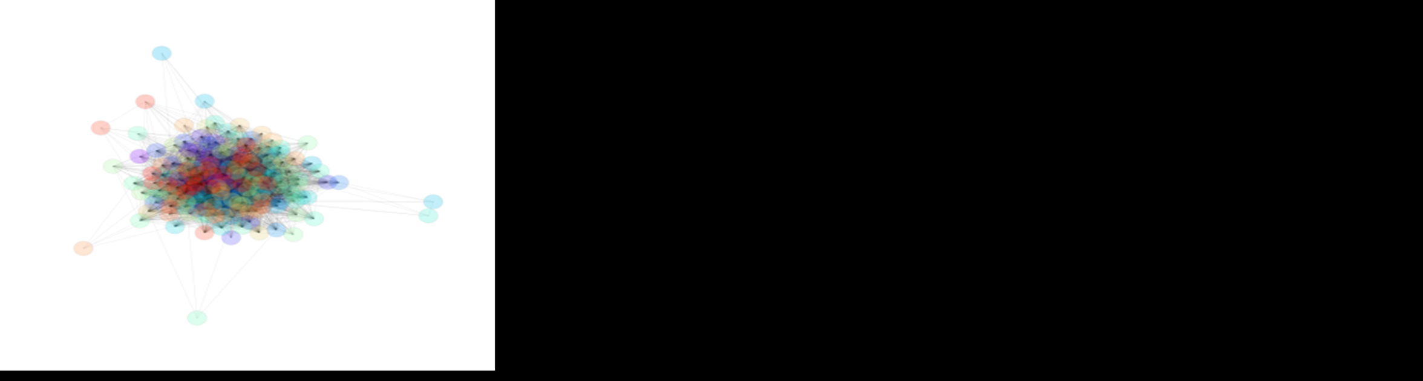
Researchers
Stanford University Boothe Prize essay

Slide 20
Researchers
OU Essay awarded high grade

Slide 21
Researchers
OU essay awarded low grade

Slide 22
Researchers
Rainbow diagrams related to mark awarded
Multivariate analysis of variance on marks awarded to 45 students
Submitted two essays
Rainbow diagrams produced from these essays and rated as high, medium or low attainment
Covariate showed a significant relationship with the marks
F(1, 43) = 5.92, p = .01 using a directional test
Essays rated as high would be expected to receive 8.56 percentage points more than essays rated as medium
17.2 percentage points higher than essays rated from rainbow diagrams as low

Slide 23

Generative Artificial Intelligence
Moving Forward
This Photo by Unknown Author is licensed under CC BY

Slide 24

Generative AI models are trained by toggling ‘weights’ or the strength of connections between different variables
Applied statistics not such a good term as AI?
Can generate academic text rapidly
Chat GTP 4 Improving but not for journal abstract
Hallucinates
Amoral and Biased
Disrupter
Generative AI
This Photo by Unknown Author is licensed under CC BY

Slide 25
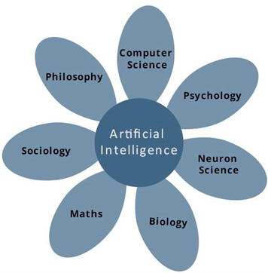
IET Curriculum development & AI
Exploring Generative AI for short course production.
Exploring funding options for developing much-needed curriculum around XR, AR & VR, drawing on OpenXR Studios facilities.

Slide 26
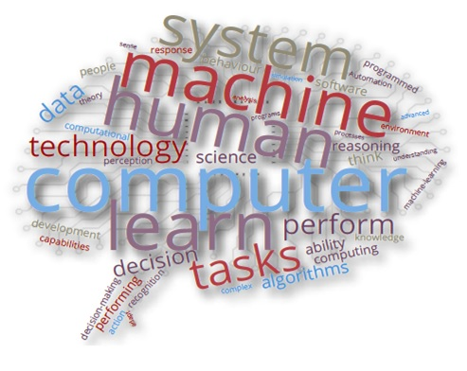
AI and new curriculum production AI as Co-Collaborator
Led by Thomas Ullman
Quality of dialogue measured through prompt completions
GitHub repository 'Prompts for Education’, include prompt for planning lessons or assignment ideation.
Principles for prompting to provide acceptable completion text : Level of detail, examples, splitting complex tasks into several smaller tasks, chain of thought prompting (i.e. recipe-like instructions), adding/repeating instructions at the prompt end
GAI can produce content that supports the co-creation of course content.
GAI aids with brainstorming ideas, creating an outline, assessing adherence to specific writing guidance (such as readability and inclusive language).
Outputs need to be verified by topic experts

Slide 27
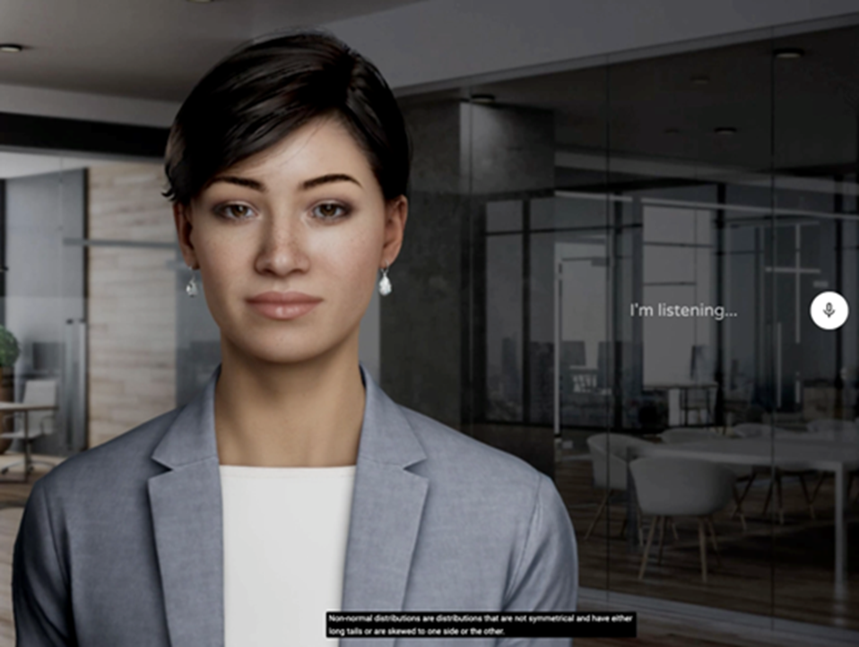
Question Answering
Version trained on Psychology Methods and Skills OU course
Structured vs unstructured interviews
Project lead: John Dominque (Kmi),
The Open University

Slide 28
Ai and new curriculum production
Journal and Conference Papers
Rienties, B., Domingue, J., Duttaroy, S., Herodotou, C., Tessarolo, F., & Whitelock, D. (2024). I would love this to be like an assistant, not the teacher: a voice of the customer perspective of what distance learning students want from an Artificial Intelligence Digital Assistant. arXiv preprint arXiv:2403.15396. https://arxiv.org/abs/2
Ullman,T.,Bektik,D.,Edwards,C.,Herodutu,C.,Whitelock,D.,(2024)Teaching with Generative AI: Moving Forward with Content Creation. EDEN 24 Annual Conference, Graz ,Au
Bektik,D., Ullman,T.,Edwards,C.,Herodutu,C.,Whitelock,D.,(2024) AI-Powered Curricula: Unpacking the Potential and Progress of Generative Technologies in Education EDEN 24 Annual Conference, Graz ,Au

Slide 29
Opportunities and Challenges
Opportunities
Challenges
Assessment changes
Prompt Pedagogy
Collaborative design for projects
Personal tutor
Guidelines and policies for staff and students
AI literacy for students and staff
More pedagogical research with teachers influencing new development
Lack of Ethics
Bias concerns
Digital inclusion with equitable outcomes
Not caring as a personal tutor
50% of the population younger than 30 years tools will be ubiquitous
Lethargic Cognition

Slide 30

Vision for AI and Learning
Problem through to Solution

Slide 31
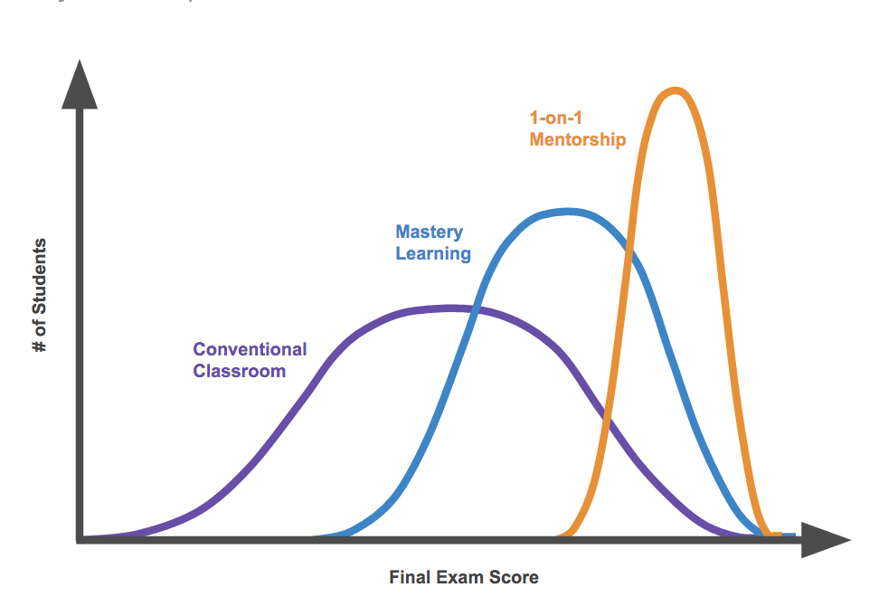
Bloom's 2 sigma problem
"the average tutored student was above 98% of the students in the control class"
https://www.pinterest.co.uk/pin/how-startups-are-solving-a-decadesold-problem-in-education--355643701810297990/

Slide 32

Research Agenda for GenAI
Rigorous systematic investigations required
Integration AI Tools means re-evaluation of Course Design
Guidelines : Academic Integrity, Assessment Design, communicating with students
Prompt engineering/Prompt Pedagogy
What corpuses are required for accurate personalised Learning?
Commercial value of Corpus
Ethics
Scale and student agreement
Future Skills preparing students for employment
This Photo by Unknown Author is licensed under CC BY-NC-ND

Slide 33

Grand Challenge: what does it mean to assess human learning that can be readily understood by students and teachers?

Slide 34
Slide Title 31

