Slide 1
Data literacy and open data: experiences from building capacity on open data research for University of Zagreb
By:
assoc. prof. Dragica Šalamon, University of Zagreb Faculty of Agriculture
dsalamon@agr.hr

Slide 2
Background and current situation in Croatia – my perspective
A lot of open initiatives nationally, internationally:
Open sector data
Open research data
Open education data
Research open data
Strong support by national institutional initiative centres
Rarely any obligation/strong insisting for research and education OD
Prioritize time and effort in capacity building and preforming the task
Not a lot of research on open data?
Different sector data- is it open? is it FAIR? Which data to open? How? Why and for whom? Who is opening data? Who is re-using? Cost-benefit? How is this changing over time?
Who can open? Where to open? What other/human capacity is required to open?
Human capacity to open/reuse data in different sectors?
Human capacity to open/reuse data in different levels of education?

Slide 3
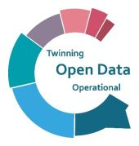
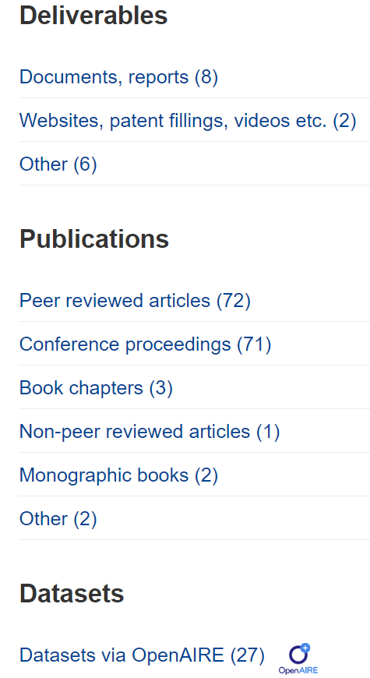
Horizon project
STARTING POINT 2019:
access to open data in Croatia limited
identify weaknesses
scientific and innovative development of staff at the University of Zagreb (6 Faculties) in partnership with Greece’s University of the Aegean and the Delft University of Technology in the Netherlands
OD research
Faculty of Agriculture contribution
18%
15.5%
0%
100%
100%
50%

Slide 4
Impacts at University of Zagreb Faculty of Agriculture
OD research group: biotechnology, social and natural sciences
MoUs
for further research and education
for further contribution to open data portals
New collaborating institutions and projects
Agricultural data extracurricular activity for students
Reviewed education content to include OD
new university courses
updated university courses
OD education guidelines- Data literacy goals
…

Slide 5
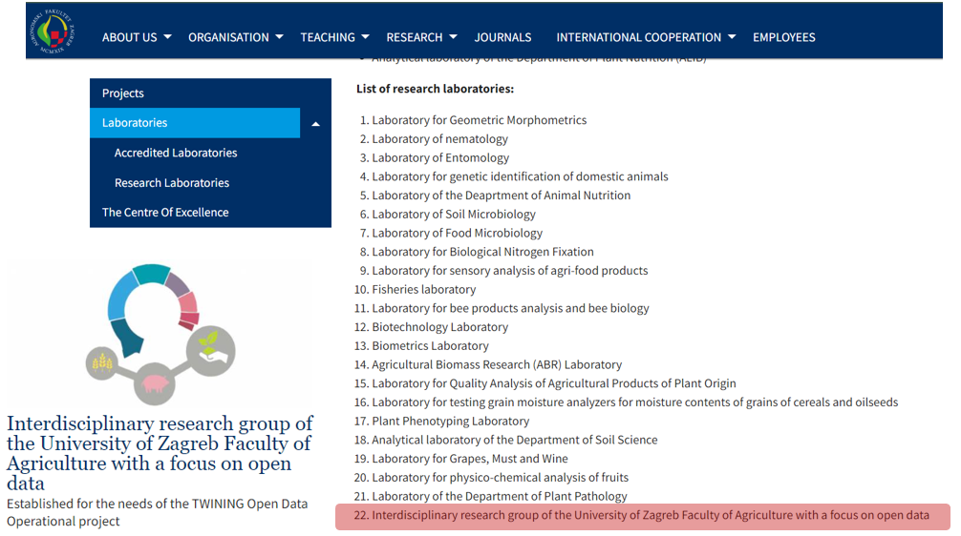

Slide 6
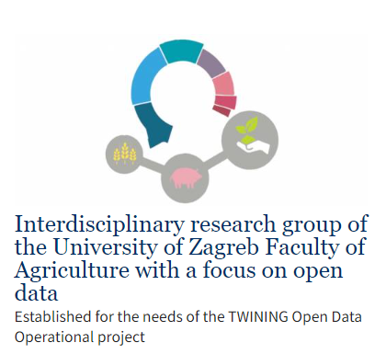
VISION:
interdisciplinary scientific excellence and the potential for innovation in the field of open data
by encouraging the supply and use of free public data, primarily from the agricultural sector
RESEARCH TOPICS:
data produced by the agricultural sector in Croatia
the importance of integration of agriculture open data space with the data space of the nature and environmental protection sector
and data literacy and education on OD and using OD
MISSION:
assessment of the state of ecosystems of data important for the transition of the agricultural and rural development sector in Croatia (research and professional projects)
increasing the level of data literacy of study programme outcomes

Slide 7
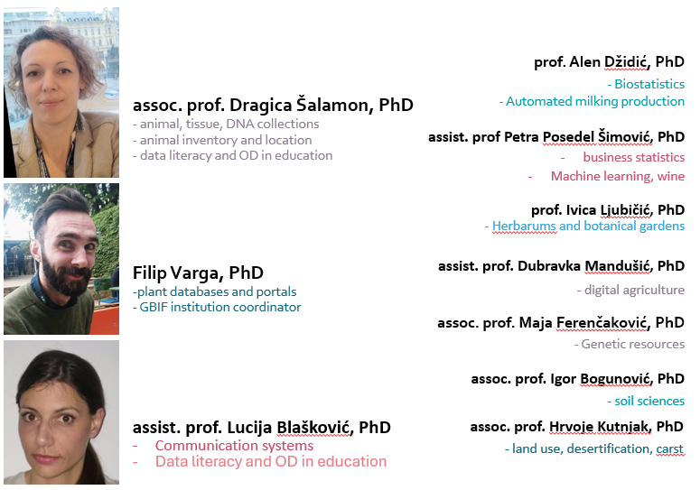
Interdisciplinary Research group of the University of Zagreb, Faculty of Agriculture with a focus on open data

Slide 9
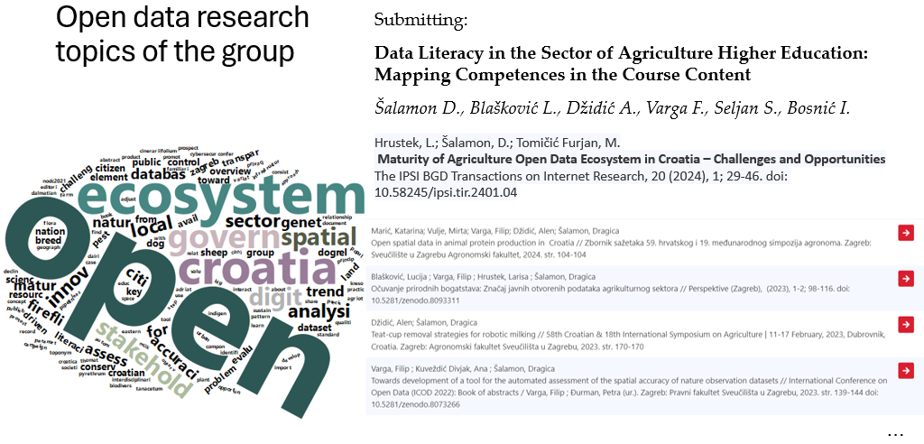

Slide 10
Data Literacy and Open Data?
the competence framework on digital competencies of the EU Science Hub (DigComp 2.0), places data and information literacy as one of four sub-competencies of digital literacy
nascent field of inquiry:
Within the information literacy movement?
Within the open data movement?
DL conceptual framework
clarity of key constructs
refinement of DL competences important in different sectors
refinement in different levels of education
ability to derive meaningful information from data in a critical manner
encompasses knowledge, skills and attitudes that include:
understanding of data;
acquiring and choosing data for a specific purpose;
interpreting and visualizing data, as well as communicating information about data to individuals who lack data literacy skills
collecting and managing data and metadata
using data and data analytic tools ethically

Slide 11
DL learning outcomes in CQF
data literacy umbrella concept covering the literacies required in the modern world (numeracy, information, IT, science, quantitative, financial, digital, media, evaluation/analytical or statistical literacy…)
with certain overlaps and enriched with skills of data handling, curating, communicating and using ethically to derive actions
OD literacy in the Croatian qualification framework in sectors:
I. Agriculture, nutrition and veterinary medicine (ANV)
VII. Electrical engineering and computing (EEC)
VIII. Construction, geodesy and architecture (CGA)
XI. Traffic and logistics (TL)
XVIII. Information and communications (IC)
XIX. Law, political science, sociology, state administration and public affairs (LPSSP)
- spring 2023: DL limited, integrated, starting from level 4

Slide 12
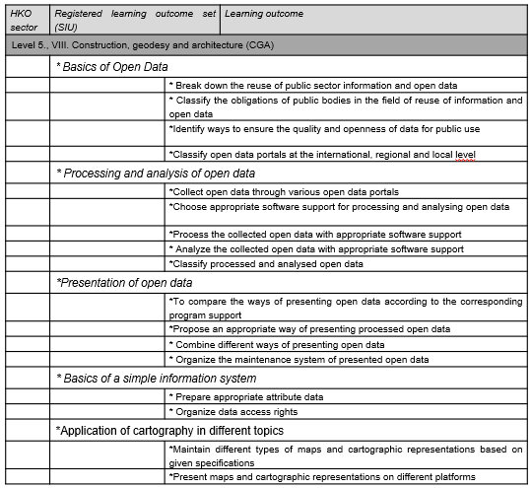
Education guidelines and CQF
Generic open data learning outcome sets registered in CQF
at education level 5
in Construction, geodesy and architecture sector
available and recommended for cross-sectoral integration in new educational programs focusing on open data

Slide 13
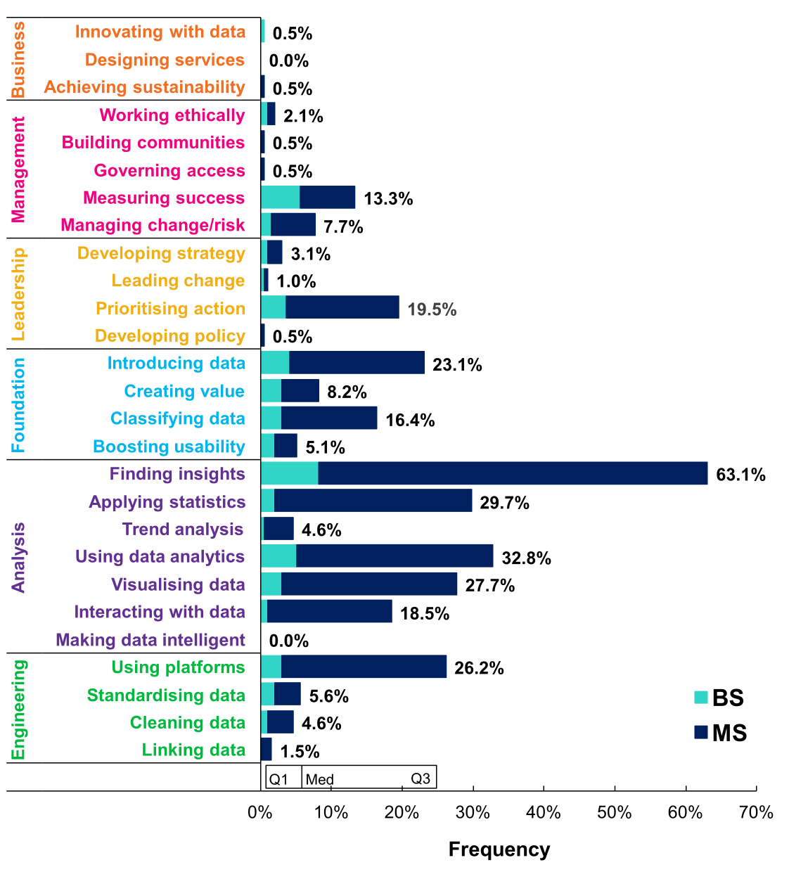
Research on data literacy offered through higher education at University of Zagreb, Faculty of Agriculture
The frequency of data literacy competencies discovered in 35% of the MS and BS courses of the University of Zagreb Faculty of Agriculture, using the thematic analysis based on the adopted ODI Data Skills Framework of the ECTS catalogue, interviews and the shared course materials.
To provide the approach for assessing data literacy and open data provided by formal education;
To assess different aspects of data literacy among future actors in the agricultural sector provided by formal education at the University of Zagreb Faculty of Agriculture;
To identify education on open data or education that uses open data, either as open educational materials or open data as content to provide some data literacy competence;
To provide data literacy and open data education guidelines for the future agricultural sector.

Slide 14
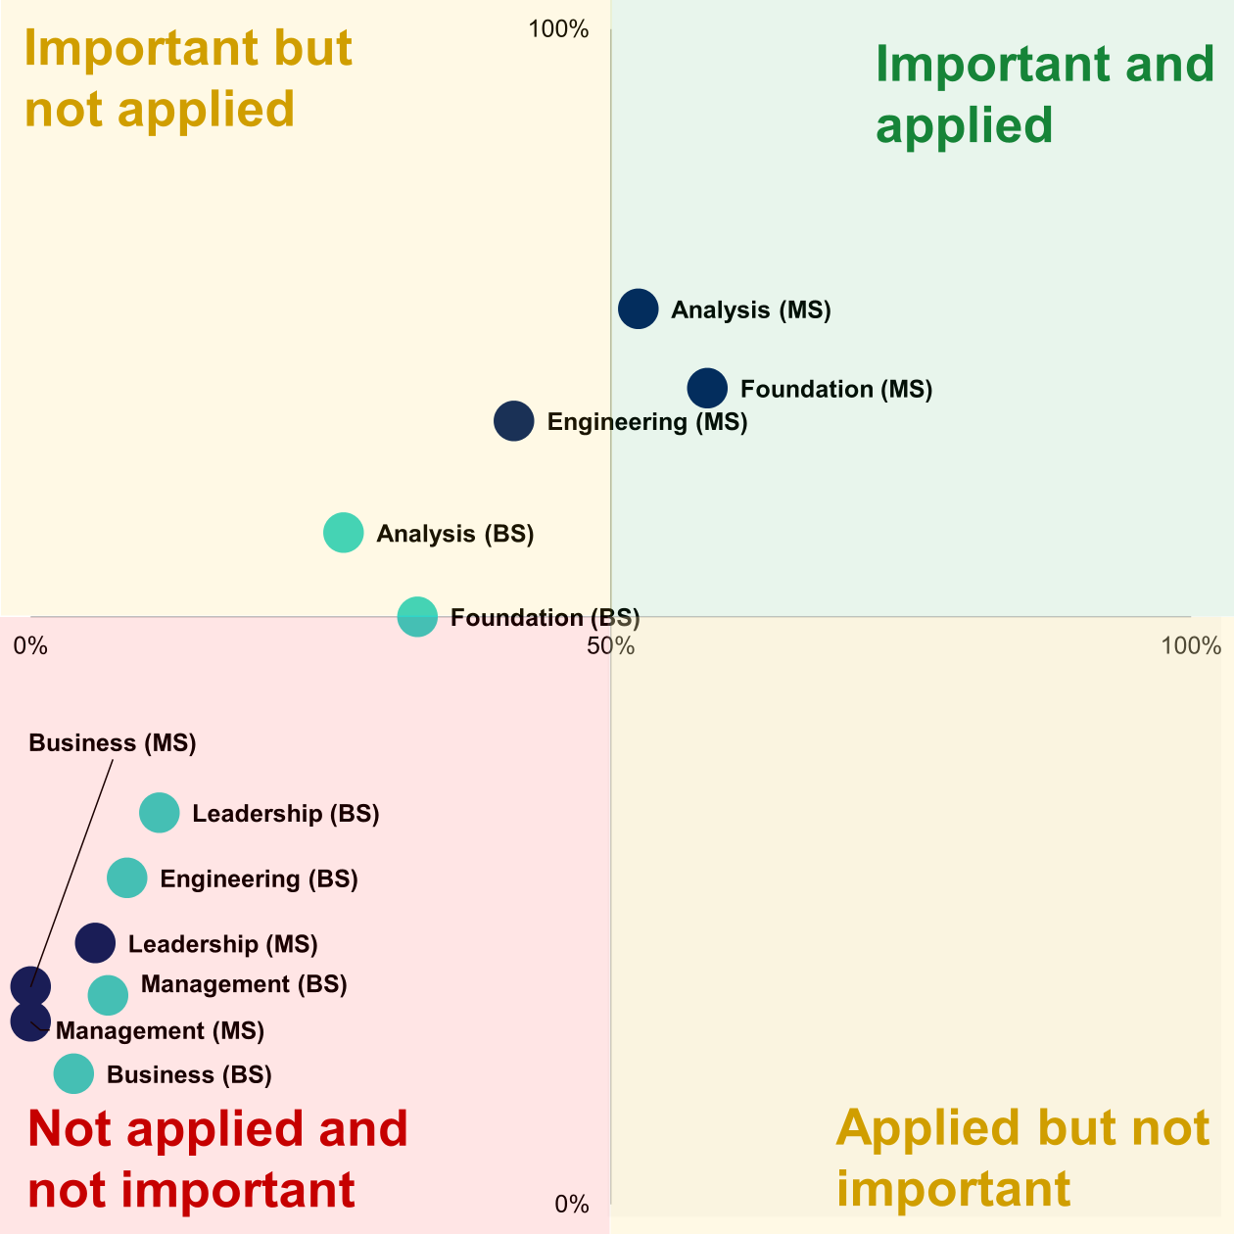
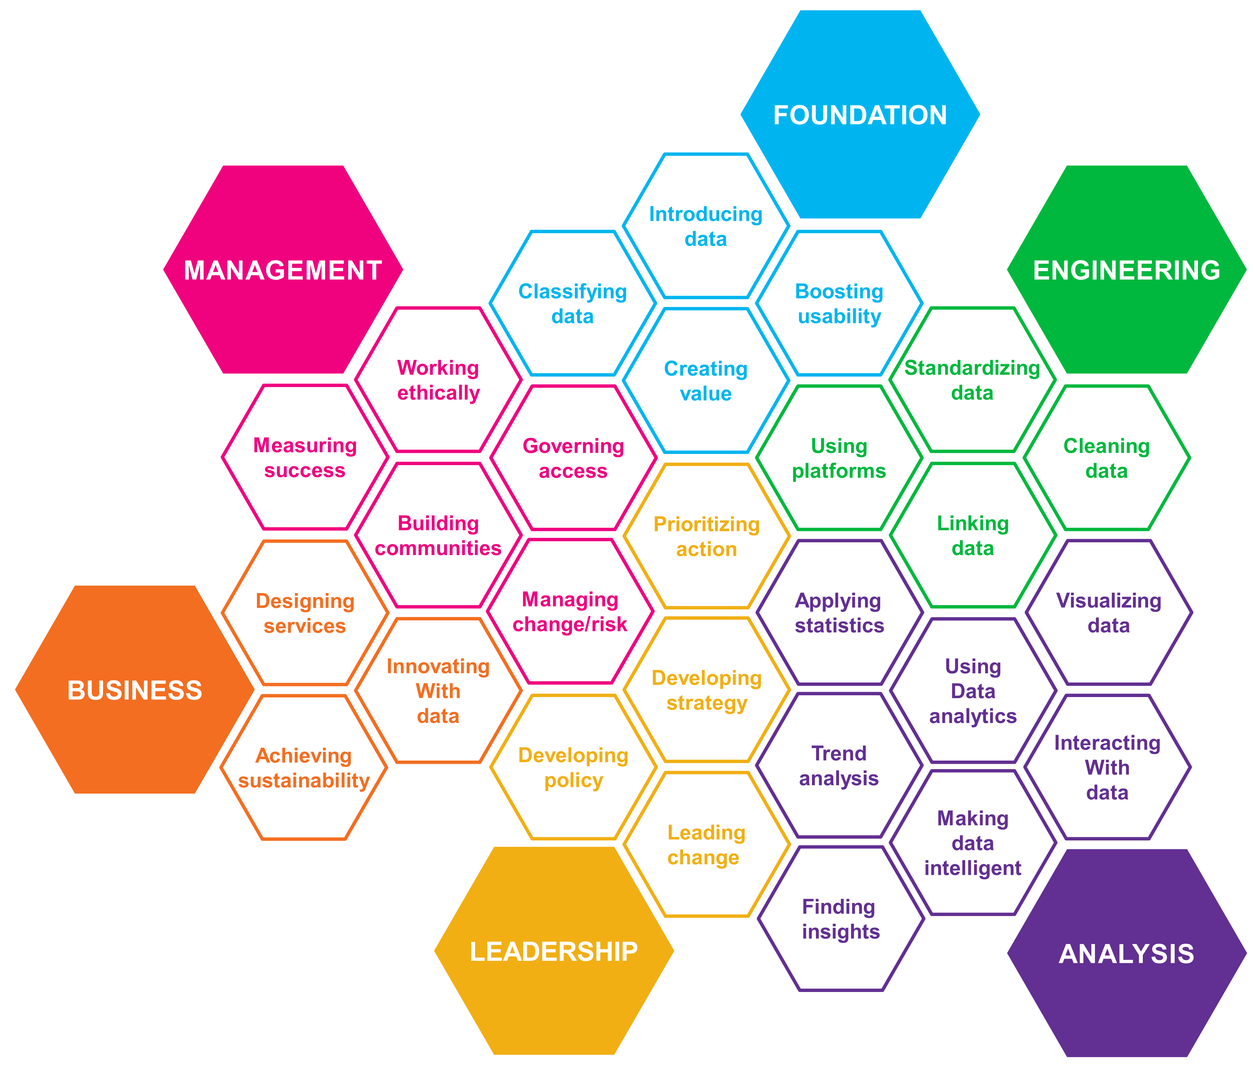
Research on data literacy offered through higher education at University of Zagreb, Faculty of Agriculture
The perceived importance of data literacy competence areas for the professional field of analyzed course according to the interviews, with respect to competencies discovered
ODI. Data Skills Framework (2020)

Slide 15
Further work and questions to answer:
Towards the institutional policy on open data and open science
Faculty of Agriculture: Data Management and Open Data Policy
Data literacy:
Open data learning outcomes
Levels 4, 5, 6 and higher
Generic
Specific for sectors of agriculture and nature protection

Slide 16
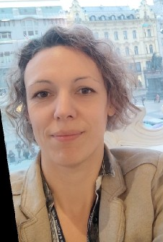
Dragica Šalamon works as associate professor at the Department of animal science of the University of Zagreb Faculty of agriculture. Open data useful for improvements in the sector of natural resource use, such as spatial, temporal, and observational environmental data, and data resulting from the activity of the agricultural sector are the focus of her scientific and professional research since 2019. Data literacy and critical thinking are in the focus of her professional work in higher education since 2016. In the field of agricultural sciences her research takes place within the framework of the evaluation of valuable genetic animal resources using molecular, genomic, spatial, and biometric techniques. Scientific publications include genetic valorization of indigenous breeds, valorization of the potential of sheep and goats in milk production. Her professional interests include the transfer of scientific techniques applied and developed for domesticated animal species to the management of endangered wild animal species.

