Slide 1


Data Center Infrastructure Management (DCIM) by Schneider Electric
Predavač(i):
Boris Majdandžić, MEP d.o.o.
boris@mep.hr, www.mep.hr , +385 98 9300 581
Dušan Ćirić, Schneider Electric / Product Application Engineer
dusan.ciric@se.com

Slide 2




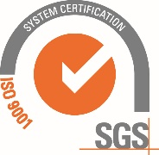
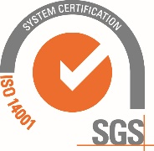




SUSTAV UPRAVLJANJA KVALITETOM I OKOLIŠEM
25 + godina iskustva
Vodeći pružatelj sveobuhvatnih rješenja za napajanje i hlađenje podatkovnih centara
Od 2018. godine prosječni godišnji rast prihoda bio je 19% iz godine u godinu.
Rast prihoda od 2022. do 2023. godine iznosio je 30%.
ISO 9001
ISO 14001
50 + zaposlenih
30 + inžinjera i tehničara specijalista
20+ voditelja produkata, voditelja projekata, voditelja kupaca, financije i računovodstvo.
ISO 27001

Slide 3

MISIJA / MISSION
Isporuka i implementacija najnaprednijih tehnoloških rješenja i proizvoda uz orijentiranost na inovacije, kvalitetu i pouzdanosti u sustavima napajanja i hlađenja.
Delivery and implementation of the most advanced technological solutions and products with a commitment to innovation, quality, and reliability in power and cooling systems.
VIZIJA / VISION
Biti vodeći isporučitelj usluga i proizvoda , a razvojem i održavanjem kvalitetnog i stabilnog partnerstava s vodećim globalnim proizvođačima, te kontinuiranim inoviranjem i ulaganjem u stručnost
To be the leading provider of services and products, while developing and maintaining high-quality and stable partnerships with leading global manufacturers, and continuously innovating and investing in expertise.

Slide 4
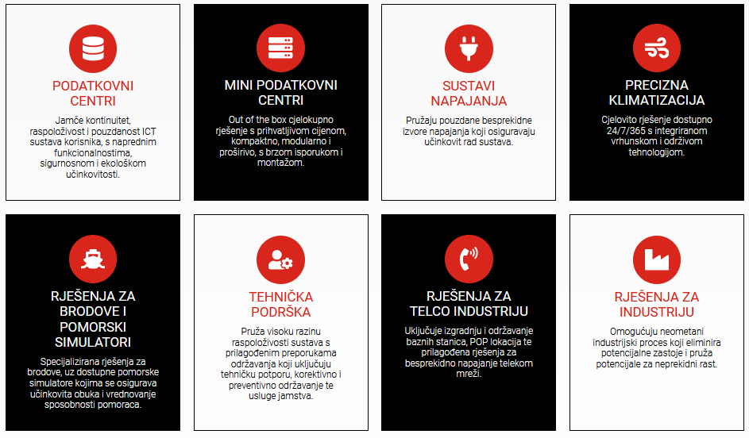
MEP d.o.o.
Pružamo tehnološki napredna rješenja i proizvode, te posjedujemo dugogodišnje iskustvo u projektiranju, implementaciji i održavanju energetskih i rashladnih sustava, te specijaliziranih rješenja za industrije, pomorstvo i telekomunikacije. Suradnjom s renomiranim svjetskim proizvođačima stvaramo preduvjete za inovativnost koja omogućuje rast i povećanje konkurentskih prednosti.

Slide 5
About Schneider Electric
Our purpose is to empower all to
make the most of our energy and resources,
bridging progress and sustainability for all.
At Schneider, we call this Life Is On.
Our mission is to be your digital partner for
Sustainability and Efficiency.

Slide 6

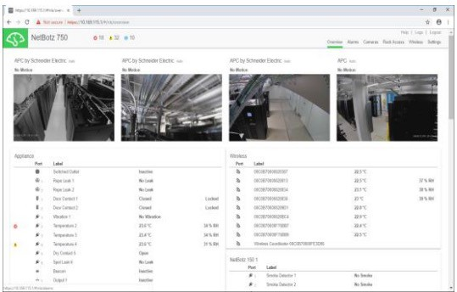
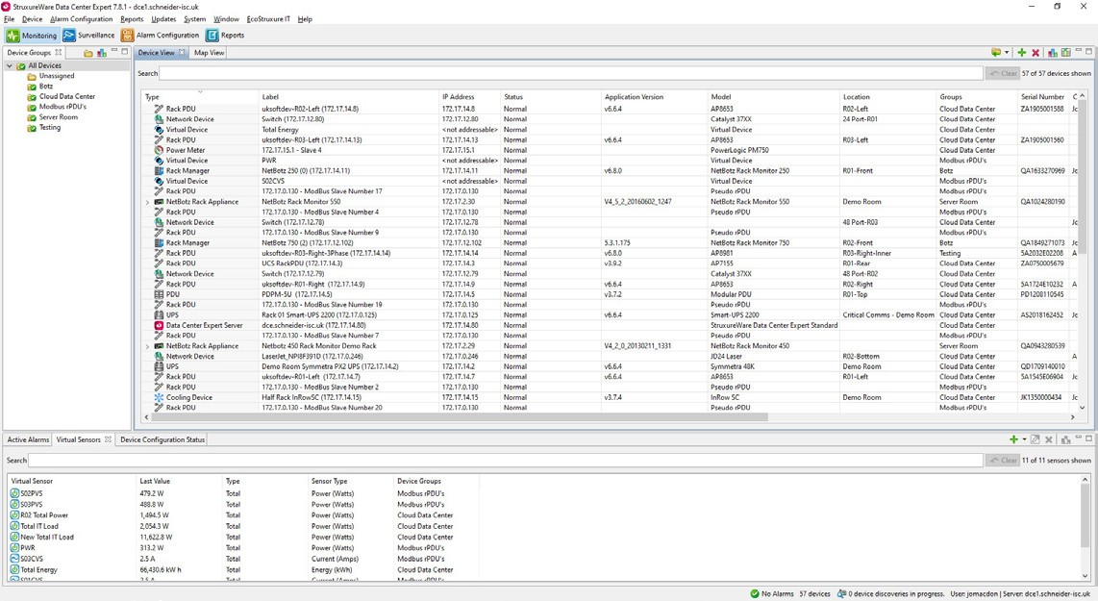
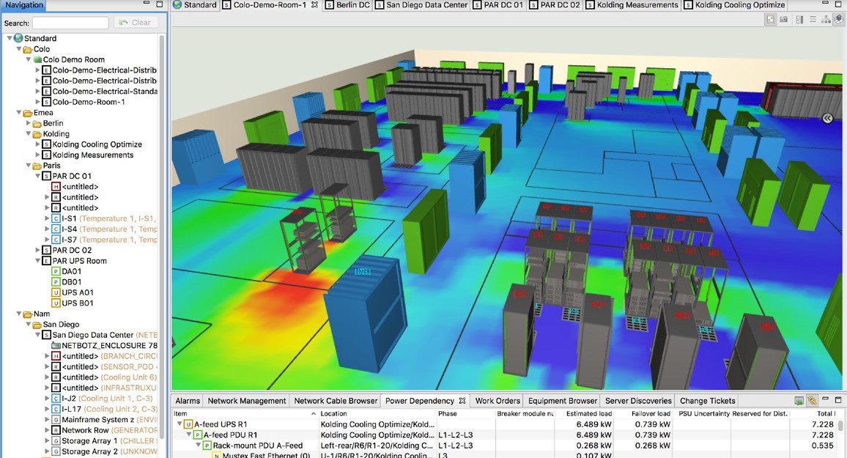
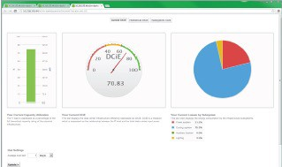
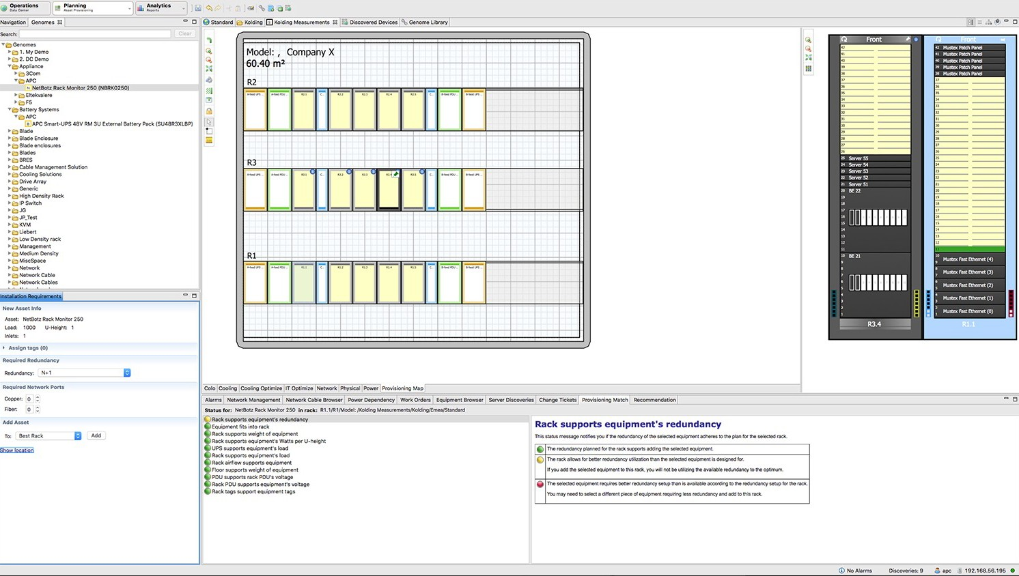

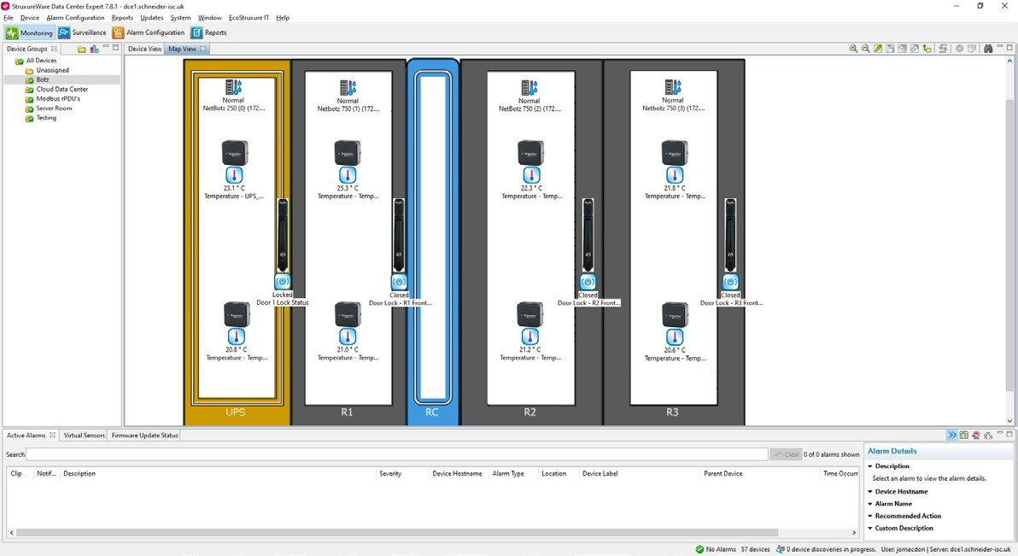

DCIM:
Data Center Infrastructure Management (DCIM) tools to:
Monitor
Measure
Manage
Control
Plan
Model
Defined
Notes:
DCIM
What is it?
Data center infrastructure management (DCIM)
tools to:
monitor
measure
manage
control
plan
model
What is it not – soley PUE – it often is misconstrued as only PUE, you can get PUE from it, but that isn’t the sole focus, its much more broad than that.

Slide 7
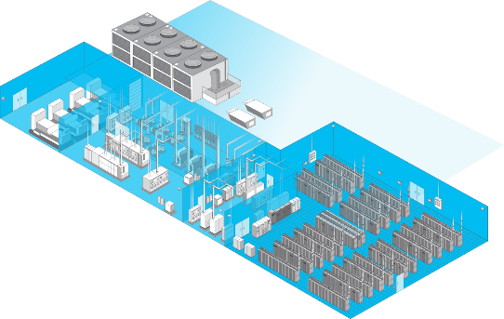
DCIM:
All IT whitespace:
Building:
Core
Cloud
Edge
Chillers
Air economizers
Pump packages & CRAH
Variable speed drives
Heat rejection
Fire & security systems
Here is what it includes
Power:
IT Physical Infrastructure Components:
UPS
Switchboards
Switchgear (MV, LV)
Busway
Power Meters & Sensors
Breakers
Transformers
Power
Cooling
AND, in some cases:
Servers
Storage
Network
Notes:
What does DCIM include?
All IT whitespace from core, to cloud, to edge:
IT Physical infrastructure components:
Power
Cooling
Data center facilities can include the use of a Building Management System (BMS), and Power Monitoring System (EPMS), also referred to as grey space in the data center. Data Center Infrastructure Management (DCIM) is unique in that it supports the IT physical infrastructure, also referred to as the IT white space in the data center.

Slide 8
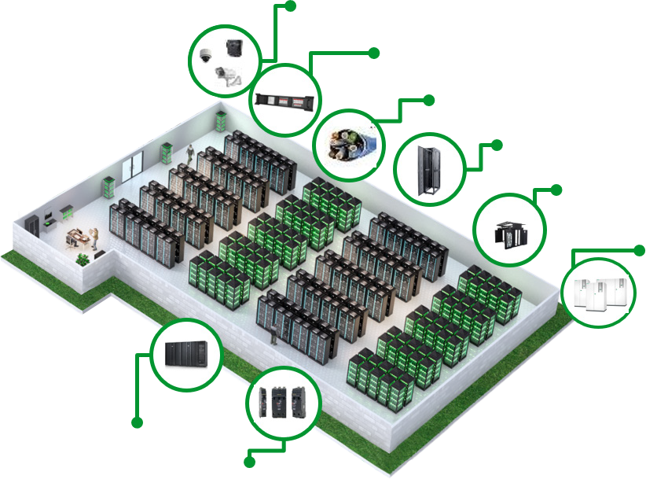
DCIM:
Included in IT physical infrastructure:
Access Control, Environmental monitoring
Busway
Network connectivity & Cable managment
Floors, Rack systems
Flexible Air Containment/PODs
Room/Row/Rack precision cooling
Here is what it is managing in the IT whitespace
Modular PDU
Row Modular UPSs
Notes:
DCIM – here is what it is managing in the IT white space:
Main power and cooling:
AND
Racks with:
-PDUS
-Network connectivity
-Access control, environmental monitoring
This is everything included in the IT physical infrastructure, and this could be in a 2MW centralized datacenter or could be multiple edge sites, such as a retailer with thousands of stores with 10kW in a rack, that’s 10 or 20 MW spread out over remote sites.
Now let’s look at how DCIM has evolved.

Slide 9

3 waves of evolution…
1
2
3
The growth of the
client / server IT model
Bursting of the dot-com bubble & centralizing IT into data centers for better control
The Pandemic and
hybrid work accelerated
sprawling data centers
1980s
2000s
2020s
Drove need for small UPSs
Subsequent software to manage them
Redefined the data center
Software for IT space planning, PUE, power & cooling challenges
Awareness of the need for “infrastructure everywhere”
DCIM 1.0
DCIM 2.0
DCIM 3.0

Slide 10
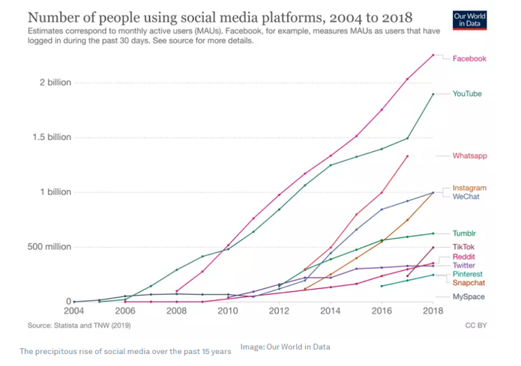
We continue to see significant growth of connected users globally, putting more pressure on data centers
Source: World Economic Forum, Nov 2020

Slide 11
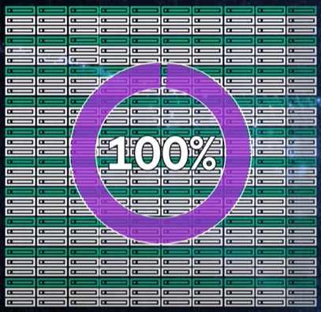
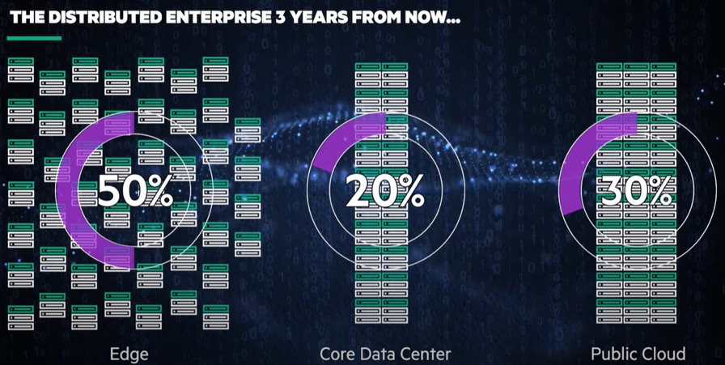
The IT data center environment is increasingly complex
In 2000…
The core-driven enterprise
By 2025…
The distributed enterprise
100%
20%
30%
50%
Source: HPE, March 2022

Slide 12
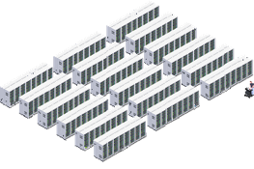
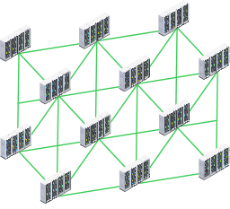
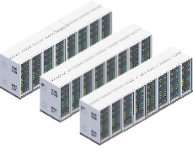
No clear boundaries to the data center
The traditional four walls and a ceiling no longer contain the datacenter. The logical datacenter construct now extends to cloud providers, colocation facilities, edge devices, and edge computing. Today’s datacenter exists without clear boundaries, creating growing complexity. The new hybrid computing environment is now much harder to operate as performance, reliability, compliance, and security are all more difficult to manage.
Centralized Data Center
Colo
Edge
Source: CIO.com, Don’t be left behind. Dramatic change is impacting datacenters and people.

Slide 13



The DCIM 3.0 Challenge: Make the hybrid environment resilient, secure, sustainable
Resilient
Secure
Sustainable

Slide 14
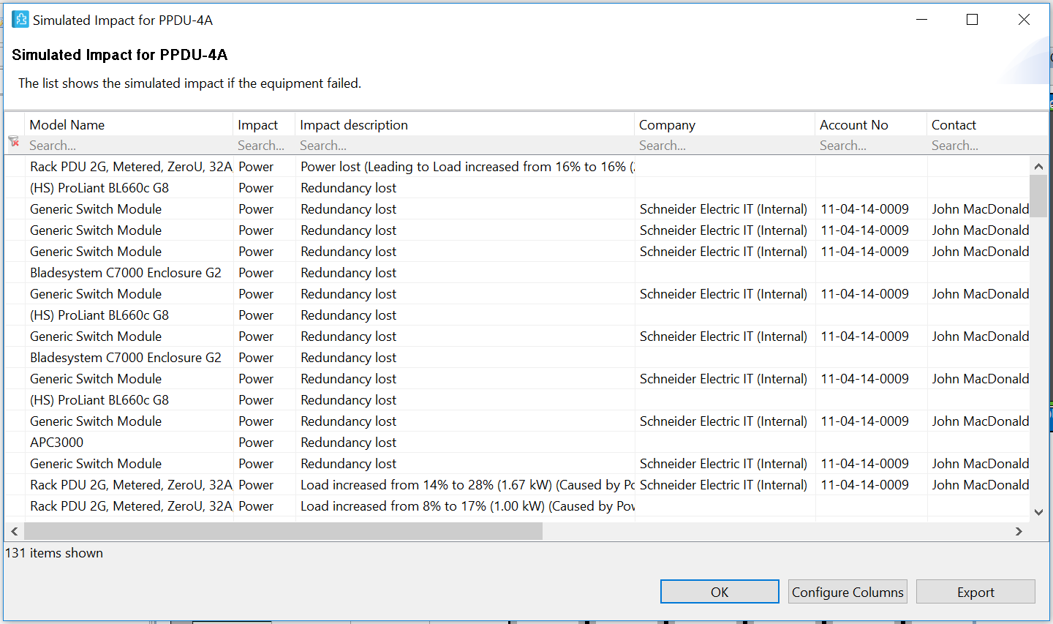
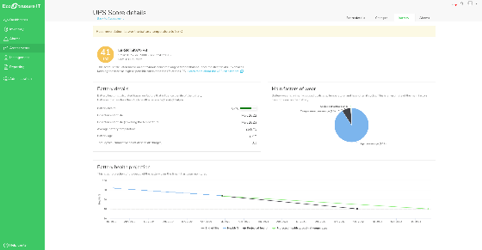
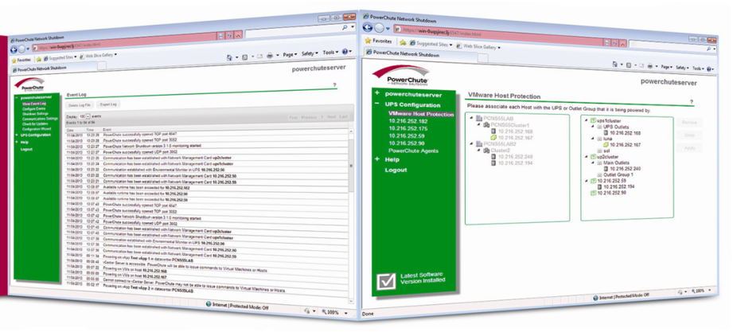
DCIM 3.0 enhances resiliency
Reduce vulnerability to unplanned downtime
Perform device monitoring and
health assessments
Run simulated impacts to expose vulnerabilities and address them
IT-integrated alarms to manage and proactively protect server and hyperconverged infrastructures

Slide 15
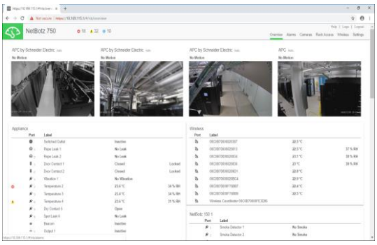










DCIM 3.0 provides visibility across your entire attack surface
Continuous monitoring ensures a secure on- and off-line environment
Monitoring environmental conditions to reduce physical threats
Lock down racks with access control using permission-based entry and tracking with audit trail to protect IT assets
Enable surveillance and recording with ability to retain recordings for compliance of critical infrastructure

Slide 16
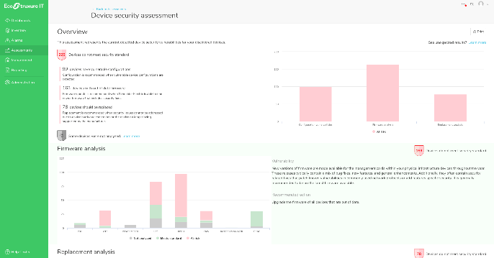

DCIM 3.0 reduces cybersecurity threats
Maintaining device security policies contributes to a cybersecure environment
Conduct cybersecurity assessments of physical infrastructure
>60% of physical infrastructure devices are running out of date firmware
Perform mass device firmware updates to keep from running outdated firmware that can create security risks

Slide 17



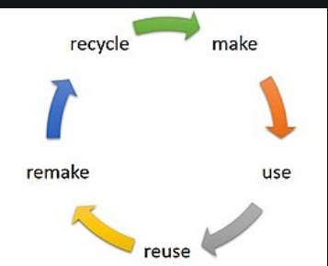
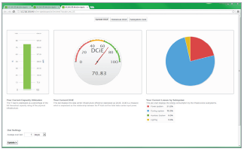
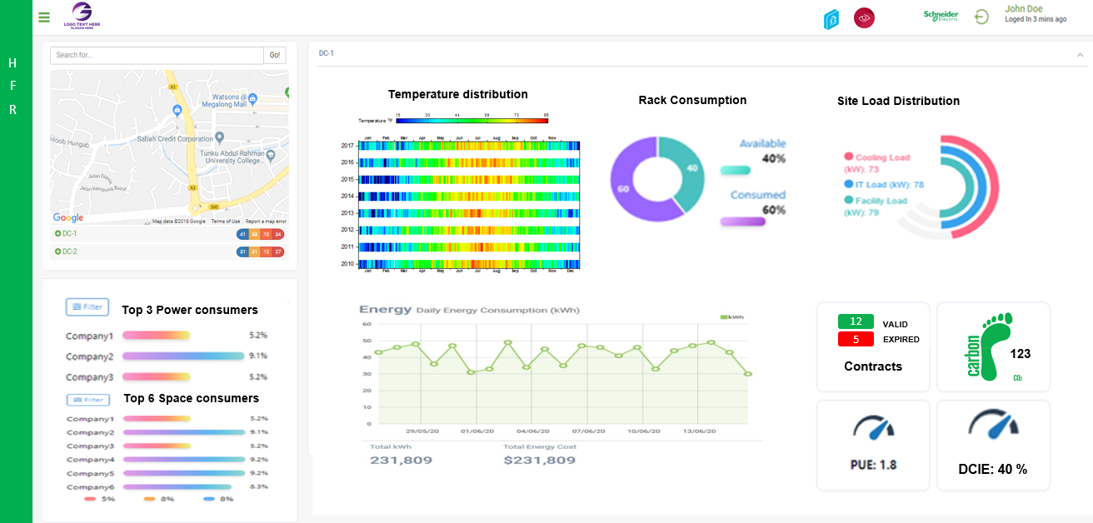
DCIM 3.0 supports sustainability goals
Dashboards & Reports for improved transparency
Better Visibility
UN SDGs
Track PUE, energy & carbon
Measure energy efficiency down to sub-system level
We deliver both standard and customized reports and
dashboards
Carbon Neutrality
Circular Economy

Slide 18
DCIM 3.0 to meet the distributed IT challenge
DCIM of tomorrow needs the following 5 capabilities
AI / ML – Driven
Integrated analytics for improved control and automation of hybrid IT physical infrastructure management
Unified Experience
Single DCIM platform for ease of use across monitoring, management, planning and modeling
Modular Implementation
Capabilities delivered via flexible modules to provide the right level of DCIM for distributed IT data centers
Hybrid IT Innovation
Adaptable software for distributed IT data centers, deployed in on-prem, private cloud or public cloud environments
Environmental Sustainability
Consolidated dashboard with
recommendations and control to improve energy efficiency and decarbonization

Slide 19
How do we achieve DCIM 3.0?
Our approach – A Comprehensive DCIM Portfolio

Slide 20



To reach DCIM 3.0 you need these 3 elements
Monitoring & Management
Planning &
Modeling
Custom Solutions & Integrations

Slide 21
EcoStruxure IT positioned to addresses the challenges of DCIM 3.0 to enable resilient, secure and sustainable IT data centers
EcoStruxure IT
Resilient
Monitoring & Management
Planning & Modeling
Custom Solutions & Integrations
Secure
Schneider Electric’s comprehensive DCIM solution, EcoStruxure IT, ensures business continuity by enabling secure monitoring, management, insights, planning, and modeling whether from a single IT rack to hyper- scale IT, on premises, in the cloud, and at the edge.
Sustainable

Slide 22

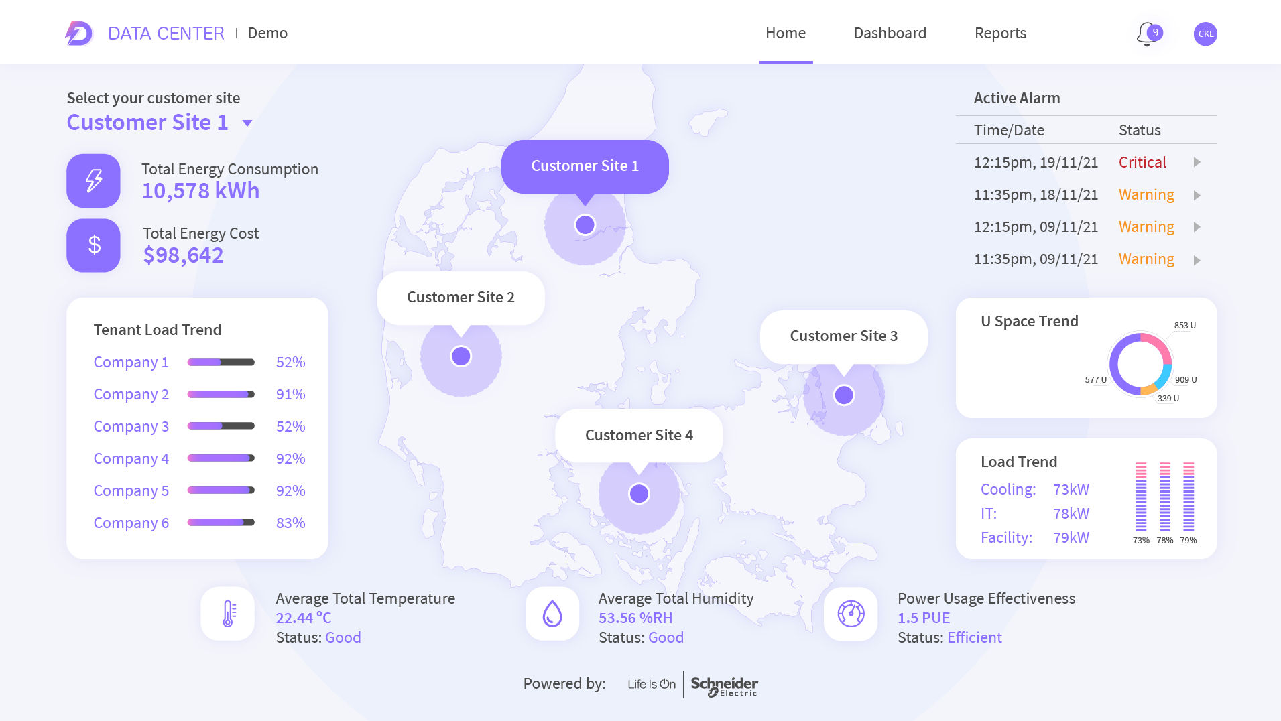
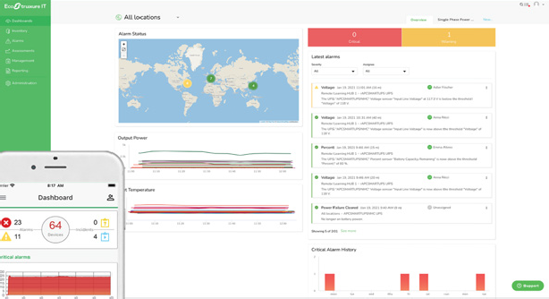
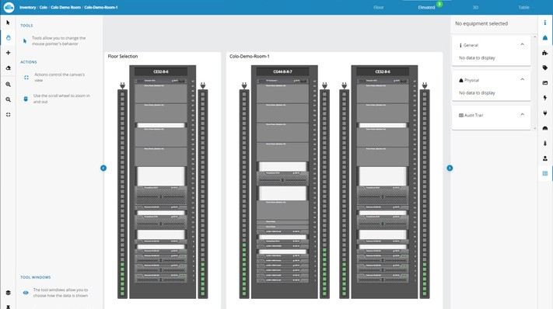
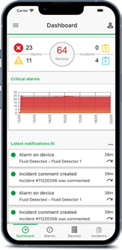
EcoStruxure IT suite of comprehensive capabilities
Covering the market shift to hybrid IT data centers to solve customer challenges
Monitoring & Management
Planning & Modeling
Custom Solutions & Integrations
EcoStruxure IT
On-premises and cloud-based solutions
On-premises and cloud-based solutions
Environment
& Security
Automated
Reports
Custom
Dashboards
3rd Party
Integrations
Customized
Software
Power
Cooling
VM
Protection
Visualization
Tenant Portal
Tracking
Simulation

Slide 23
DCIM Components
Here is what makes up EcoStruxure IT DCIM 3.0

Slide 24

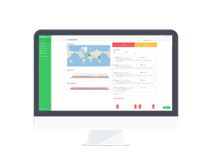

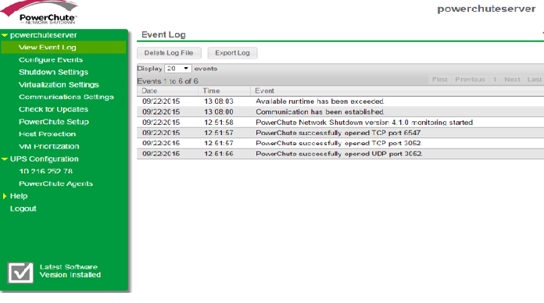

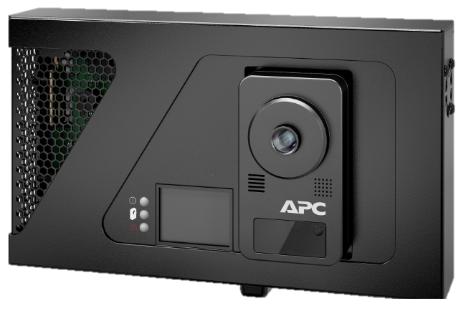


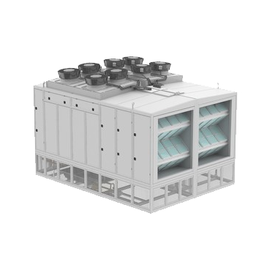



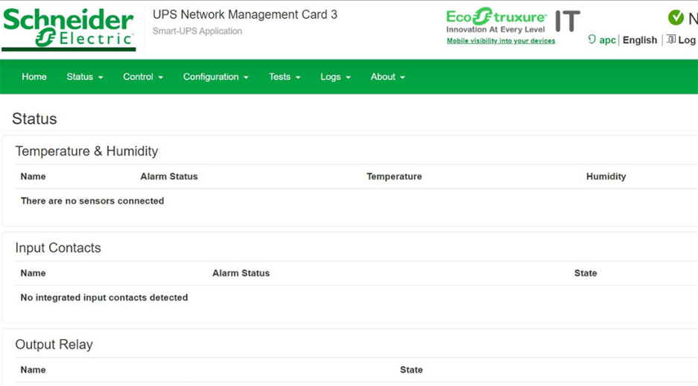
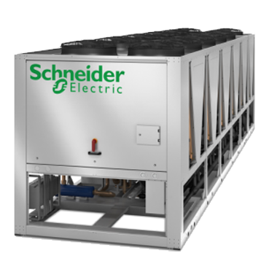


EcoStruxure IT Ecosystem
DCIM solution overview
EcoStruxure IT
IT White Space DCIM
Management for Single or Multi-Site Operation
Run efficient local IT operations and remotely monitor
and manage distributed IT with smart applications
Apps, analytics,
services
EcoStruxure IT
ACS Engine
Combines data sources from DCE & ITA to create automated energy and environmental customer reporting
IT Expert
NetBotz
Security/
Environmental
Data Center
Expert
IT Advisor
PowerChute Network Shutdown
Connected Products
Smart devices & equipment
for power & cooling
PDUs
InRow
cooling
UPS, Racks, Power, Cooling,
physical / environmental
NetBotz
Security/
Environmental
Appliances
Chillers
Air Economizers
UPS
NMCs
Smart-UPS
Cooling Systems
IT Power and Cooling

Slide 25
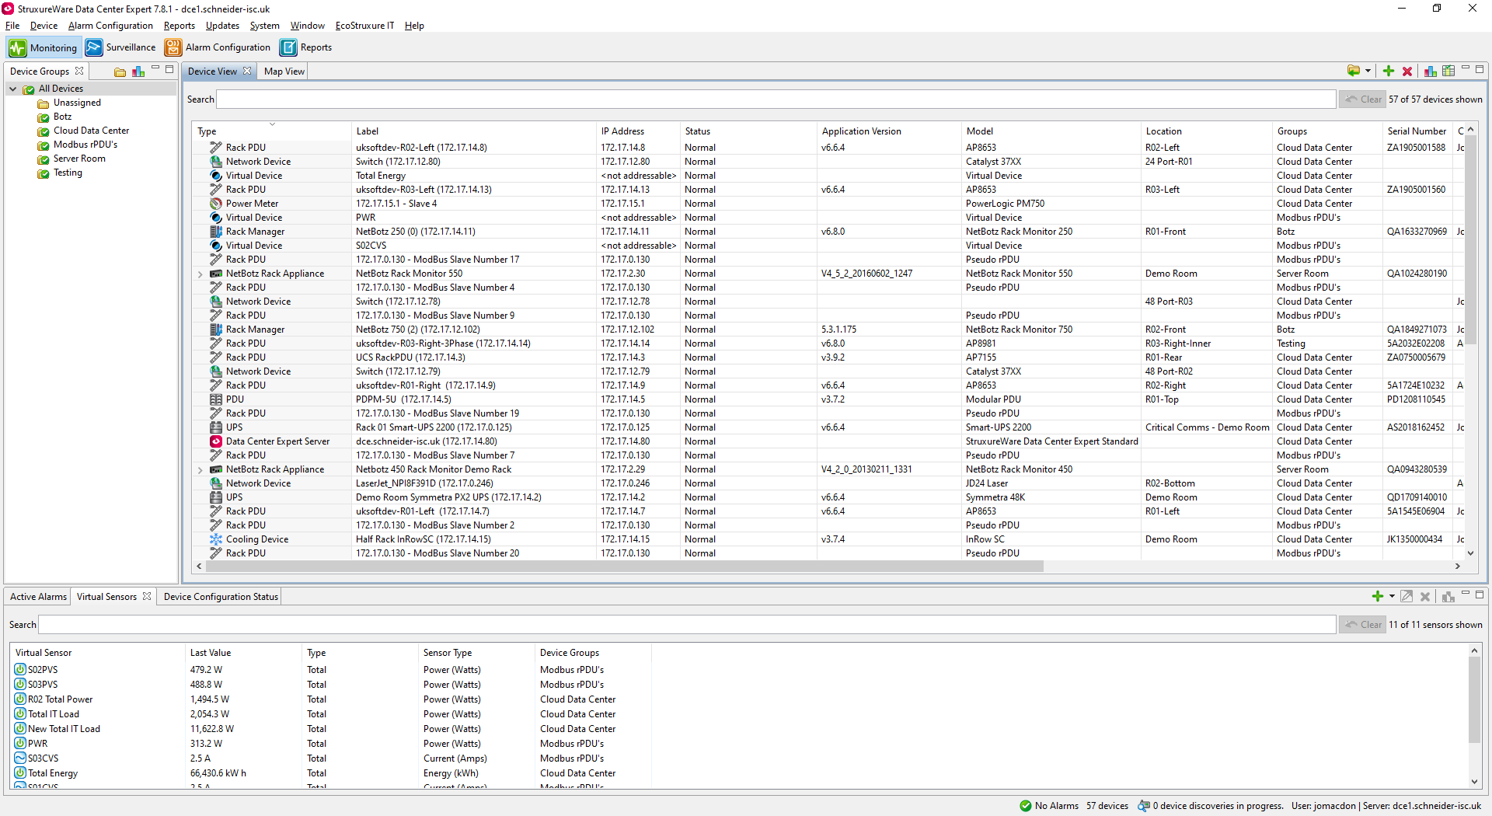
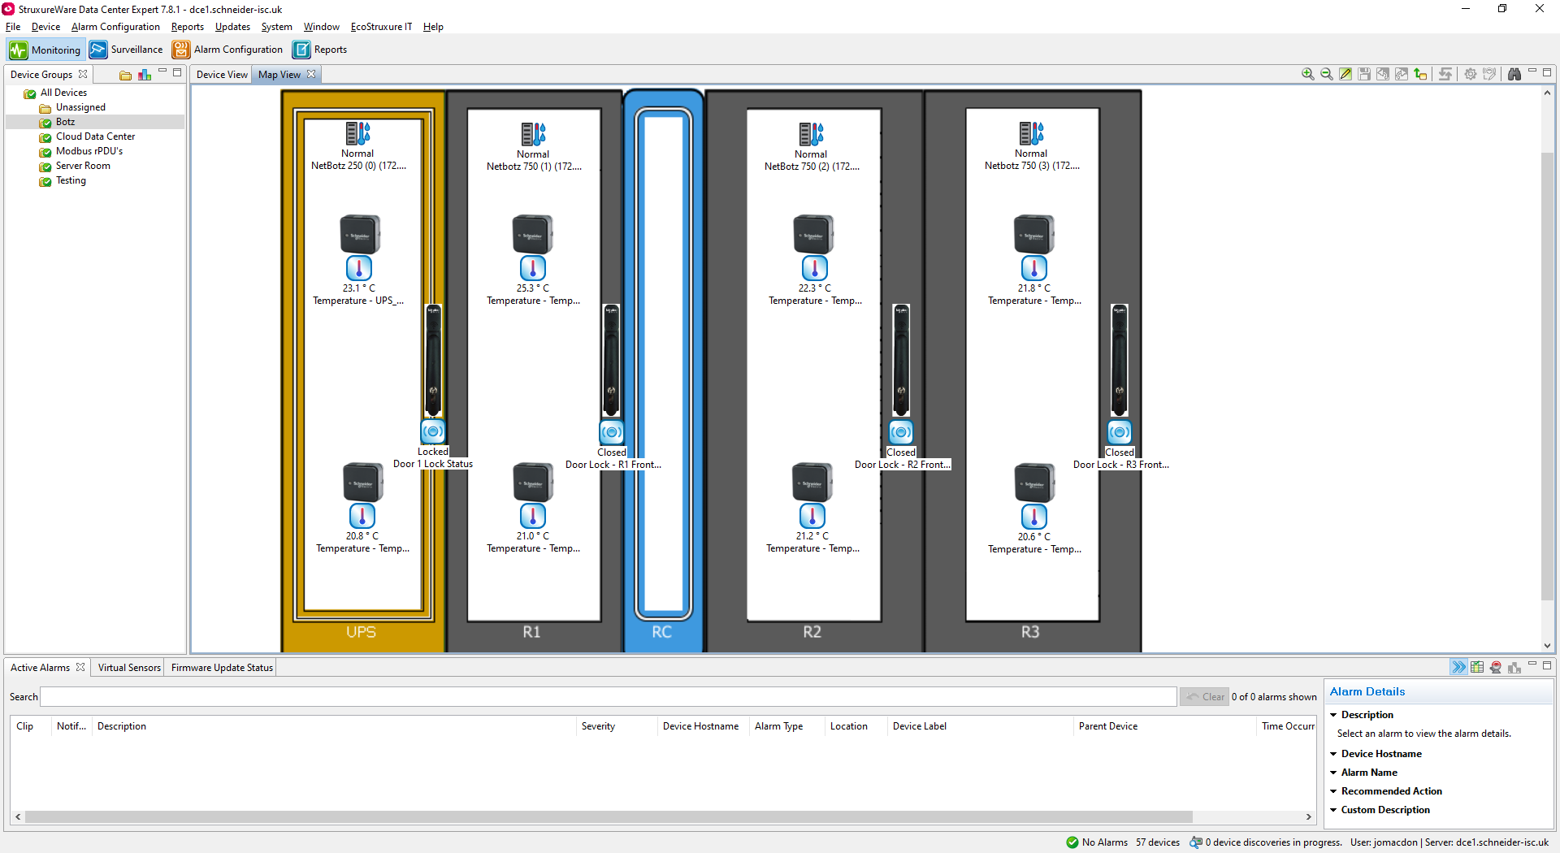
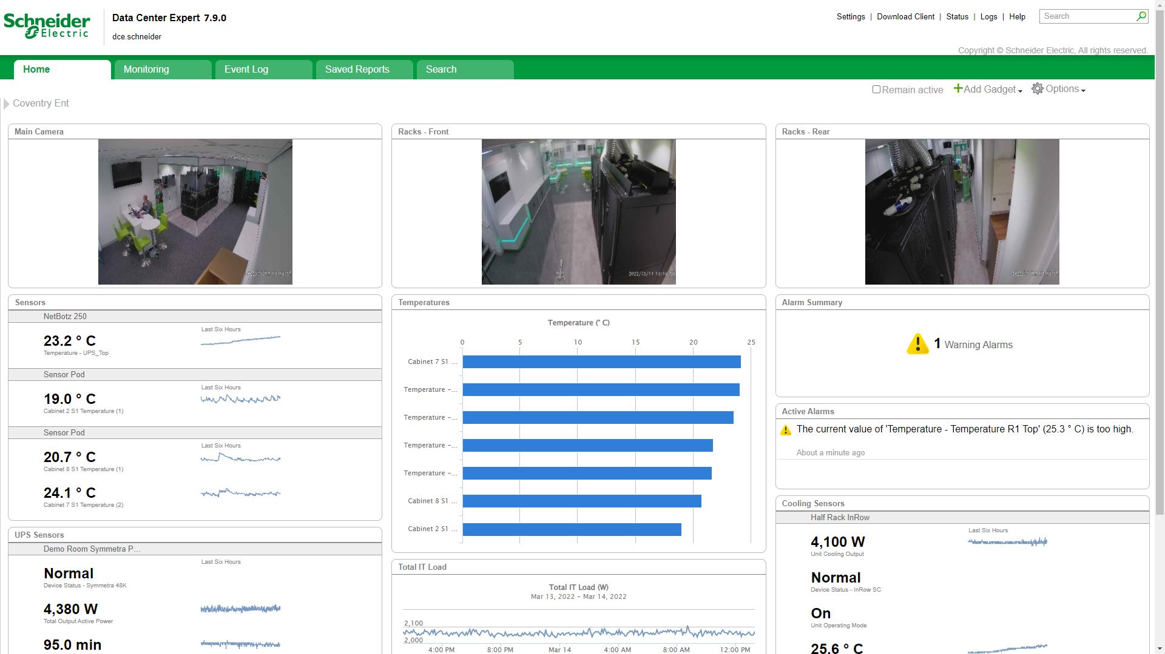





Monitoring &
Management
EcoStruxure Data Center Expert
Real-time Monitoring and Centralized Management
“
On premises, enterprise data center software, provides an efficient way for organizations to monitor and manage their company-wide multi-vendor physical infrastructure: power, cooling, security, and environment.”
Monitoring
and alarming
Device mass configuration
Integrated data storage
NetBotz physical monitoring
Private network

Slide 26
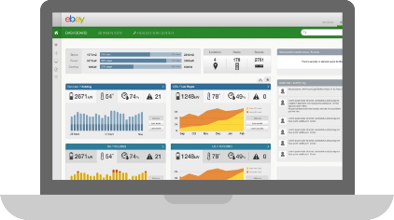
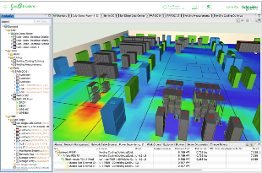
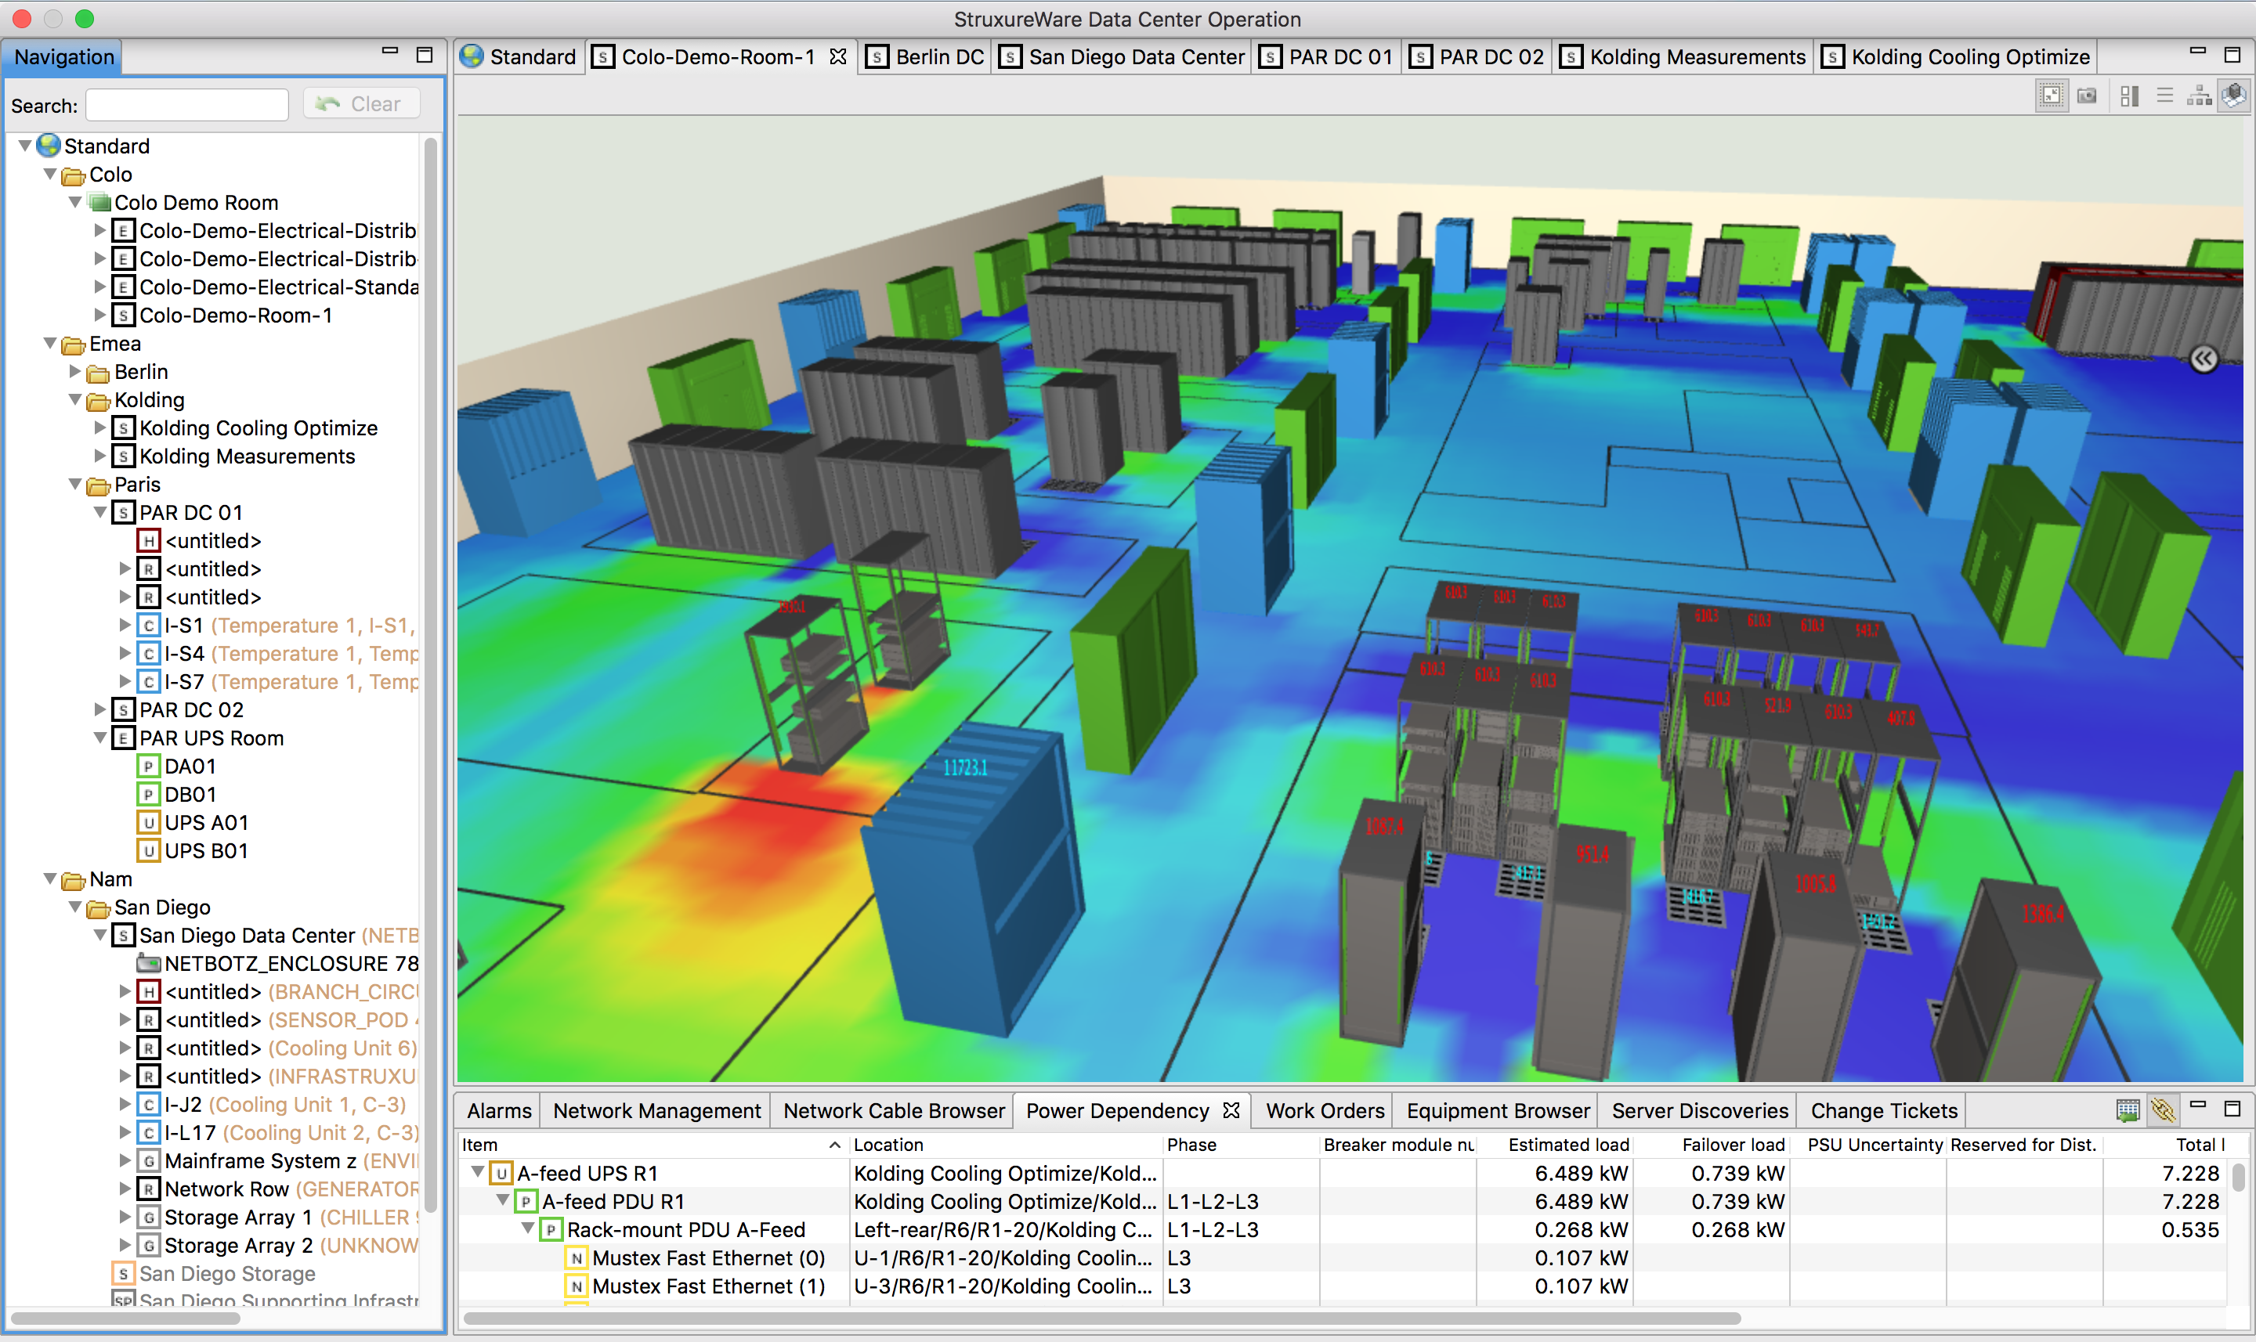
Planning &
Modeling
EcoStruxure IT Advisor
Data center infrastructure planning and modeling solution
“
… IT is complicated, let’s simplify it. Let’s make the most of every square meter and kW with better planning and more visibility. Daily data center infrastructure management made simpler and more efficient with full insights into your data center or colocation infrastructure-from big picture to individual devices. Achieve operational excellence through proper asset tracking, risk management, and capacity optimization”
Information
Profitability
Efficiency
Availability

Slide 27
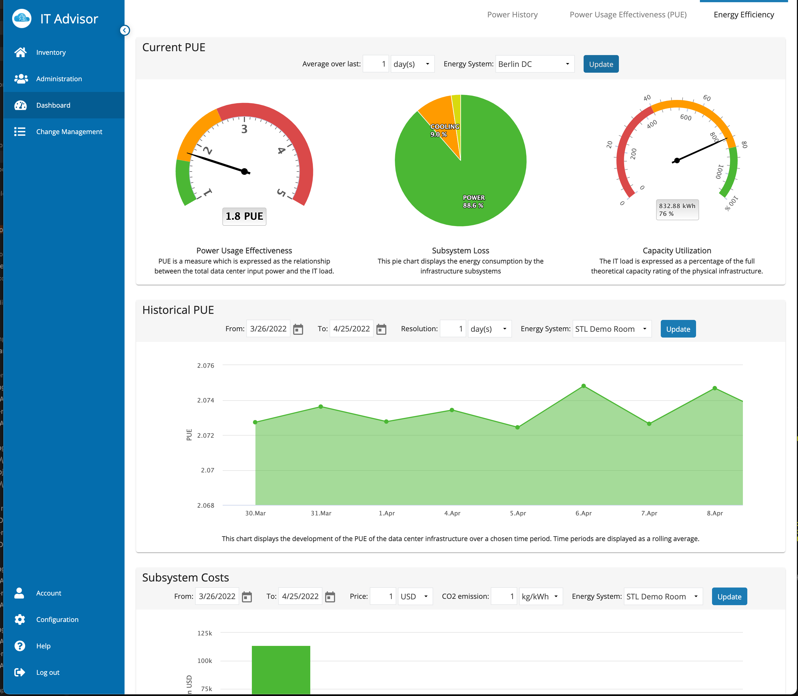
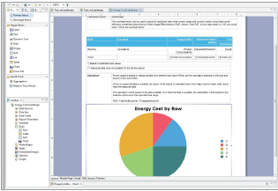




Planning &
Modeling
EcoStruxure IT Advisor
Energy Efficiency
“
… Full insight into current and historical energy efficiency for facilities, identifying efficiency losses and enabling improved Power Usage Effectiveness (PUE) values at subsystem level”
Insight into
energy usage
How to
improve
energy
usage
Web-based
dashboards
for efficiency data and cost analysis
IT Advisor and integration with DCE and other 3rd party systems

Slide 28
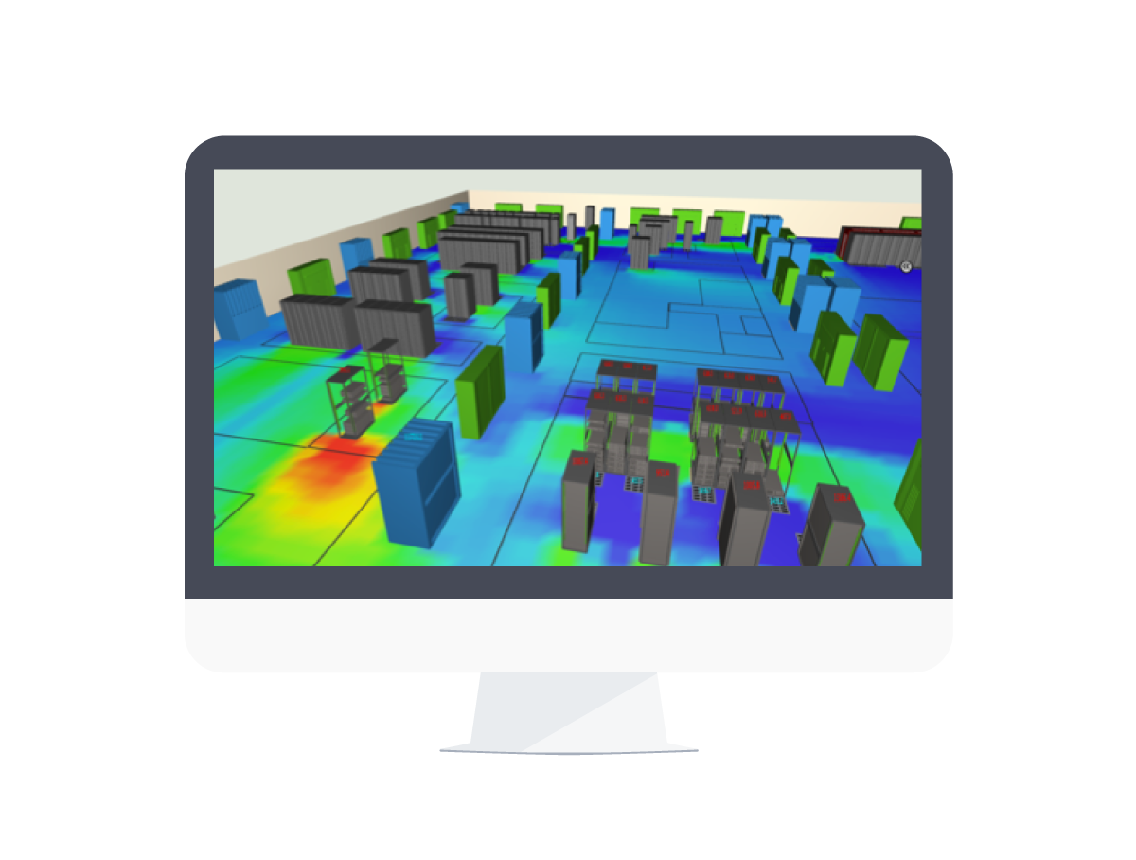
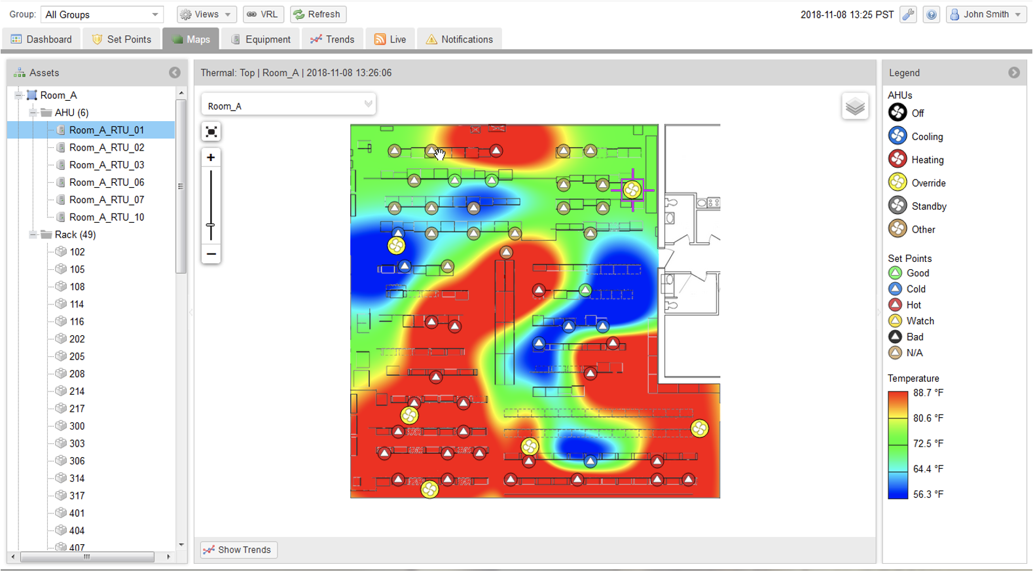
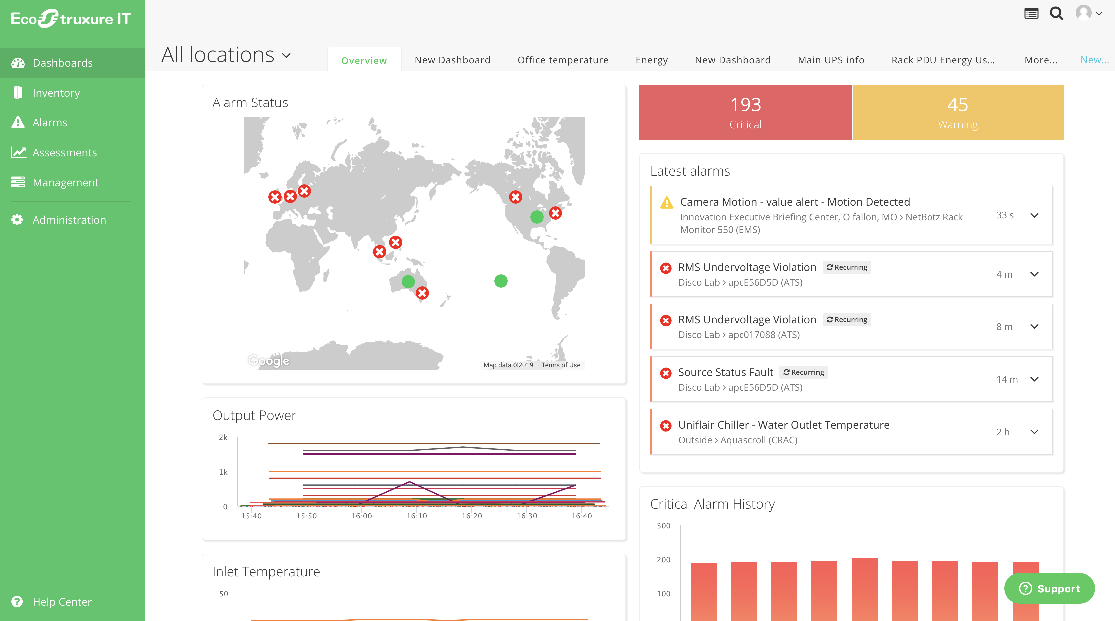


Planning &
Modeling
EcoStruxure IT Advisor
Cooling & Optimize
“
… The challenge is to keep mission-critical devices in a data center optimally cooled while at the same time trying to be more sustainable and save energy cost. Make your data center more sustainable by dynamically reducing your cooling consumption”
Improved
availability
Operational
efficiency
Energy
consumption
& cost savings
Improving PUE & reducing carbon footprint

Slide 29

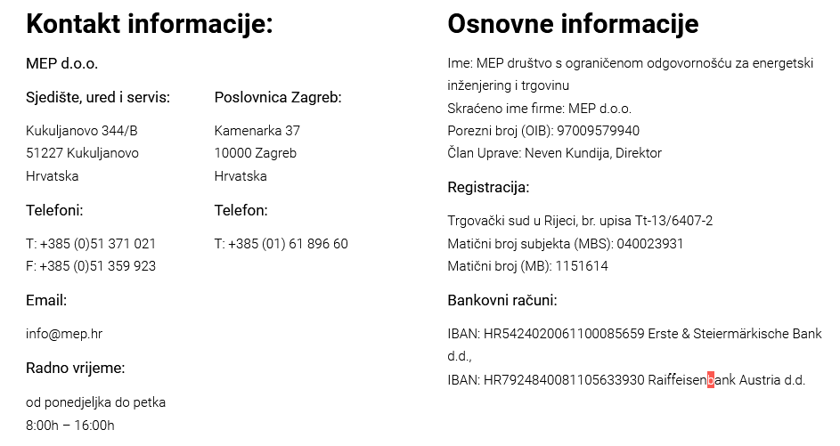
www.mep.hr / info@mep.hr

Slide 30
Vrijeme za Vaša pitanja
Hvala na pažnji!

