Slide 1
State of Play in Croatia - news from the Ministry
Croatia National Tripartite Event 2025
Zagreb
March 27th 2025
THE MINISTRY OF SCIENCE, EDUCATION AND YOUTH
Hrvoje Meštrić, Ph.D.
Director General for Science and Technology

Slide 2
Content
General overview
European Context
National Context
OECD

Slide 3
Croatia’s open science overview
Croatia has a long history of supporting open science.
We are part of international bodies and research infrastructures that support open science.
OECD has also confirmed our dedication to open science.
We are in line withe ERA priorities in open science.
We used Programme Based Agreements to encourage Public Research Institutes and Higher Education Institutions to start implementing open science.
National Plan for Open Science will be adopted by April.
National Council for Higher Education, Science and Technological Development is developing new criteria that will take into account use of open science.

Slide 4
The Organization for Economic Cooperation and Development (OECD)
Croatia successfully completed accession process at the Committee for Scientific and Technological Policy (CSTP)
It was concluded that Croatia complies with OECD recommendations in the field of scientific and technological policies.
Croatia is in line with long-term recommendations on open science, international cooperation and policies on digital and green transitions.
Croatia's efforts to strengthen science and technology policies and keep pace with European and global good practices were recognized
National Recovery and Resilience Plan
4

Slide 5
European Context
European Research Area Policy Agenda
Proposal for a Council Recommendation on the European Research Policy Agenda 2025-2027 is currently being discussed.
ERA Policy Agenda 2025-2027 outlines:
8 ERA actions that are concise, policy-driven and goal-oriented
11 structural policies that are long-term ERA policies
These are the result of an extensive co-creation process within the ERA Forum and ERAC and the aim is to start implementation in 2025
National Recovery and Resilience Plan
5

Slide 6
European Context
European Research Area Policy Agenda
1 Priority Area: Deepening a truly functioning internal market for knowledge
Identified as a structural policy:
Enabling open science via sharing and re-use of data, including through the European Open Science Cloud (EOSC)
Expected outcomes are:
Develop a high-value EOSC federation and increase its uptake.
Increase the amount and productivity of FAIR research data in Europe.
Identify areas for legislative and non-legislative measures to ensure an EU copyright and data legislative and regulatory framework fit for research.
Assess the impact of open science policies and practices based on an open science policy intelligence platform.
National Recovery and Resilience Plan
6

Slide 7
European Context
European Research Area Policy Agenda
1 Priority Area: Deepening a truly functioning internal market for knowledge
Identified as an ERA Action:
Equity in Open Science
Expected outcomes are:
Stocktaking of equity challenges in open science across ERA countries .
Policy and funding support to operate high-quality not-for-profit open access scholarly publishing services across the ERA.
Development and dissemination of shared tools, training methods and services to boost capacity in terms of open science skills; in collaboration with stakeholders.
Recommendations for developing an EU policy approach to equity in open science in its different practices.
National Recovery and Resilience Plan
7

Slide 8
European Context
Project in HE supporting open science
In Horizon Europe Croatian beneficiaries participated in 27 projects that in some way contribute to open science.
Total cost: € 635.3 M Max contribution: € 346.6 M
In Horizon2020 Croatian beneficiaries participated in 35 projects that in some way contributed to open science.
Total cost: € 575 M Max contribution: € 427.8 M
8

Slide 9
Research Infrastructures
European Context
Croatia participates in 9 ERICs
EPOS (The European Plate Observing System)
EATRIS (European Infrastructure for Translational Medicine)
CERIC (Central European Research Infrastructure Consortium)
CLARIN (Common Language Resources and Technology Infrastructure (for humanities and social sciences)
SHARE (Survey of Health, Ageing and Retirement in Europe)
DARIAH (Digital Research Infrastructure for the Arts and Humanities)
ESS (European Social Survey)
CESSDA (Consortium of European Social Science)
EHRI (European Holocaust Research Infrastructure)

Slide 10
Research Infrastructures
European Context
ERICs play a key role in promoting open science by providing open access to research data, tools, and services, ensuring transparency, reproducibility, and accessibility of scientific knowledge.
CESSDA, CLARIN, DARIAH and CERIC ERIC participate in OSCARS (Open Science Clusters' Action for Research and Society) project that brings together RIs to advance open science by enhancing data sharing, accessibility and collaboration across disciplines.

Slide 11
National Context
Programme funding agreements
Determine the total multi-annual financing of public research institutes and public higher education institutions from state budget funds.
Currently negotiations with Universities are being prepared in order to sign the agreements.
Universities will be able to independently select ten or more specific goals and corresponding activities to achieve those goals over a four-year period.
Under the strategic objective 1, Enhancing Scientific Excellence, there is a specific objective “Contribution to open science” and more than half institutes chose that objective.
11

Slide 12
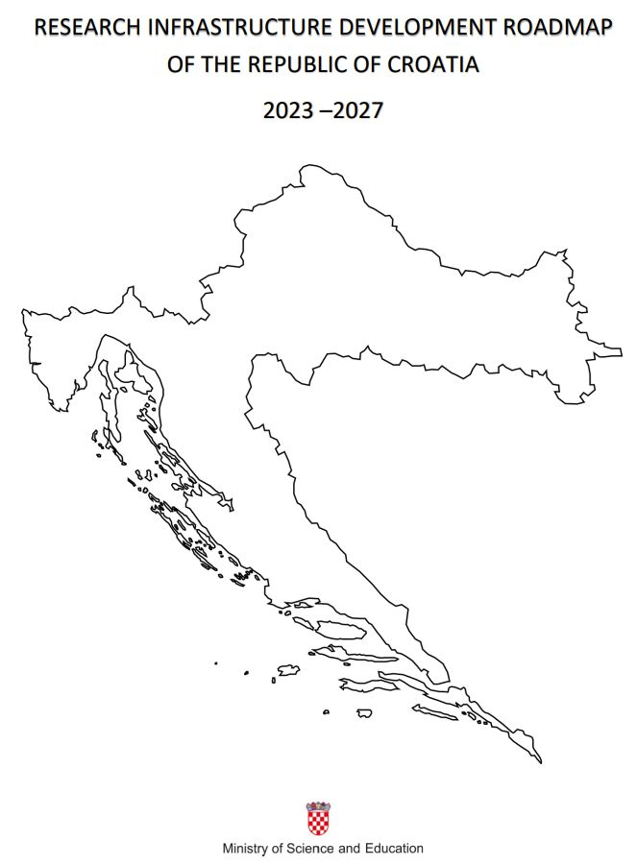
National Infrastructure Development Roadmap of the Republic of Croatia 2023 - 2027
National Context
This year we plan to update our National RI Roadmap.
If necessary adapt some of the priorities and principles.
Add new infrastructure that we became a part of.
It will continue to support open science as one of the horizontal principles as well as promote the use of FAIR principles for research data and promoting the implementation of ORDM

Slide 13
National Context
National Plan for Open Science
Will be adopted by April.
Based on the work done by Croatian Open Science Cloud Initiative (HR-OOZ).
Will give overview of national efforts since 1997.
Will give recommendations on activities and open science principles.
With vision that science, research and higher education will rely on the principles, values, and practices of open science, thereby effectively contributing to faster progress, sustainable development, and the international relevance of the Republic of Croatia

Slide 14
National Context
Yearly Conference
This year we in cooperation with the Agency for Mobility and EU Programmes we are planning a Yearly Conference that will focus on the topic of open science.
Planned for the beginning of May.
Follow national portal for Horizon Europe https://www.obzoreuropa.hr/ to be notified on time.
We would love if you could join!

Slide 15
Thank you!

