Slide 1
Otvorena znanost i EOSC: Od principa do prakse
Digitalisation of European Research: Building the EOSC Federation
Stefan Liebler European Commission, DG Research & Innovation Unit A4 Open Science & Research Infrastructures

Slide 2
Open Science in the ERA Policy Agenda 2022-2024
Priority Area: Deepening a truly functioning internal market for knowledge
Developing the enablers
Incentives and rewards to adopt open science practices
Action 3 – Advance towards the reform the assessment system for research, researchers and institutions to improve their quality, performance and impact
Legislative and regulatory environment for practicing open science
Action 2 – Propose an EU Copyright and data legislative and regulatory framework fit for research
Open research infrastructures and skills
Action 1 – Enable the Open Sharing of Knowledge and the re-use of research outputs, including through the Development of the European Open Science Cloud (EOSC) Action 8 – Strengthen sustainability, accessibility and resilience of research infrastructures in the ERA

Slide 3
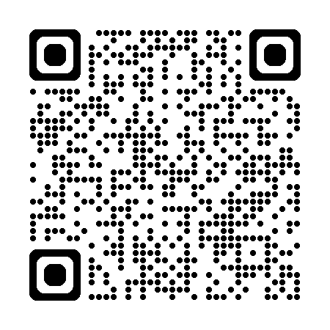
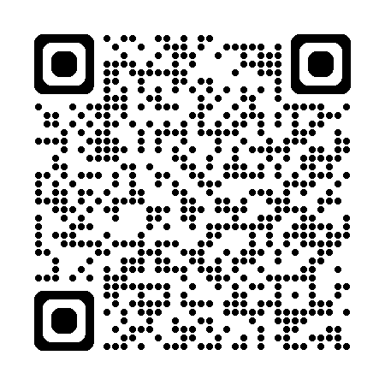
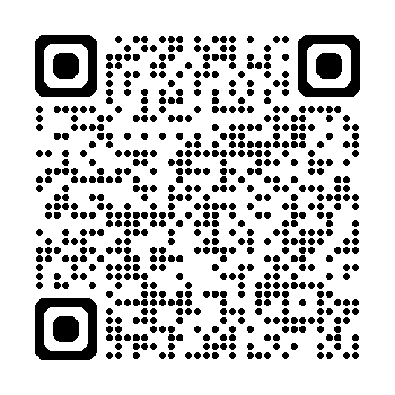
ERA Policy Agenda 2022-2024 - Action 1 European Open Science Cloud (EOSC)
Action 1
Outcomes
Enable the open sharing of knowledge and the re-use of research outputs, including through the development of the EOSC
Deploy Open Science Principles and identify Open Science best practices
e.g. Brochure of use cases on EOSC and Open Science
Deploy the core components and services
of EOSC and federate existing data
infrastructures in Europe
EOSC EU Node
and building the EOSC Federation (web of distributed EOSC Nodes)
Establish a monitoring mechanism to collect data and benchmark investments, policies, digital research outputs, open science skills and infrastructure capacities
Relaunching the EOSC Open Science Observatory
​

Slide 4
ERA structural policy #1: Enabling Open Science via sharing and re-use of data, including through the EOSC
ERA policy agenda 2025-2027: Council recommendation Feb. 2025
Objectives
Open science practices and skills are rewarded and taught, becoming the ‘new normal’
standards, tools and services allow researchers to find, access, reuse and combine results
a federated community-driven infrastructure enabling open sharing of scientific results is deployed and maintained
Europe is in the driving seat towards a web of FAIR research data with established links to other data spaces
Researchers are provided with better legal conditions and resources to access and reuse publicly funded research results and use publications and data for scientific purposes.
Expected outcomes
Develop a high-value EOSC Federation and increase its uptake
Increase the amount and productivity of FAIR research data in Europe
Identify areas for legislative and non-legislative measures to ensure an EU copyright and data legislative and regulatory framework fit for research
Assess the impact of open science policies and practices based on an open science policy intelligence platform

Slide 5
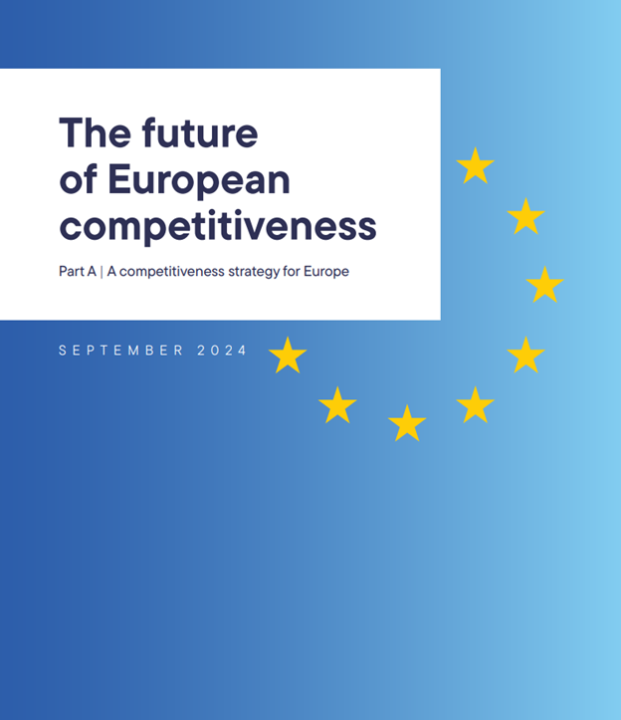
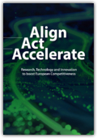
EOSC – keeping the policy momentum
EU Strategy for Data: EOSC is the basis for a science, research and innovation data space that will be connected and fully articulated with the sectoral data spaces.
“A central pillar of this strategy is the creation of a European Knowledge Commons – a centralised, digital platform providing access to publicly funded research, data sets, and educational resources. ...”
Letta
Much more than a Market
“An important factor that would enhance R&I capacity is the availability of world-leading research and technological infrastructure, capable of serving the whole European ecosystem”
“The EU’s efforts to hone its competitive edge need to be guided by European values, […] such as academic freedom and independence, research integrity and ethics, transparency, diversity, inclusion, gender equality, open science and open access to scientific publications and research data.”
Draghi
The future of European competitiveness
Heitor et al.
Align, Act, Accelerate.
Research, technology and innovation to boost European competitiveness
“The European Open Science Cloud (EOSC) is a key enabler of the digitalisation of research infrastructures while delivering the European Data Space for research data. It has potential to become the most generally used infrastructure in Europe”.

Slide 6
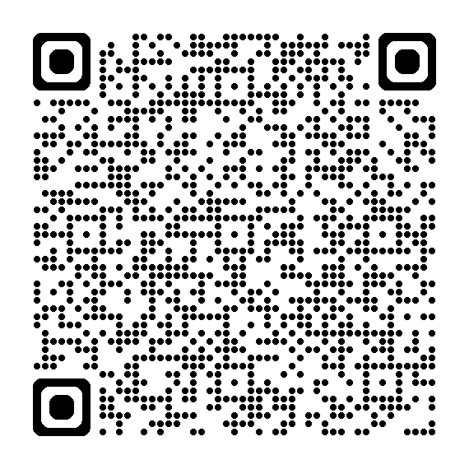
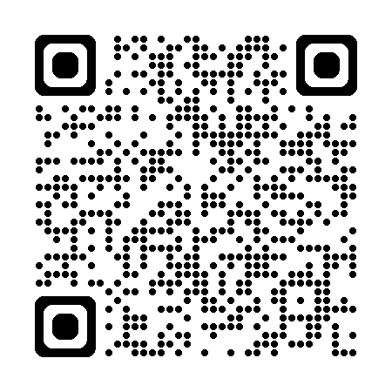
EOSC Steering Board and EOSC Tripartite, future strategies
EOSC SB: EOSC as a cornerstone of a “fifth freedom” in research and innovation
EOSC as a key pillar of a "fifth freedom" for research and innovation in the Single Market. The Board underlined EOSC's role in driving innovation, economic growth, and competitiveness across Europe, and provided its recommendations as regards the role of the EOSC in the future.
EOSC Tripartite: Why EOSC is pivotal to European competitiveness?
[…] As a transformative tool, EOSC fosters digital sovereignty, inclusivity, trust, and transparency in the research and innovation domain. It is designed not only to support the Open Science movement but also to underpin Europe’s broader competitiveness agenda […]
Specifically: Fostering European leadership in artificial intelligence
EOSC contributes to Europe’s leadership in AI by offering a vast pool of quality data that can be leveraged by scientific communities and businesses to drive innovation.
By integrating EOSC into its broader digital strategy, Europe can nurture a thriving AI ecosystem that adheres to its ethical and security standards.
Two expected upcoming strategies with strong links to EOSC:
Research infrastructures and technology infrastructures, AI in science

Slide 7
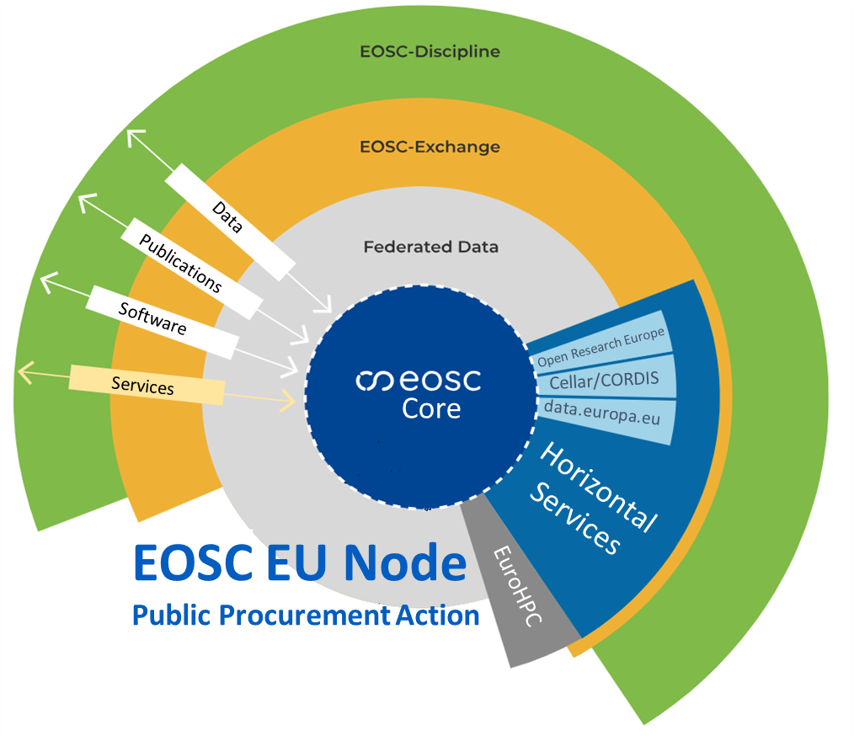
Rollout of the EOSC Federation (I), the EOSC EU Node
EOSC as an open and trusted Federation of collaborative and autonomous infrastructures,
a web of distributed EOSC Nodes:
The EOSC EU Node provisioned from the European Commission:
Can I use it? Yes, you can!
Launched at EOSC Symposium in Oct. 2024!
How can I use it? Go to:
https://open-science-cloud.ec.europa.eu/

Slide 8
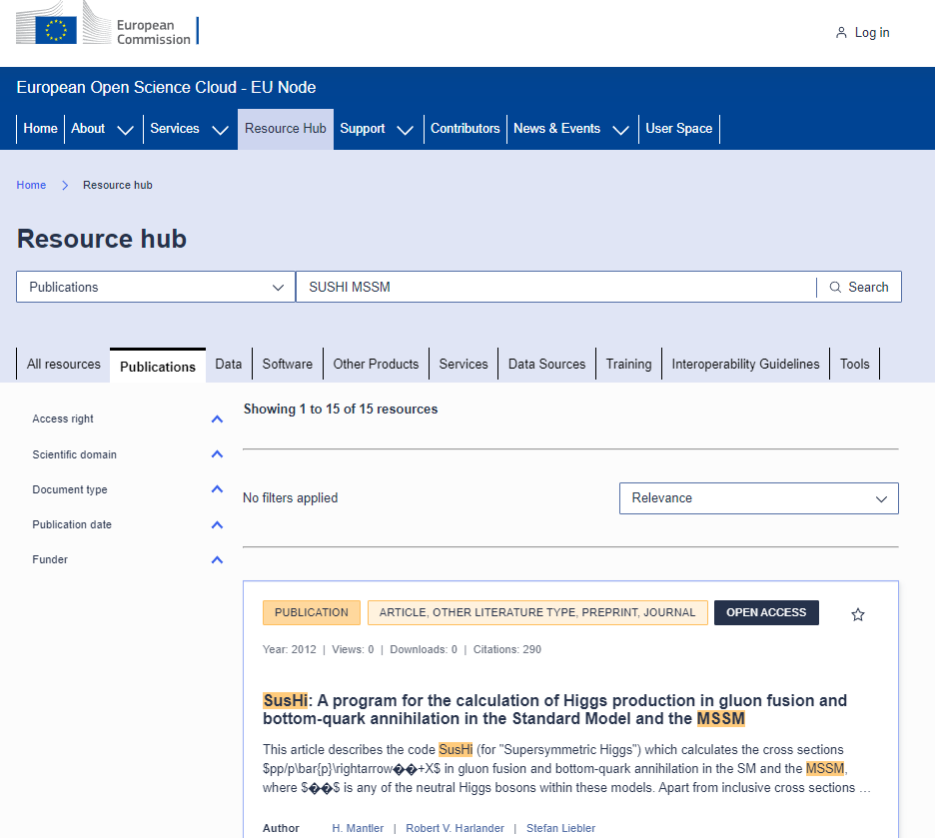
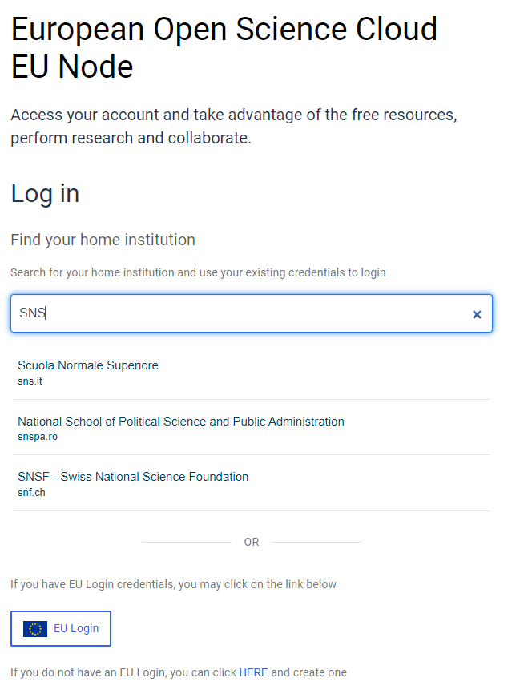
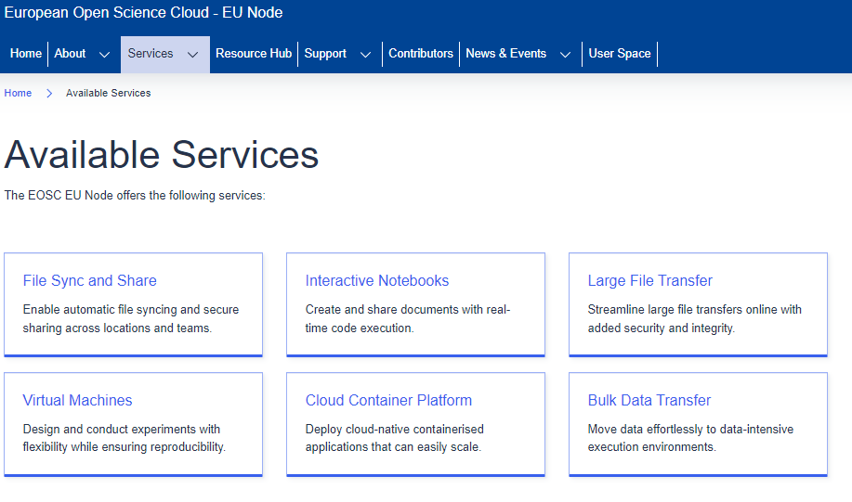
Rollout of the EOSC Federation (I), the EOSC EU Node
Helpdesk
Technology Forum

Slide 9
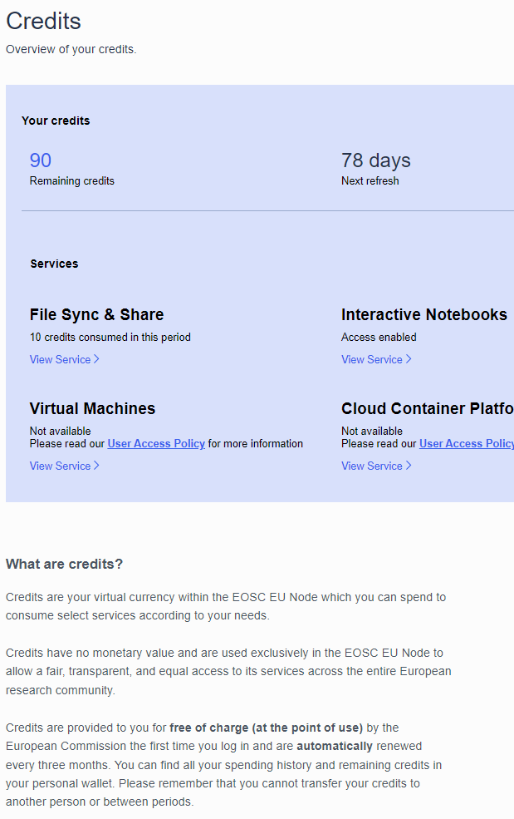
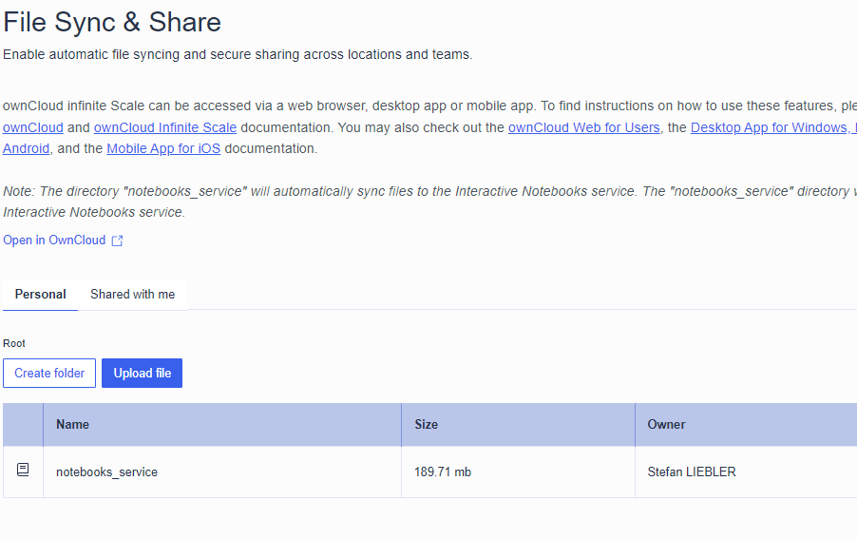
EOSC EU Node: User Space

Slide 10
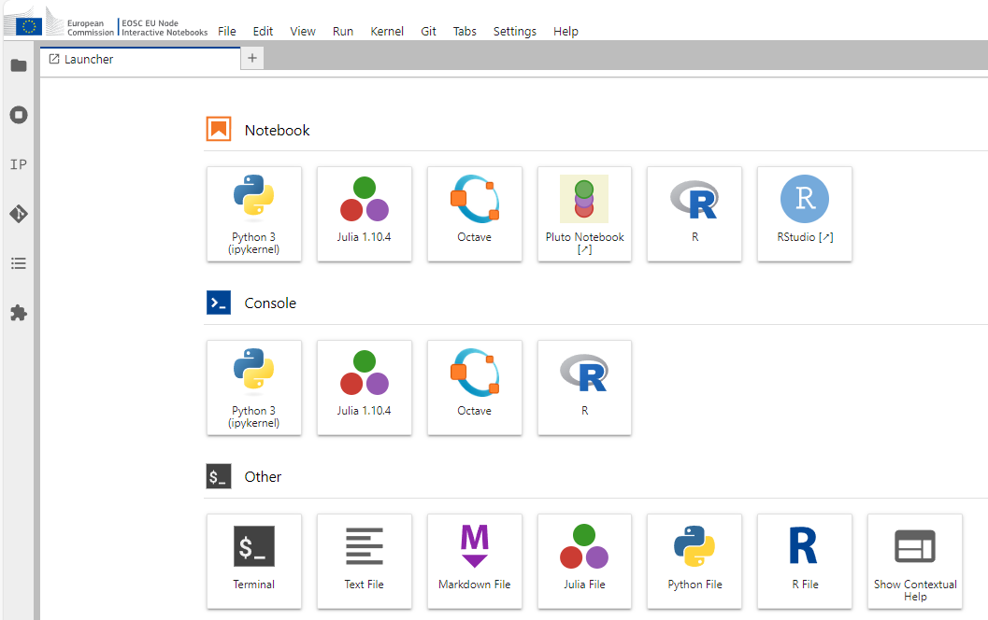
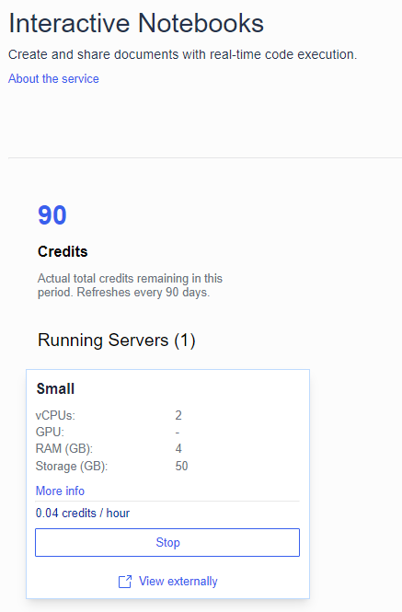
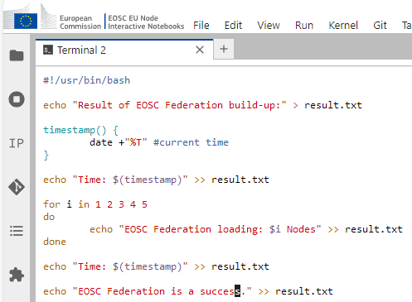
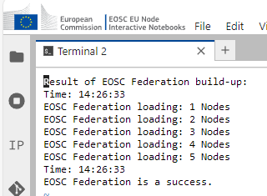
EOSC EU Node: User Space
Real scientific use cases:
EOSC Symposium 2024, Day 3
Deep dive into the EOSC EU Node
https://eosc.eu/eosc-symposium-2024-outcomes-and-resources/
Live demo at the Technical launch event:
https://open-science-cloud.ec.europa.eu/news/technical-launch-european-open-science-cloud-eosc-eu-node-sets-stage-successful-deployment

Slide 11
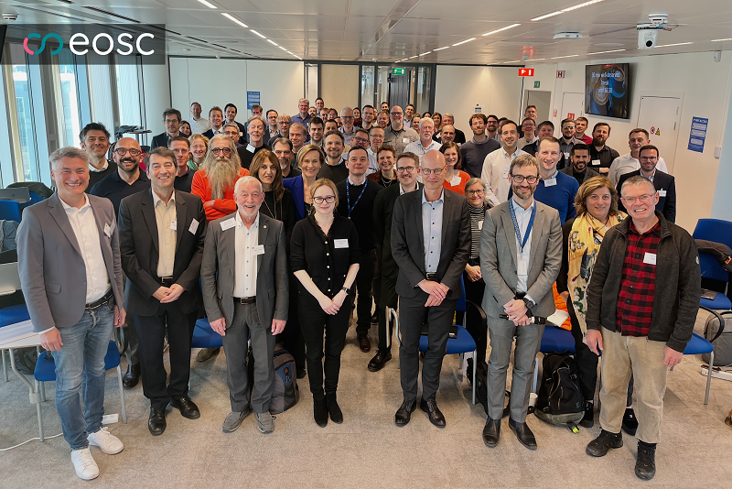
Rollout of the EOSC Federation (II)
Following a dialogues process with 121 interested organisations interested to join the EOSC Federation, 13 organisations were invited for the
Kick-off workshop of the EOSC Federation build-up phase, held 17-18 March 2025 in Brussels.
Besides the EOSC EU Node the 13 involved organisations/consortium are:

Slide 12
EOSC Tripartite Governance
Rollout of the EOSC Federation (II)
The kick-off workshop served to commonly…
…get to know each other, find gaps and commonalities.
…elaborate the planning of the main activities of the build-up phase, on the basis of draft project charters prepared by the organisations and on the input by the EU Node representatives. This included prioritization of use cases and tasks, working towards a common timeline.
…set out the organisational modalities of the build-up phase and define the next steps, specifically to set up an “EOSC Federation build-up group”.
Continuous engagement of further interested organisations:
Webinar(s)
EOSC Federation Handbook (endorsed this week)
EOSC Association Task Forces
Next “wave” to be launched in summer
EOSC Federation build-up group

Slide 13
EOSC Investments
EOSC projects....
At least 1 billion euros will be invested in EOSC over the lifetime of Horizon Europe.
During the duration of the co-programmed partnership both partners finance EOSC by equal amounts of In-Kind contributions by members of the EOSC Association and continuous fund projects through the European Commission.
… and further to come.

Slide 14
2025

