Slide 1
Towards the EOSC Federation – Current Status and next Steps
Klaus Tochtermann
EOSC-Association
NTE Croatia, Zagreb
27 March 2025

Slide 3
EOSC Nodes
The EOSC Nodes will be the entry points for end users to the entire EOSC Federation.
An organisation may therefore enrol its activities as an EOSC Node in the EOSC Federation or onboard its services on an existing EOSC Node as a provider.
A set of minimum requirements for Nodes agreed by the Tripartite group: https://eosc.eu/building-the-eosc-federation

Slide 4
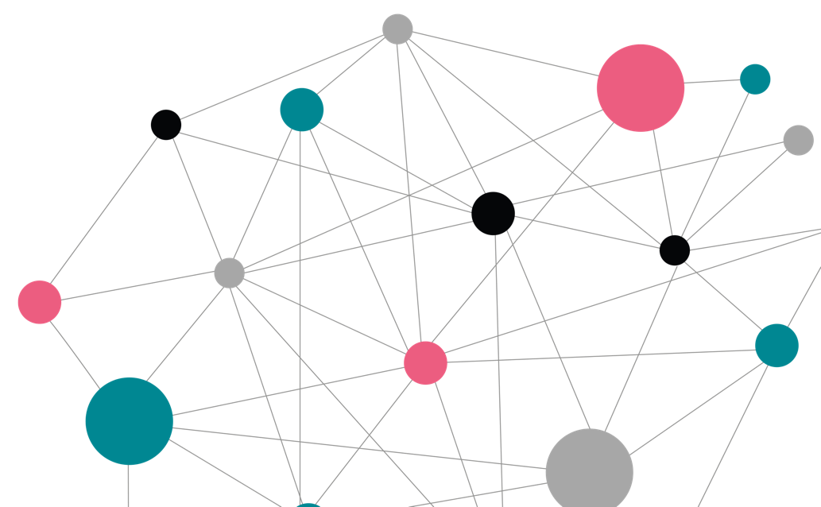
Overview of questionnaire submissions and assessment
Open: 12 Jun 2024 - 18 Aug 2024 (late submissions accepted until 31 Aug 2024)
121
Submissions
25
Countries plus many internationalorganisations
Organisations identified to be invited to a dialogue with the Tripartite and EU node.
5
Node types: thematic, national, institutional, regional, and other (such as the EU Node)
29
Goal of dialog process was to get from 29 to ~13 nodes for first wave of deployment
~13
To join the first wave starting March 2025
+
Subsequent waves of enrolment from Q3 2025 onwards
Notes:
Submissions were received from a total of 25 countries (20 EU member states)
IO – international organisations includes ERICs and EIROforum members with IO status (such as CERN) as well as the EC but not e-infrastructures such as EGI, GEANT
These node categorisations were derived from the answers obtained and NOT indicated by the submitters - Other includes e-infrastructures (EGI, OpenAIRE) and European Commission (EC node)

Slide 5
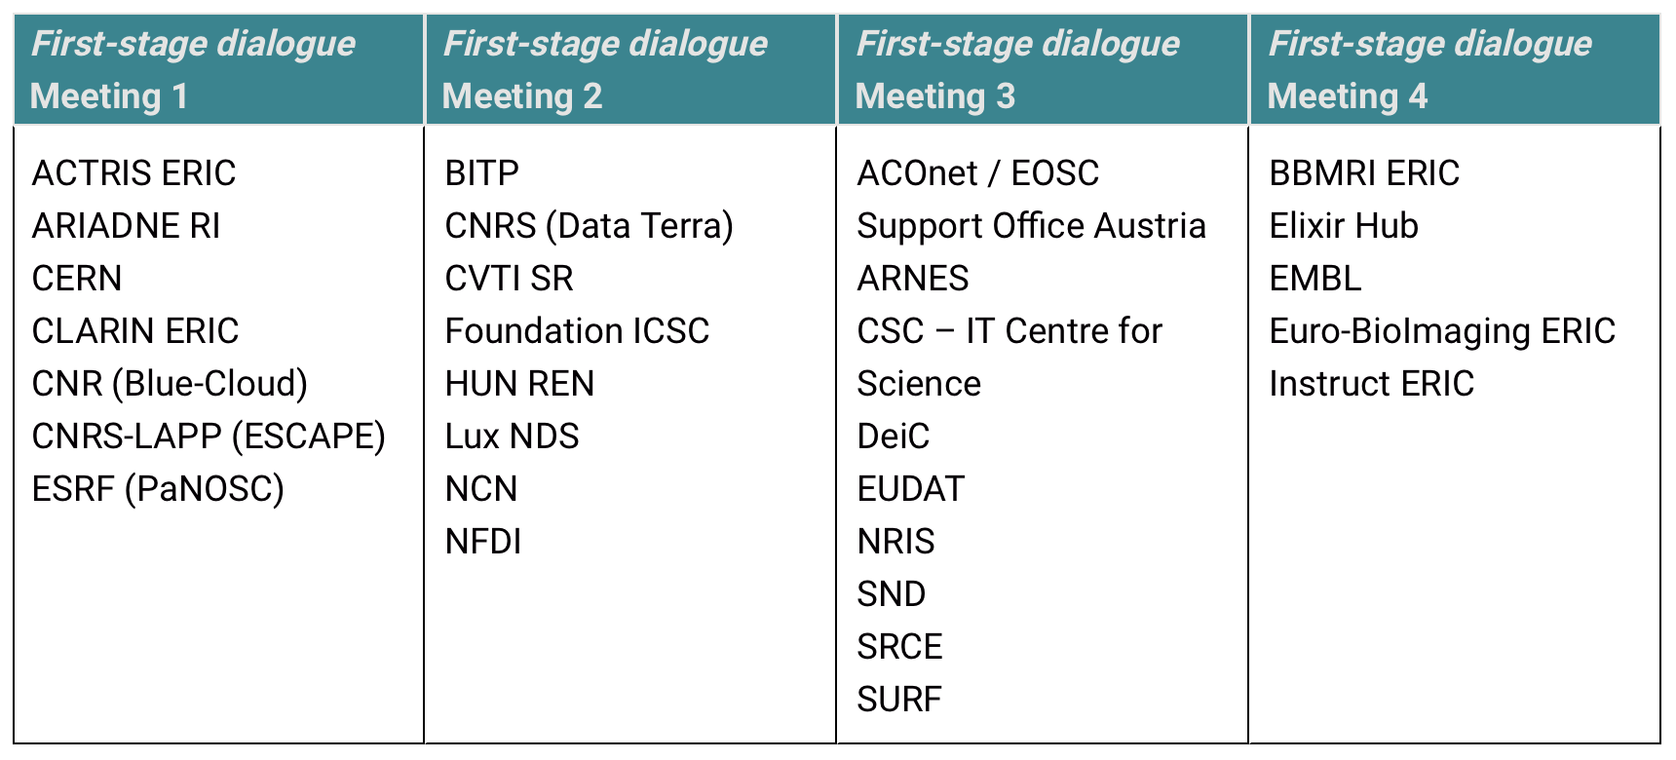
2-stage dialogues with Potential Candidate Nodes
1st stage: 4 meetings during December - January

Slide 6
13 Candidate Nodes

Slide 7
Indicative Timeline for 2025
2 days
16-20 June F2F Review workshop: location?
17/18 March: Kick-off workshop, Brussels;
03-05 Nov:
EOSC Symposium
2 days
29 Sept-3 Oct F2F Review workshop: location?
Draft Letter of Intent / call with Legal teams
27/28 June:
Present status at Meeting INFRAEOSC projects
March
April
May
June
July
August
Sep
Oct
Nov
Direct communication between nodes
Temporary working groups on operational aspects
28 March: Webinar for all questionnaire respondents
Monthly “Build-up Group” call
Monthly “Build-up Group” call
31 March: deadline for revised project charters
Monthly “Build-up Group” call
Monthly “Build-up Group” call
Monthly “Build-up Group” call

Slide 8
EOSC Federation Handbook

Slide 9
Outline of EOSC Federation Handbook (60+ pages)
Purpose of 1st version of Handbook
How to build the EOSC Federation during the period 2025 to 2027
What will the EOSC Federation enable and provide for researchers
How will the success of the EOSC Federation be measured
Chapter 1 – Purpose
Chapter 2 – Governance
Chapter 3 – Operations
Chapter 4 – Architecture
Chapter 5 – Scientific Resources
Chapter 6 – Policies

Slide 10
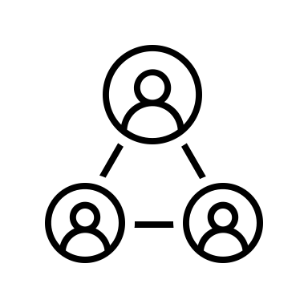
Sustaining EOSC in practice
WHAT
Task
Task
Task
Task
Task
Deploying and operating the EOSC EU Node
EOSC
Federation
Enabling a web of FAIR data and services for science
Research and prototyping new capacities for the EOSC Federation
Enabling OS policies and
the uptake of
OS practices
through EOSC
WHO
Implementing these 5 Tasks will require each member of the Tripartite to take on new roles and responsibilities that in turn must be accompanied by secure funding streams that are well-structured and well-understood
Member States and Associated countries: Largest contributors to OS and EOSC-related investments in Europe, supporter of potential EOSC Nodes during the build-up phase
European Commission: Driver of relevant policy-making and seed funder for EOSC and the EOSC Federation
EOSC Association: Legitimate voice of the broader stakeholder community and de facto leader of the “coalition of the doers”

Slide 11
The role of the EOSC Association AISBL relative to the 5 Tasks
The EOSC Association AISBL shall
Proposal #1
Be entrusted with a budget to
ENTRUSTED
Manage and operate the EOSC EU Node (if the European Commission wishes to outsource this function) Task
Manage, operate, and evolve the EOSC Federation Task
Innovate the EOSC Federation with new capabilities Task
Remain the strategic partner of the EC and the MS/ACs represented in the respective Programme Committees to
STRATEGIC
PARTNER
Continue serving as the voice of the EOSC community relative to Open Science policy development and the implementation of a Web of FAIR data and services Tasks

Slide 12
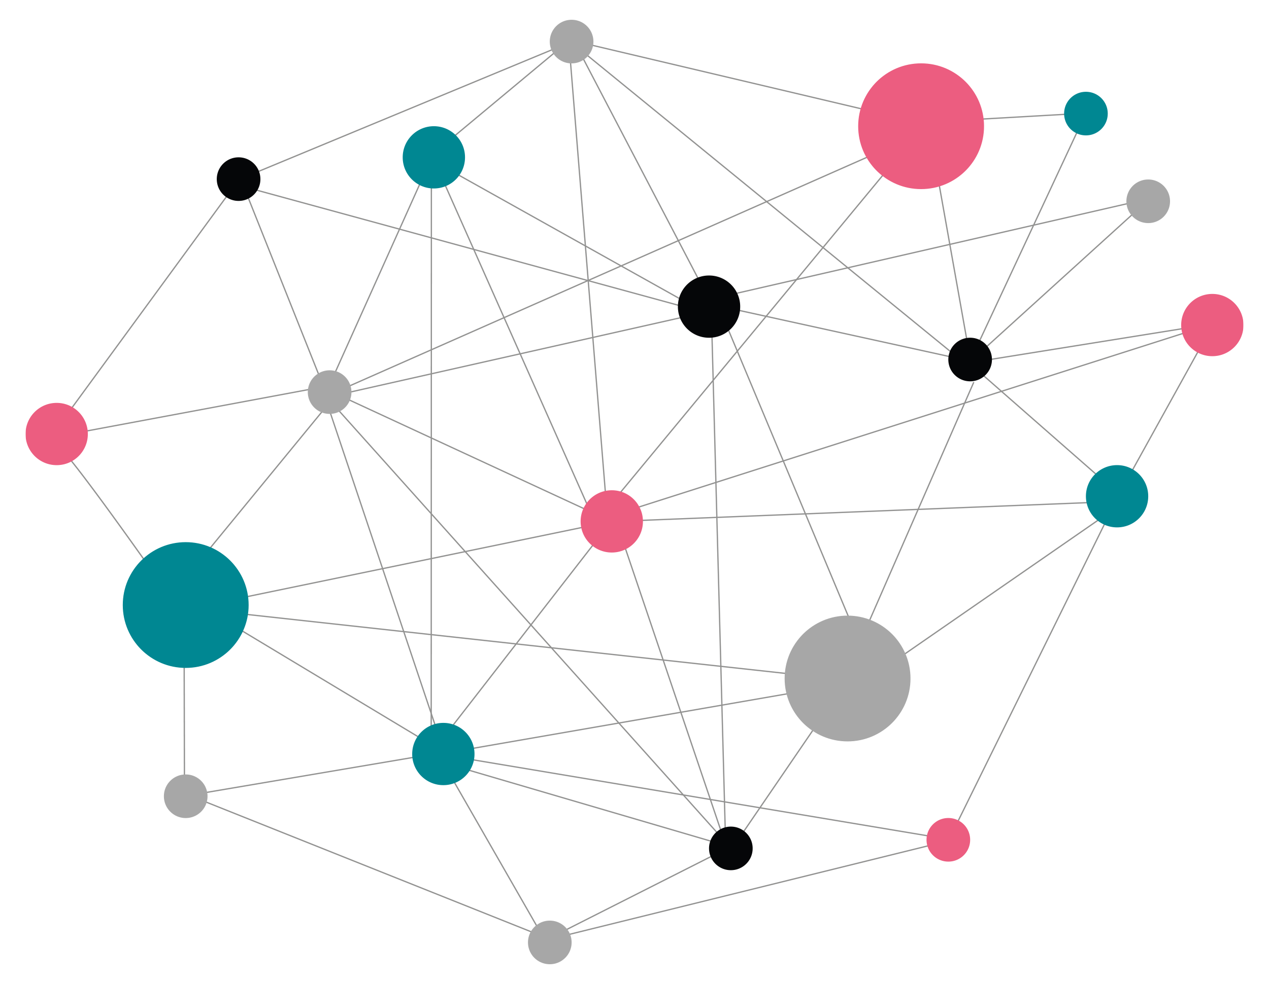
Operation and management of the EOSC Federation
The establishment of the EOSC Federation requires identifying a designated legal entity to be mandated with the responsibility of operating and managing the EOSC Federation
Core tasks of EOSC
Federation Management Organisation (FMO)
Oversee daily operations and monitor the EOSC Federation, including legal, policy, interoperability, and technical aspects
Manage the EOSC Federation’s contractual and collaboration framework

Slide 13
Federation Management Organisation (FMO)
The EOSC Association Board proposes to establish a limited liability company, EOSC FMO SRL, wholly owned by the EOSC Association AISBL, which will act as the EOSC FMO. The EOSC FMO SRL takes on the responsibilities relative to Task (which may include outsourcing of services).
Proposal #2
Two-layered structure
The EOSC FMO SRL will be co-financed by the European Commission and the Member States and Associated Countries. The financing could be implemented in a staged approach:
During the Horizon Europe timeframe: with in-cash contributions by the European Commission (via the budget granted to the EOSC Association AISBL); in that period the Member States and Associated Countries support the work done by the FMO by either hosting an active EOSC Node or by their contractually contribution to an international Research Infrastructure operating an active Node in the EOSC Federation.
In the next framework programme: with 100% of initial funding sourced from the European Commission, then transitioning to a co-financing mechanism of 70% from the Member States and Associated Countries and 30% from the European Commission, for example (see section D.2).
Executive management layer: responsible for the daily operations
Governance layer (an FMO non-executive board): steers the direction of the FMO

Slide 14
The short-term plan
The EOSC Association Board proposes that the European Commission
Proposal #3
Fills the EOSC FMO budget gap via an EU grant for the EOSC Association AISBL as identified beneficiary in order to facilitate the Association’s transition as owner of EOSC FMO SRL, the mandated legal entity purposed to execute Task
Takes action to procure the operation of the EOSC EU Node at least until the end of 2027

Slide 15
The long-term plan
Proposal #4
Co-financing by the European Commission and Member States and Associated Countries is essential to ensure the long-term sustainability of the EOSC policy initiative and the EOSC Federation.
Using the Horizon Europe benchmark of €490 million, we make an inflation-adjusted assumption of a total Multiannual Financial Framework contribution of €665 million, supplemented by additional contributions from the Member States and Associated Countries to support EOSC at national level.
The funding of Task (EOSC FMO) and Task (evolution of the EOSC Federation) could be implemented in a staged approach, with 100% of initial funding sourced from the European Commission, then transitioning to a co-financing mechanism of 70% from the Member States and Associated Countries and 30% from the European Commission, for example. The EOSC EU Node funding will remain the sole responsibility of the European Commission.
The Member States and Associated Countries and the European Commission will maintain their role in the design of the SRIA and the future Research Programme.

Slide 16
Q&A
Photo by Leeloo The First on Pexels

