Slide 1
Regional collaboration with(in) the Research Data Alliance
Ana Inkret
Slovenian Social Science Dana Archives
Zagreb, 27 March 2025

Slide 2
What is RDA?
RDA is an international member-based organisation focused on the development of infrastructure and community activities that reduce barriers to data sharing and exchange, and the acceleration of data-driven innovation worldwide. With more than 14,000 members globally representing 152 countries, RDA includes researchers, scientists and data science professionals working in multiple disciplines, domains and thematic fields and from different types of organisations across the globe.
RDA builds the social and technical bridges that enable open sharing and re-use of data.

Slide 3
What does RDA do?
Members come together through self-formed, volunteer and focused Working Groups and exploratory Interest Groups to exchange knowledge, share discoveries, discuss barriers and potential solutions, explore and define policies and test as well as harmonise standards to enhance and facilitate global data sharing & re-use.
Reproducibility
Data preservation
Data management planning
Best practices for domain repositories
Legal interoperability
Data citation
Data type registries
Metadata
FAIR, CARE, TRUST
Ethics
Research software
Artificial Intelligence
Semantics, ontology, standardisation
and many more

Slide 4
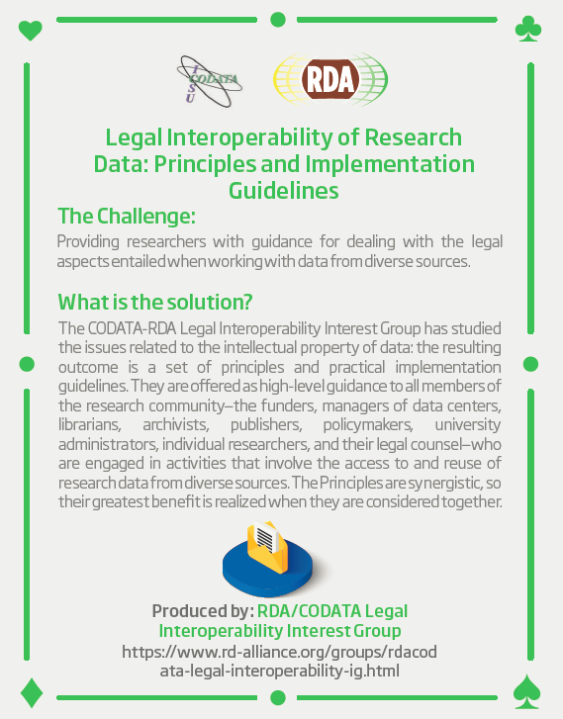
RDA Recommendations and Outputs
technical and social infrastructure solutions developed by the Working or Interest Groups
adopted code, policy, specifications, standards, or practices that enable data sharing, exchange, and interoperability
CATEGORIES
Recommendations
Supporting Outputs
Other Outputs
Currently in review:
Secure Processing Environments for Open Science: Proposing Legal Foundations
Searchable Recommendations & Outputs Catalogue: https://www.rd-alliance.org/recommendations-and-outputs/outputs/

Slide 5
RDA Community
Individual members
Collaborate and contribute to debates, recommendations and outputs
Organisations
Assist in the customisation, adoption and implementation of the RDA’s recommendations
Regions
Localise, network, provide a global perspective
Interest groups: long-term initiatives, platforms for communication and coordination
Working groups: short-term (18 months) and come together to develop and implement data infrastructure, which could be tools, policy, practices and products that are adopted and used by projects, organizations, and communities

Slide 6
RDA Regions
RDA Regional engagement an instrument to add value to the RDA community by increasing engagement with national level data professionals to engage with international counterparts and to offer support to national level decision makers to achieve the international cooperation and engagement priorities. The regional partnership framework is integral to the recommendations and priorities defined in the RDA Financial Sustainability Plan and the RDA Strategic Plan 2024 - 2028.
Value of RDA to Regions
Strong partnerships with regional members is crucial to success of RDA as international organisation;
Achieved through complementary and mutually beneficial relationship;
RDA provides forum for international community to connect and share knowledge;
Global perspective a key strength;
Value and benefits are realized through work and business of RDA.
RDA support for regions: spporting regional development, administration and leadership; establishing a Regional Assembly; supporting Regional leadership to achieve fundraising goals; providing organizational partnership and support for regionally-hosted RDA plenaries; hosting regional websites; providing official support and approval for the use of RDA brand; resolving and adjudicating conflicts.

Slide 7
Slovenia in RDA
Established in 2019 as part of the RDA Europe 4.0 project
Funded by the Ministry of Higher Education, Science and Innovation 2023-2030
Aims:
to act as a long-term central contact point between the Research Data Alliance and data practitioners, funding organizations, research agencies and other relevant stakeholders in Slovenia
to raise awareness of RDA and encourage active involvement of the Slovenian community
to support the rise of data sharing culture in Slovenian research community by facilitating use of RDA‘s knowledge, outputs and other resources
to contribute to the implementation of data sharing and open access policies and practices research data at the national level

Slide 8
Slovenian Open Science Framework
Resolution on the Slovenian Scientific Research and Innovation Strategy 2030 (ReZrIS30)
6.2. Open Science to improve research quality, efficiency, and responsiveness
6.2.1 Manage and finance the development of the national Open Science ecosystem and ensure its coherence with international standards, develop national structures and infrastructures related to OS, and foster their integration into international networks and infrastructures.
6.2.2 Introduce modern approaches to the evaluation of scientific research in accordance with OS principles
6.2.3 Ensure that the results of scientific research are consistent with the FAIR principles, and that full and immediate Open Access is provided (subject to justified exceptions).
Action plan for Open Science
Slovenian Open Science Community
"Support for the Implementation of Open Science Principles in Slovenia" (SPOZNAJ) project
National Open Science Portal with the Digital repository of Slovenian research organizations

Slide 9
Plans and activities of the Node
Support for trusted repositories
Collaboration on the criteria with the national funder
Training and support for CoreTrustSeal certification
Update landscape report
Meden, K., & Erjavec, T. (2021). Pregled Slovenskih repozitorijev raziskovalnih podatkov. CLARIN.SI. [PDF]
Open Science Terminology WG
SSHOC Multilingual Data Stewardship Terminology
Contribution to the glossary of open science in the first guidebook on open science in Slovenian language

Slide 10
Plans and activities of the Node
Support for scientific journals
Promotion and update of the recommendations
Štebe, J., Bezjak, S., & Dolinar, M. (2020). Smernice za oblikovanje politik znanstvenih založb glede navajanja raziskovalnih podatkov v znanstvenih publikacijah in zagotavljanja dostopa do primarnih podatkov, uporabljenih v člankih (2.5). Zenodo. https://doi.org/10.5281/zenodo.4040643
Training for editors
Helpdesk for editorial teams
Support for data editors
Promotion, support for active involvement in the global RDA community
Report on the RDA groups and outputs in the context of the national action plan
Refunding plenary fees for active participants from Slovenian community
National event (potential topic: AI in research)
International seminar on continued education of data stewards

Slide 11
How can we collaborate?

Slide 12
RDA Invitations

Slide 13
Resources
RDA in a Nutshell February 2024
International Data Week – Benefits and Opportunities Webinar
The State of Open Science in Slovenia Webinar

Slide 14
Thank you for your attention
Find us at
https://www.rd-alliance.org/groups/rda-slovenia/activity
vozlisce.RDA@fdv.uni-lj.si

