Slide 1
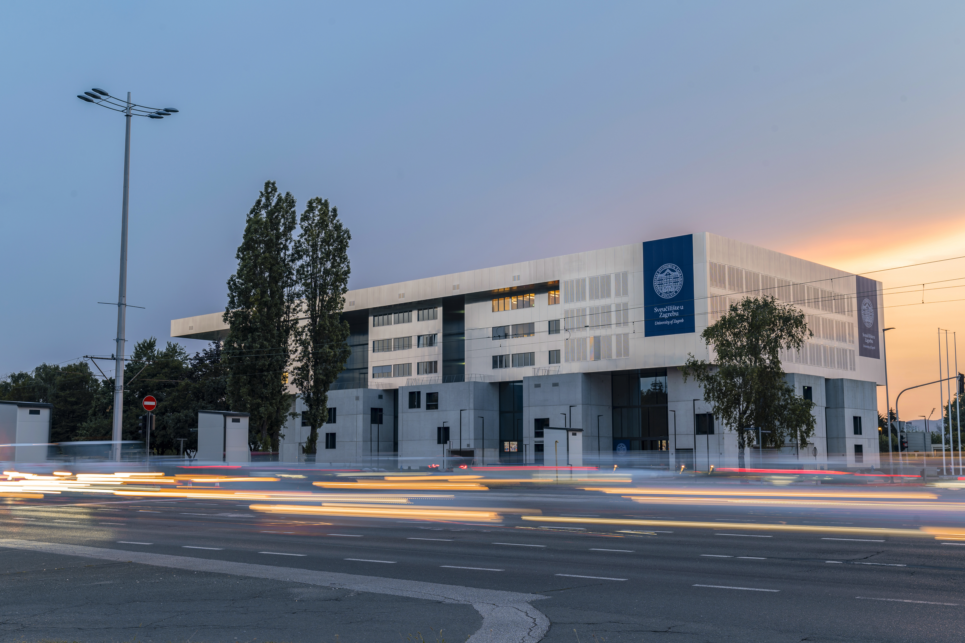
University of Zagreb
Open Science Policy
26th March 2025

Slide 2
Open Science Policy
University of Zagreb
Open Science Policy

Slide 3
Open Science Policy
Board for Science, Arts and International Cooperation
Board coordinator
prof. dr. sc. Jurica Pavičić, vice-rector for international and interinstitutional cooperation
Board co-coordinator
prof. dr. sc. Dubravko Majetić, vice-rector for science, research and postgraduate studies
Members:
Document preparation:
prof. dr. sc. Nina Begičević Ređep, FOI, president
prof. dr. sc. Nikola Mišković, FER, deputy president
prof. dr. sc. Mirko Planinić, PMF
prof. dr. sc. Neven Duić, FSB
izv. prof. dr. sc. Marko Jurić, PF
red. prof. art. Martina Gojčeta Silić, MUZA
prof. dr. sc. Marko Rogošić, FKIT
prof. dr. sc. Marina Dabić, EFZG
izv. prof. dr. sc. Danijela Bursać Kovačević, PBF
izv. prof. dr. sc. Daniel Miščin, FFRZ
izv. prof. dr. sc. Mario Bačić, GRAD
prof. dr. sc. Goran Šimić, MEF
prof. dr. sc. Nevena Škrbić Alempijević, FFZG
prof. dr. sc. Damir Ljubotina, FFZG
prof. dr. sc. Jasmina Lovrić, FBF
doc. dr. sc. Dario Babić, FPZ
izv. prof. dr. sc. Stanko Ružičić, RGNF
doc. dr. sc. Andreja Đuka, FŠDT
Tomislav Gržan, PhD students’ representative
Mario Prišlin, Student representative
izv. prof. dr. sc. Miroslav Rajter, UNIZG
Marijana Glavica, FFZG
Iva Melinščak Zlodi, FFZG
nasl. doc. dr. sc. Lea Škorić, MEF

Slide 4
Open science policy
CONTENTS
INTRODUCTION
OPEN SCIENCE
RESOURCES AND JURISDICTIONS
OPEN ACCESS TO SCIENTIFIC PUBLICATIONS
FAIR RESEARCH DATA
OPEN CODE AND OTHER OPEN RESULTS OF RESEARCH PROCESSES
OPEN EDUCATIONAL MATERIALS
OPEN SCIENTIFIC INFORMATION INFRASTRUCTURE
OPEN INCLUSION OF WIDER SOCIETY OUTSIDE THE ACADEMIC COMMUNITY AND OPEN DIALOGUE WITH OTHER SYSTEMS OF KNOWLEDGE
OPEN SCIENCE POLICY IMPLEMENTATION MONITORING
CLOSING REMARKS
SOURCES

Slide 5
Open science policy
Background – EU and national Open Science
Council of the European Union, Council conclusions on High-quality, transparent, open, trustworthy and equitable scholarly publishing, 2023.
Council of the European Union, Council conclusions on Research assessment and implementation of Open Science, 2022.
UNESCO Recommendation on Open Science, 2021.
The EUA Open Science Agenda 2025
Act on Higher Education and Science, 2022
Initiative for Croatian Open Science Cloud (HR-OOZ) – SRCE, 2022.
Croatian Open Science Plan, 2023.

Slide 6
FREE ACCESS TO SCIENTIFIC INFORMATION
COMMUNITY INVOLVEMENT IN RESEARCH
INTERDISCIPLINARY STUDIES
INTERNATIONAL COOPERATION
OPEN SCIENCE

Slide 7
Open science policy
Aims of Open Science Policy
To increase access to scientific results, ensuring the availability of scientific papers and data to all stakeholders
To encourage transparent sharing of methodologies and research results
To improve networking and enable easier cooperation among scientists, institutions and wider public
To enable faster development of new ideas and technologies, thus encouraging innovations
To ensure the development of citizen science as a primary resource for dealing with global challenges and a key element of the development of knowledge-based society.

Slide 8
Open science policy
Access to the existing knowledge, and thus the creation of new knowledge, becomes easier
Increase in visibility and influence of publications and other research results at the University, thus increasing their application in the education, culture, innovation and the economic and societal development
Expected results for the University,
For the academic community and for the society
Strengthening of the scientific integrity and societal trust in science and scientific knowledge
Strengthening of the cooperative aspect of scientific work and recognition of the importance of all societal stakeholders in defining of scientific goals and the implementation of scientific studies

Slide 9
Open science policy
This policy was developed as one of the measures outlined in the Strategic Guidelines for Scientific and Research Activity at the University of Zagreb 2023–2026
Goal 1 To increase scientific and artistic productivity and excellence at the University.
Goal 2 To develop further a supportive research environment and open science.
Goal 3 To encourage internationalization through global and inter-institutional collaboration and European university alliances.
Goal 4 To develop and strengthen the University’s role in innovation by transferring knowledge and technology to the economy and society.
Goal 5 To strengthen the University’s scientific reputation and the visibility of its research and artistic achievements.

Slide 10
RESOURCES AND RESPONSIBILITIES
Open science policy
Faculties and academies must regulate open science processes internally.
Researchers must adopt open science principles.
Teachers introduce open science to students.
University relies on SRCE's infrastructure (CroRIS, DABAR). SRCE ensures resource availability, system security, and updates.
Ensure access to European research infrastructures (ERIC, EOSC).
Faculties and academies provide researcher support and education.

Slide 11
OPEN ACCESS TO SCIENTIFIC PUBLICATIONS
Open science policy
The University promotes open access for all research outputs (students, teachers, etc.).
This can be achieved through:
Diamond open access (free publication and access).
Open access with author fees (article/book publication charges).
Closed access with simultaneous repository manuscript deposit.
All cases require Creative Commons licensing (CC BY recommended).

Slide 12
FAIR RESEARCH DATA
Open science policy
Faculties and academies should support researchers in research data management throughout the project. Researchers should store data in trusted repositories or institutional repositories.
Priority should be given to repositories within the national infrastructure.
In cases where data are subject to open licenses that allow redistribution, it is desirable to store the data in multiple repositories.

Slide 13
OPEN CODE AND OTHER OPEN RESULTS
Open science policy
Research Output Storage:
University encourages storage of original program code and research results.
Use of institutional or publicly available repositories (e.g., GitHub).
FAIR Principles:
Complete, up-to-date, and accurate code documentation is a prerequisite for FAIR principles.
Recommendation for Author:
Record research software and code in the Croatian Science Information System (CroRIS)

Slide 14
Open science policy
Open Science Policy implementation monitoring
University of Zagreb will develop analytical tools for the monitoring of principles defined by this policy
University of Zagreb will take account of the specifics of different scientific fields and individual scientific profiles
University of Zagreb will revise action plans and develop recommendations for the change of system of evaluation of scientists based on the principles of open science
As a special principle in the metric of open science, we recognize the monitoring of the implementation of open science. University will develop a system for monitoring the effect of this policy in the context of a wider societal benefit.

Slide 15
University of Zagreb
Open science policy
26th March 2025

