Slide 1
New Leadership for New Digital Education Scenarios?
Days of e-infrastructure DEI Conference
Prof. Albert Sangrà
Full professor in Education
Universitat Oberta de Catalunya
UNESCO Chair Holder in Education & Technology for Social Change
Chair, EDEN DLE Fellows Council

Slide 2
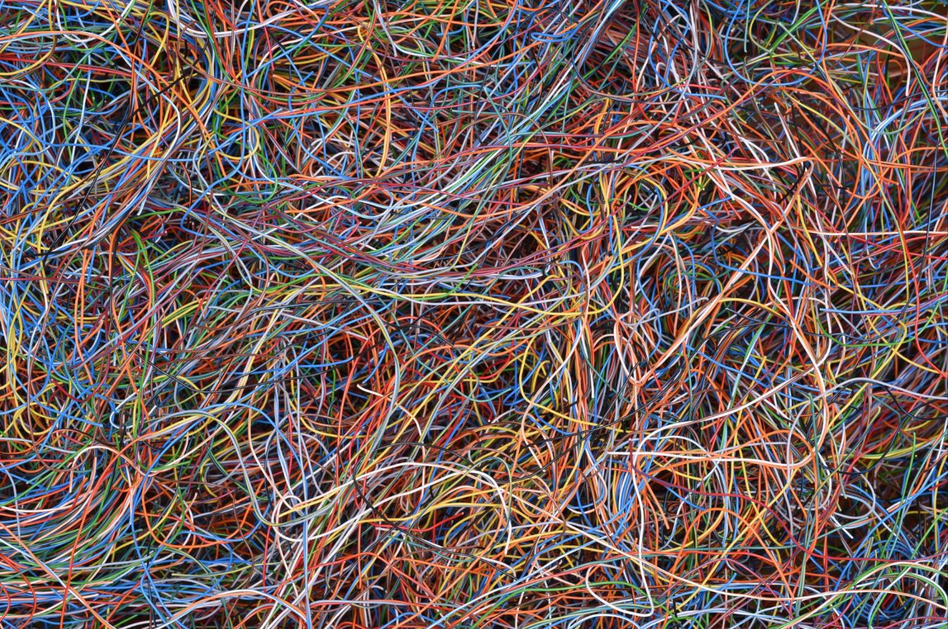
COMPLEXITY
Author: Kevin Perkins

Slide 3
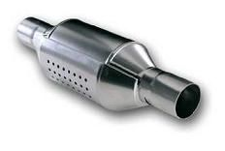
4 (+1) catalysts for the metamorphosis of learning
Connected networks enable connected learning
Empowerment of learners
Overcoming time and space barriers
Acceptance of the existence of an unconcious, informal, invisible and silent learning
(González-Sanmamed, Sangrà, Souto-Seijo, & Estévez, 2020)
Learning
The discontinuity or intermittence generated by the situation of the pandemic
The pandemic just sped these changes up

Slide 4
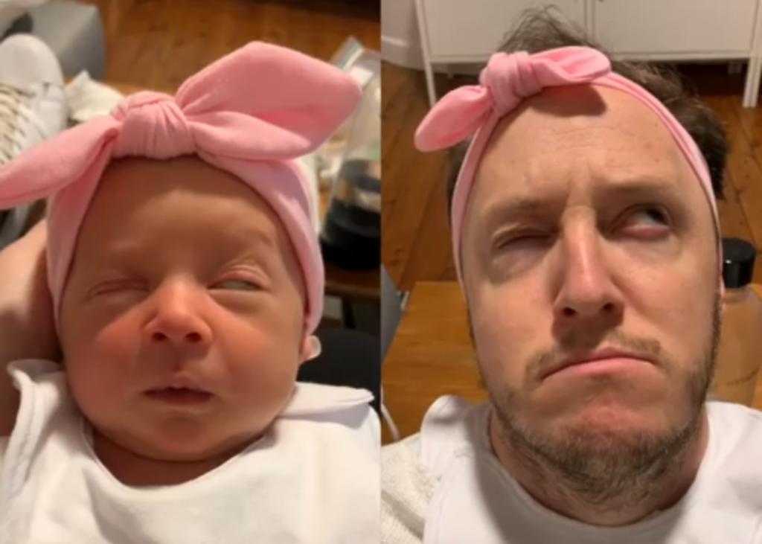
Warning: do not replicate in-presence classroom teaching
The copy is always worse than the original
Given different contexts, different combination of strategies

Slide 5
2. Where are we going? Which are the possible new scenarios?

Slide 6
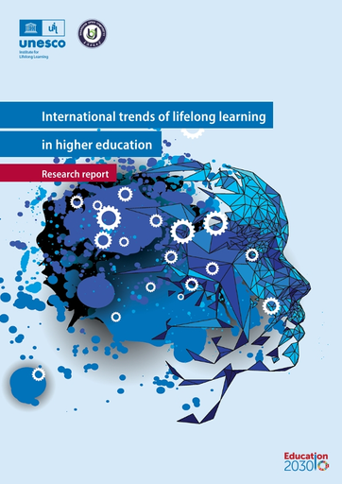
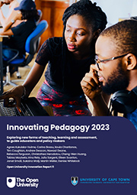
Reports on current trends on Higher Education

Slide 7
Current trends challenging education
Increasing learning flexibility in all ways
Flexible learning pathways
Hybrid/blended teaching and learning models
Pedagogy of autonomy (SRL; learner agency)
Adapting the learning offer to the societat needs: Upskilling and re-skilling
Dual learning scenarios
Microcredentials
Lifelong pedagogical journeys
Exploring the opportunities and risks of Artificial Intelligence
AI-Enabled Applications for Predictive, Personal Learning (Learning Analytics)
Generative AI

Slide 8
3. Some imminent challenges to be faced

Slide 9
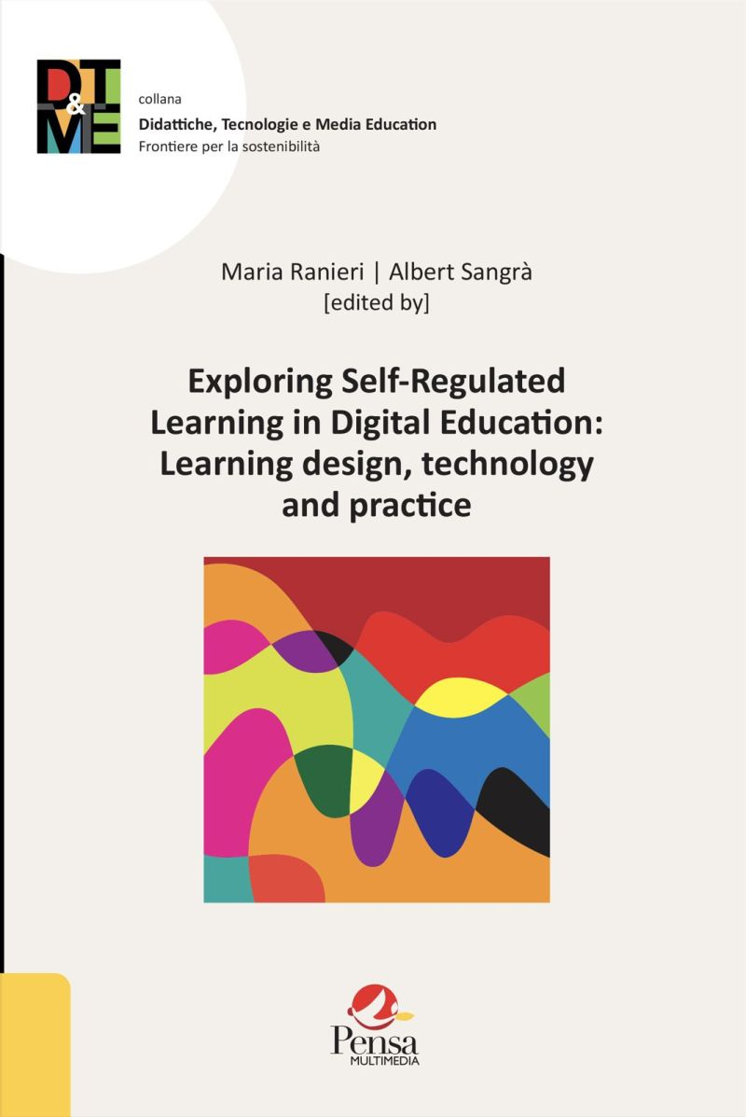
Challenge 1
Increasing learning flexibility in all ways
Flexible learning pathways
- Be open, avoid “the winner takes it all” models
- Don’t give the university mission up, but widen it
- Flexibility of space and time, but also aim, content and rythm
- Foster mobility and internationalization
Pedagogy of autonomy
- Get the students ready for their educational development online: let’s help them to transition to online education with better tools to succeed (Self-Regulated Learning, agency)
Hybrid/blended teaching and learning models
Explore new models
Don’t try to become blended/hybrid or in-presence institutions
Go further than “F2F +”

Slide 10
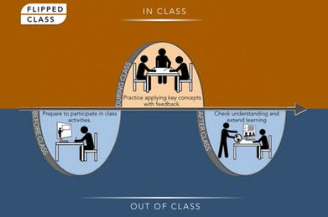
Conditions for successful hybrid/blended models
Dissociating time
(Barberà, Gros, & Kirchner, 2014; Hrastinski, 2008; Tynan, Ryan, & Lamont-Mills, 2015)
Autonomy and self-regulation growth: the job of learning
(Zimmerman, 2008)
A formative, continuous and diversified assessment
A hybrid model designed from a different look
(Lage, Platt, & Treglia, 2000; Bates & Sangrà, 2011)
(Gibbs, 2006; McCallum & Milner, 2021)

Slide 11
Challenge 2
Adapting the learning offer to the societal needs: Upskilling and re-skilling
Dual learning scenarios
- Take better advantage of augmented and virtual reality
- Foster more agreements for practice in companies and institutions
Microcredentials
- Linked to competencies. But really linked.
- It is a current trend, but it is not everything.
- Risk of higher concurrence with companies and other newcomers.
Lifelong educational journeys
- Learning ecologies: understand better, make it more possible

Slide 12
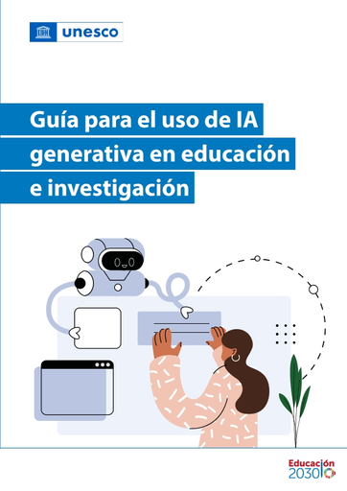
Challenge 3
Exploring the opportunities and risks of Artificial Intelligence

Slide 13
What do we know about AI and, particularly, about IA and teaching and learning?
What we do believe we know
What we don’t yet know that we don’t know

Slide 14
Challenge 3
Exploring the opportunities and risks of Artificial Intelligence
AI-Enabled Applications for Predictive, Personal Learning (Learning Analytics)
- More and better personalization
- Inclusion
- Equity
Generative AI
- Co-design and co-creation with the students
- Learning through experimenting and discovering
- Need of more active and empowering teaching methodologies
- Formative assessment as a must

Slide 15
4. Which kind of leadership do we need?

Slide 16
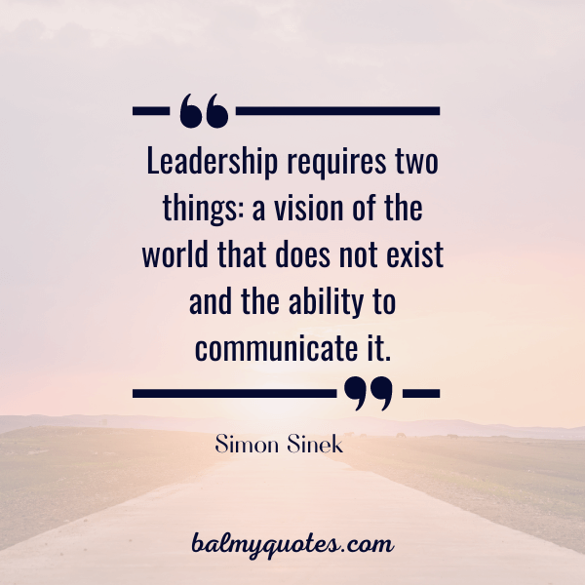

Slide 17
Rationale
Affordances of educational technology under-exploited
Lecture capture, MOOCs, Learning Management Systems (Cuban, 2001; Bates & Sangrà, 2011; Orr et al., 2018)
Management of learning, not learning
Learning Analytics, Antiplagiarism software, proctoring (Passey, 2019)
“Copshit” (Watters, 2020)
Covid-19 response - Emergency remote teaching
(Bozkurt et al., 2020; Weller, 2020)
Need for leadership, vision and strategic thinking
(Bates & Sangrà, 2011; Maguire et al., 2020)
Digital Education in campus-based universities
Business as usual?

Slide 18
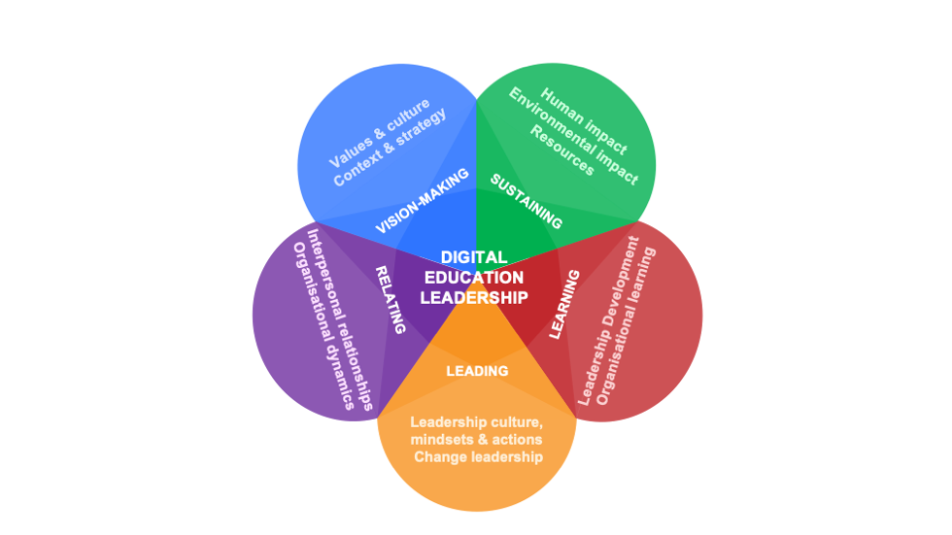
Digital Education Leadership Literacies for Higher Education (DELLHE) Framework
A set of mindsets, attitudes and behaviours which enable HE leaders to address complex problems relating to the integration of Digital Education
Mindsets = how we see the world
Digital
Education
Leadership
Actions = what we do as leaders
Strategy
Plans
Organisational structure
Relationships
(Arnold, 2022; Davis, 2012; Jameson, 2013)

Slide 19
A study on several European Higher Education Institutions
Leadership Development
Lack of attention to pedagogical considerations (VISION-MAKING) and SUSTAINING in the Leadership Development Programmes studied
Changes required:
Mindsets, not competences
Leadership rather than leader development
Build a culture of trust and collaboration
Develop a critical awareness of challenges and affordances of the digital world

Slide 20
Digital Education
+
Leadership (collective, relational, as practice)
+
Leadership Literacies (mindsets and behaviours)
Digital Education Leadership Literacies for Higher Education (DELLHE)

Slide 26
The third space
The space in which professional staff engage in leadership on the basis of their expertise, in particular with respect to supporting learning and teaching
(Bolden et al., 2015)

Slide 28
The TOP triangle
(Bates & Sangrà, 2011)

Slide 29
4. Closing remarks

Slide 30
New leadership for digital education scenarios
Leadership literacies
- Attitudes, understandings and mindsets (Arnold, 2022)
Convinced and convincing leaderships
- New generation
- Believing in digital education
Because (digital) educational leadership matters!
(Brown & Duart, 2023)

Slide 31
Avoid the involution, embrace the evolution
Transforming ≠ Coming back to the past ≠ Everything goes
Competitiveness through flexibility and quality
Other changes will also affect HEIs: rankings, DORA, etc.
Big fish in a small pond or small fish in a big pond?

Slide 32
Our main challenge is to transform ourselves in what we want to be

Slide 33
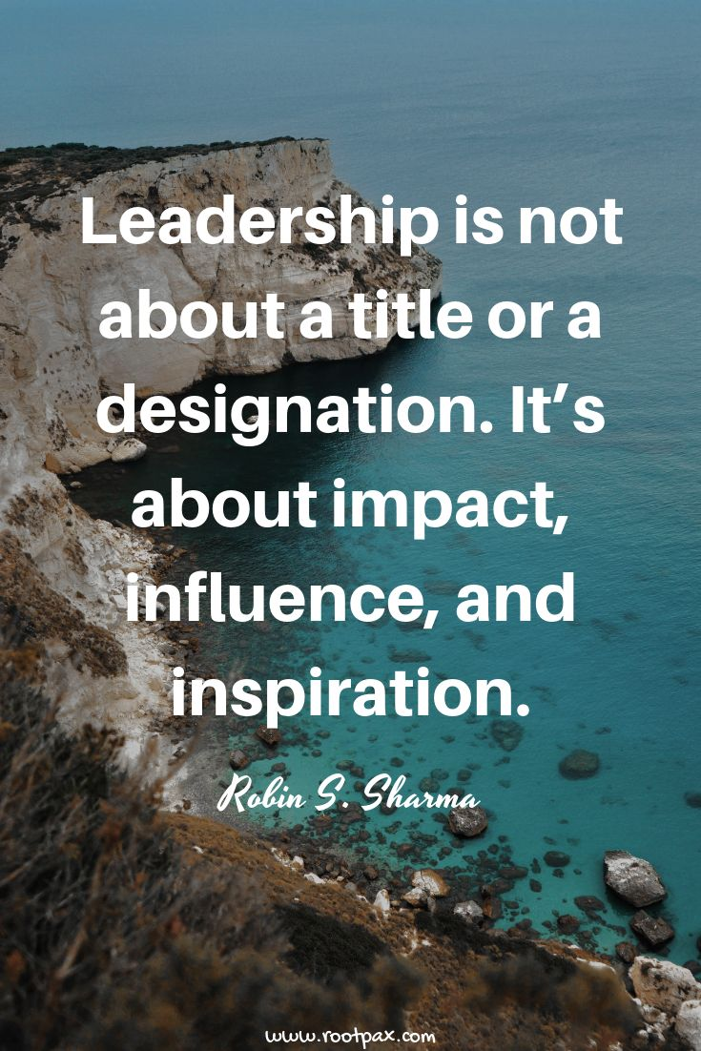

Slide 34
Hvala ti puno
Thank you very much
www.edulab.uoc.edu
Email: asangra@uoc.edu
Twitter: @albert_sangra

