Slide 1





Challenges to research integrity in publishing
Prof. Ana Marušić, MD, PhD
University of Split School of Medicine
ana.marusic@mefst.hr

Slide 2




Declaration of activities and relationships
University of Split School of Medicine, Split, Croatia:
Chair, Department of Research in Biomedicine and Health
Head, Center for Evidence-based Medicine
Senior Co-editor in Chief, ST-OPEN
Council member, Committee on Publication Ethics (COPE)
President, The Embassy of Good Science Foundation
Funding:
Croatian Research Foundation
Horizon 2020 and Horizon Europe grants (EnTIRE, VIRT2UE, SOPs4RI, iRECS, iRISE, GATHER)

Slide 3
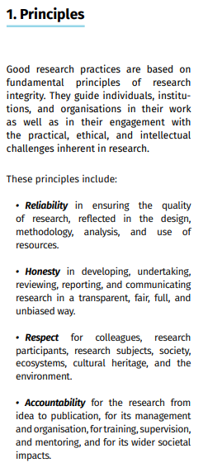
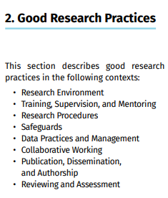

European Code of Conduct for RI
virtue-based
&
principle-based
approach to ethics and research integrity

Slide 4
Research ethics and Research integrity
N. Steneck, 2006, Sci Eng Ethics

Slide 5
RI is a spectrum
N. Steneck, 2006, Sci Eng Ethics

Slide 6
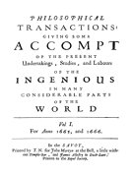
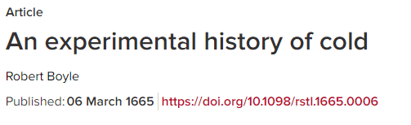
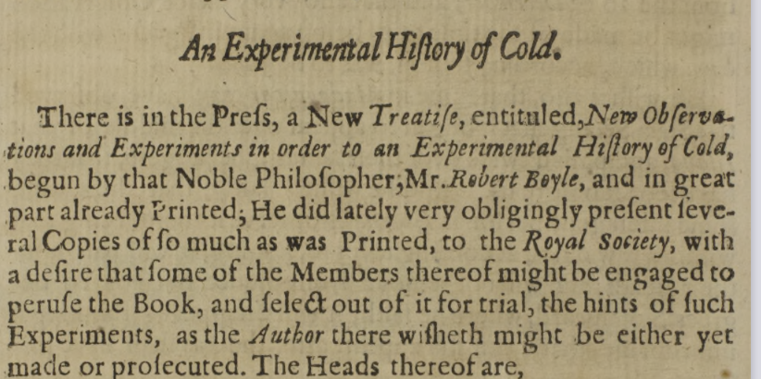
Authorship
Challenges to RI

Slide 7
Challenges
Challenges to RI
Authorship
AI
Digital image manipulation
Papermills
Predatory journals
Preprints
Peer review

Slide 8
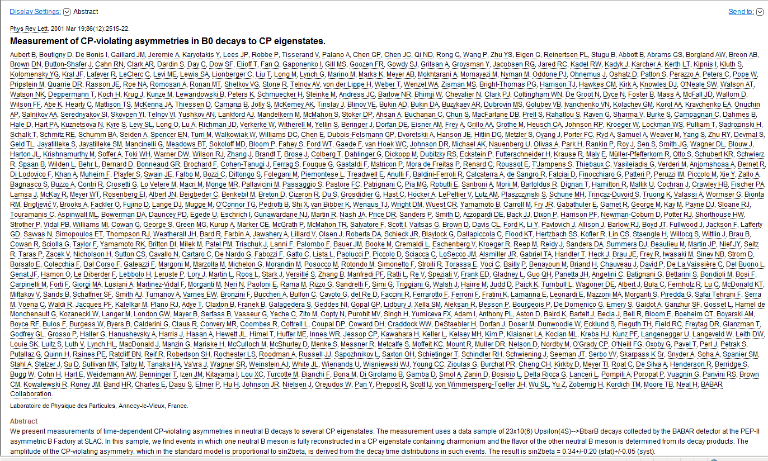
Authorship
Challenges to RI
Definition of authorship across disciplines
2001: 743 authors
743 autora

Slide 9
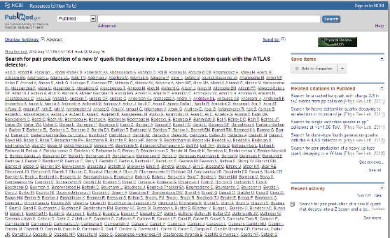
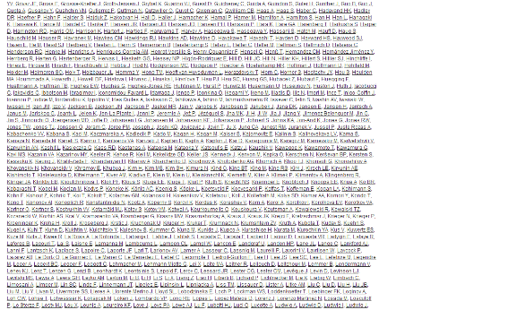
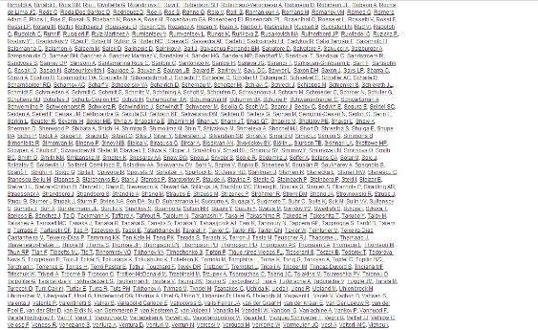
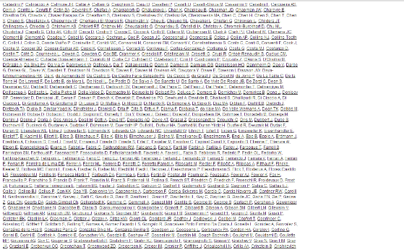
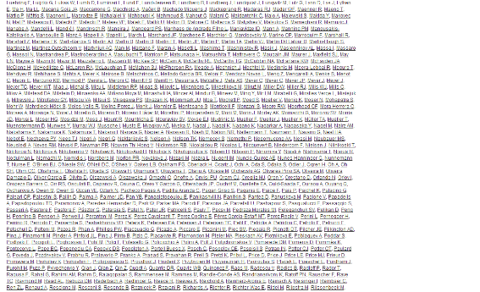
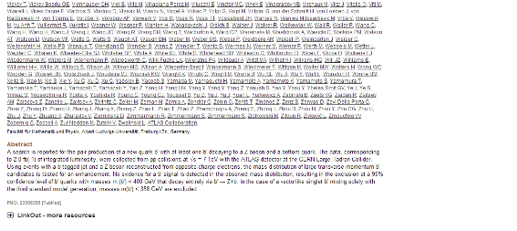
Authorship
Challenges to RI
3040 authors on the byline
2012 paper on particle physics experiment at the Large Hadron Collider at CERN, European Organization for Nuclear Research (http://www.ncbi.nlm.nih.gov/pubmed/23006356).

Slide 10
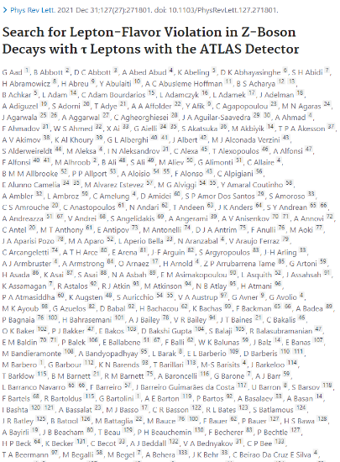
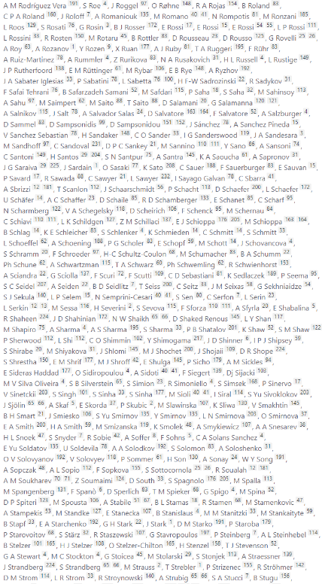
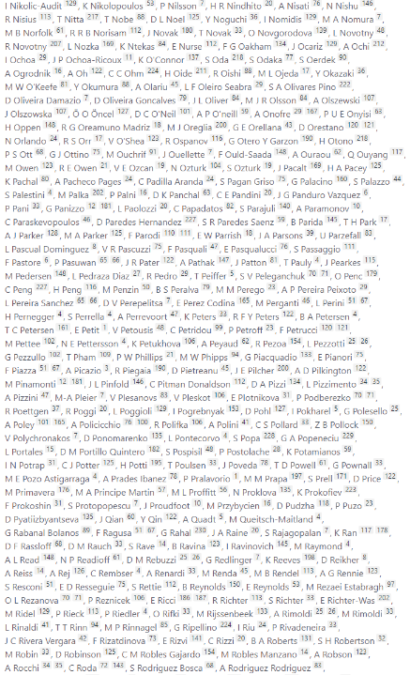
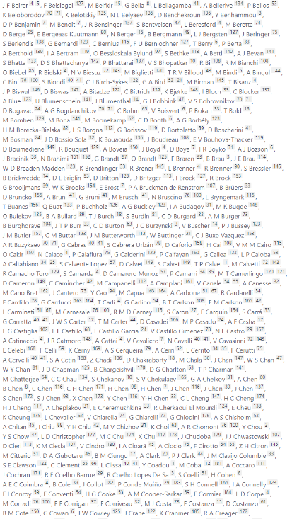
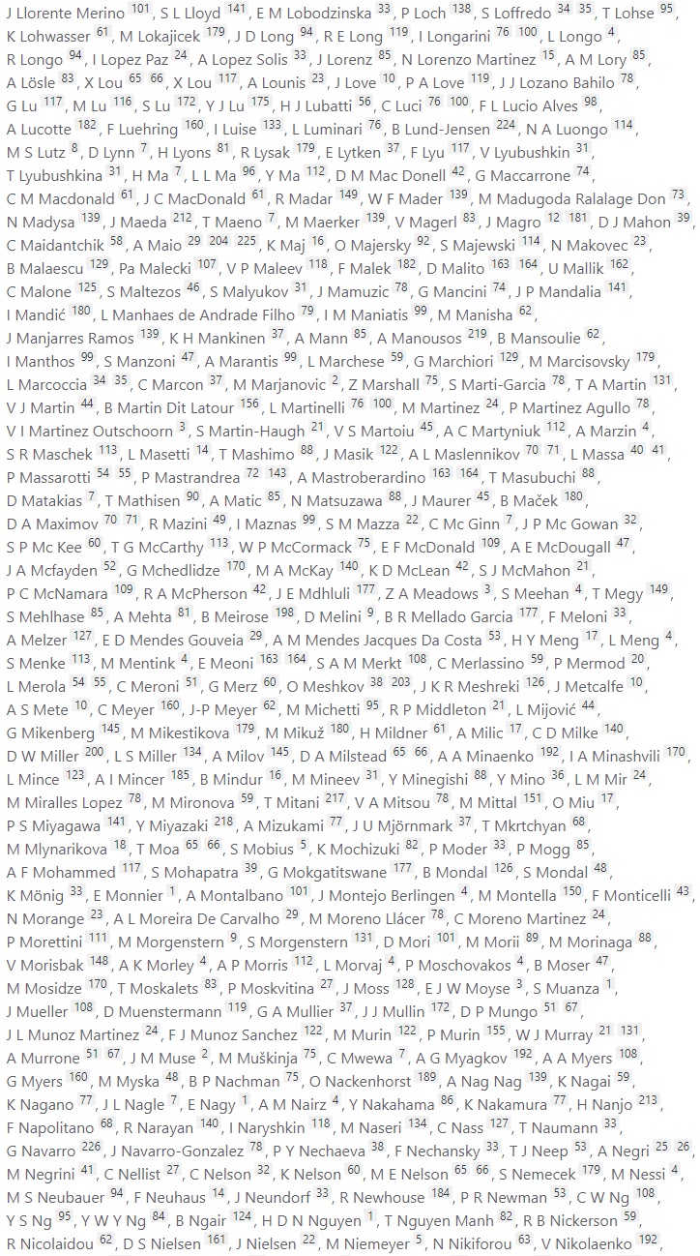
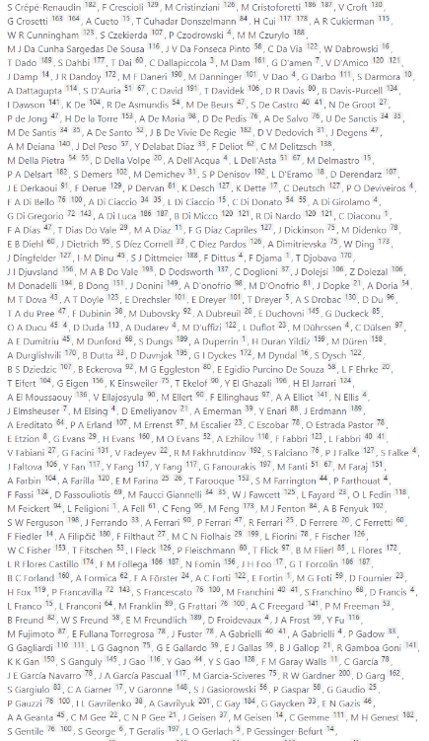
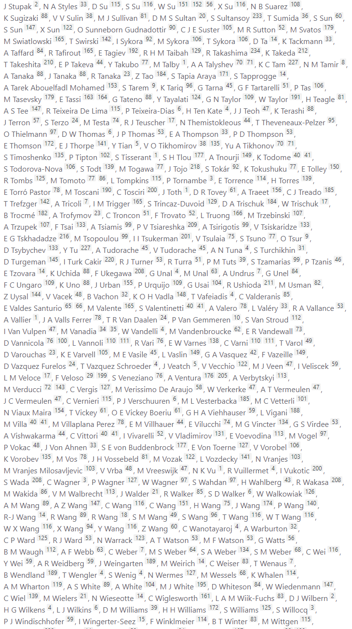
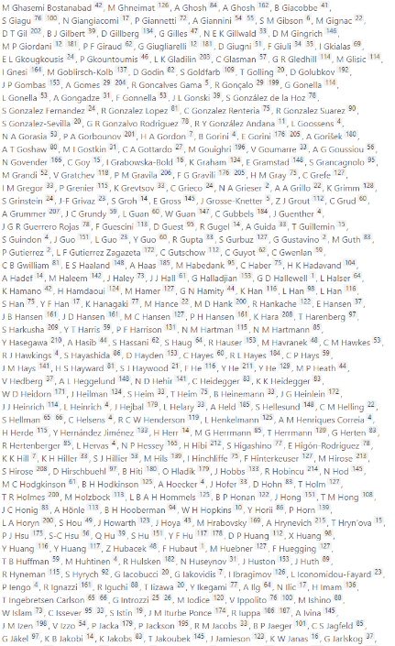
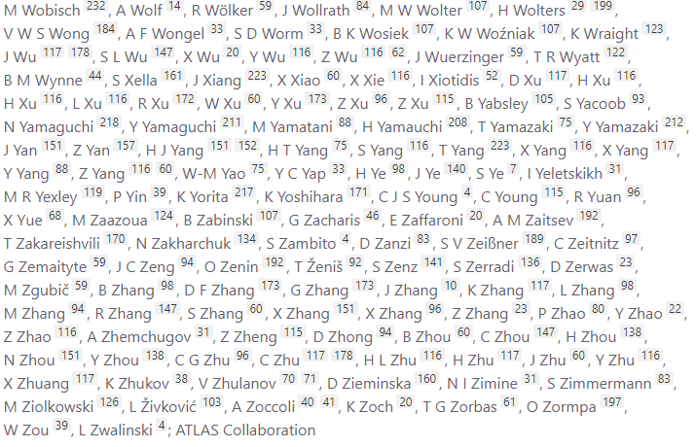
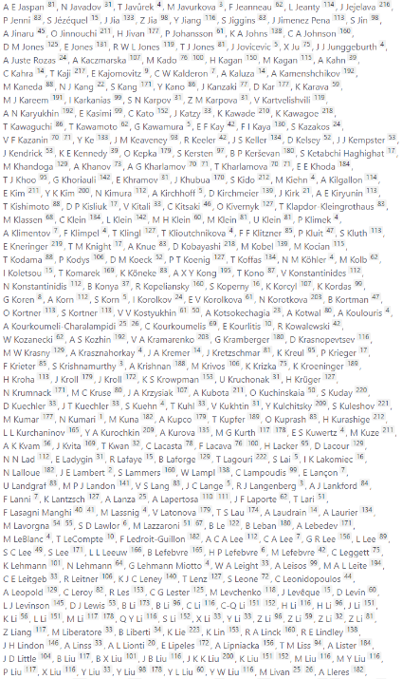
Authorship
Challenges to RI
Phys Rev Lett. 2021 Dec 31;127(27):271801. https://pubmed.ncbi.nlm.nih.gov/35061407/

Slide 11
Authorship
Challenges to RI
Marušić A, Bošnjak L, Jerončić A. A systematic review of research on the meaning, ethics and practices of authorship across scholarly disciplines. PLoS One. 2011;6(9):e23477
Hosseini M, Gordijn B. A review of the literature on ethical issues related to scientific authorship. Account Res. 2020 Jul;27(5):284-324.
Authorship perceptions, definitions, and practices (n=58 articles)
Order of authors on the byline (n=45)
Ethical and unethical authorship practices (n=46)
Power issues in authorship (n=19)
Attribution (n=100 articles)
Violations of the norms of authorship (n=94)
Bias (n=81)
Responsibility and accountability (n=46)
Authorship order (n=43)
Citations and referencing (n=43)
Definition of authorship (n=38)
Publication strategy (n=37)
Originality (n=35)
Sanctions (n=16)
Prevalence of authorship problems 29% (95%CI 24-35%)
743 autora

Slide 12
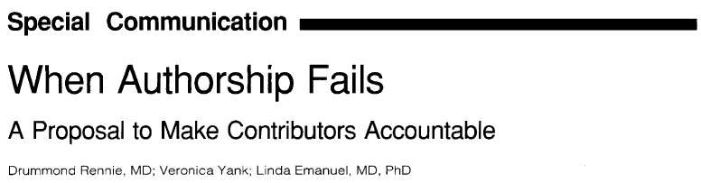
Authorship vs contributorship
Challenges to RI
We propose dropping the outmoded notion of author in favor of the more useful and realistic one of contributor. This requires disclosure to readers of the contributions made to the research and to the manuscript by the contributors, so that they can accept both credit and responsibility. In addition, certain named contributors take on the role of guarantor for the integrity of the entire work.
743 autora

Slide 13
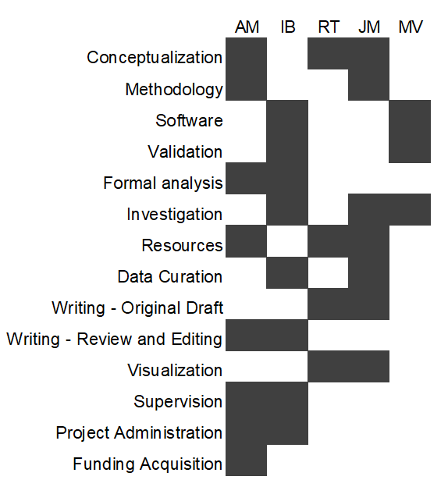
Authorship
Challenges to RI
CRediT (Contributor Roles Taxonomy)
Term | Definition
Conceptualization | Ideas; or evolution of overarching research goals and aims
Methodology | Development or design of methodology; creation of models
Software | Programming, software development; designing computer programs; implementation of the computer code and supporting algorithms; testing of existing code components
Validation | Verification, whether as a part of the activity or separate, of the overall replication/ reproducibility of results/experiments and other research outputs
Formal analysis | Application of statistical, mathematical, computational, or other formal techniques to analyze or synthesize study data
Investigation | Conducting a research and investigation process, specifically performing the experiments, or data/evidence collection
Resources | Provision of study materials, reagents, materials, patients, laboratory samples, animals, instrumentation, computing resources, or other analysis tools
Data curation | Management activities to annotate (produce metadata), scrub data and maintain research data (including software code, where it is necessary for interpreting the data itself) for initial use and later reuse
Writing - Original Draft | Preparation, creation and/or presentation of the published work, specifically writing the initial draft (including substantive translation)
Writing - Review & Editing | Preparation, creation and/or presentation of the published work by those from the original research group, specifically critical review, commentary or revision – including pre-or postpublication stages
Visualization | Preparation, creation and/or presentation of the published work, specifically visualization/ data presentation
Supervision | Oversight and leadership responsibility for the research activity planning and execution, including mentorship external to the core team
Project administration | Management and coordination responsibility for the research activity planning and execution
Funding acquisition | Acquisition of the financial support for the project leading to this publication
Brand et al., Learned Publishing 2015; 28(2)
743 autora

Slide 14
Equal autorship
Challenges to RI
Conte et al. FASEB J. 2013;27(10):3902-4.
Change from no joint first authorship in 1990 to co-first authorship of >30% of all research publications in 2012.
Resnik et al. Account Res. 2020;27(3):115-137.
Survey of 1,540 researchers:
58% had been designated as an EC at least once.
38% regarded these designations as useful but ethically questionable.
32% said EC designations are ethically questionable because ECs are difficult to define or measure an
26% said they are ethically questionable because people rarely contribute equally.
Lount & Pettit. Shared first authorship should be declared on academic CVs. Nat Hum Behav. 2023;7(5):659.
743 autora

Slide 15
Group autorship
Challenges to RI
Hosseini et al. Accountability in Research, DOI: 10.1080/08989621.2024.2322557
Group authorship, an excellent opportunity laced with ethical, legal and technical challenges
Group (corporate, team, consortium) authorship – attribution practices that use the name of a collective in the authorship byline
Ethical challenges – attribution of credit and responsibilities
Legal challenges – how copyrights are handled
Technical challenges – lack of persistent identifiers (PIDs) for groups.
743 autora

Slide 16
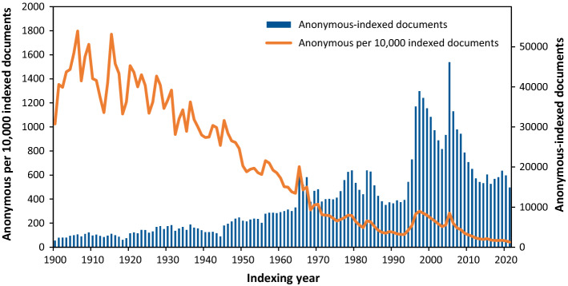
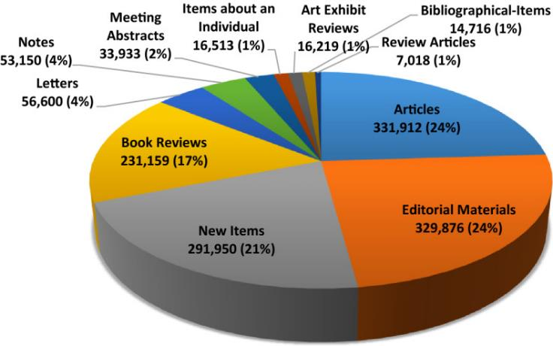
Anonymous authorship
Challenges to RI
Shamsi A et al. A grey zone for bibliometrics: publications indexed in Web of Science as anonymous. Scientometrics. 2022;127(10):5989-6009.
(WoSCC), 1,420,842 documents under "anonymous" authorship in Web of Science Core Collection from 1900 to 2021 (1.5% of the total indexed documents)

Slide 17
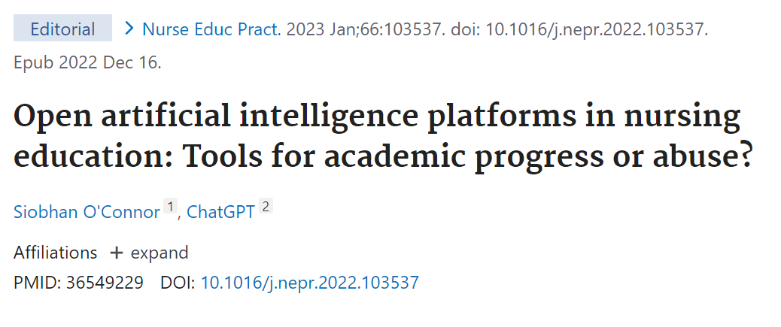
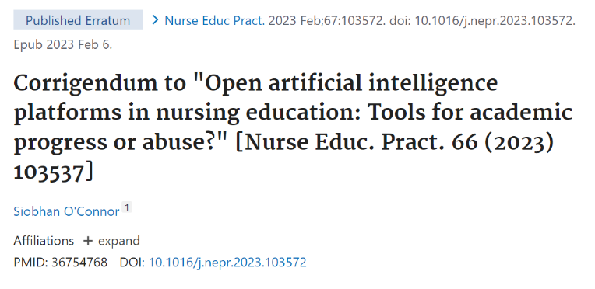
AI
Challenges to RI
“Artificial intelligence (AI) refers to systems that display intelligent behaviour by analysing their environment and taking actions – with some degree of autonomy – to achieve specific goals.” – European Commission
By January 18, 2023, four studies in the PubMed database had ChatGPT listed as a co-author
743 autora

Slide 18

AI
Challenges to RI
World Association of Medical Editors, 2023
Chatbots cannot be authors.
Authors should be transparent when chatbots are used and provide information about how they were used.
Authors are responsible for the work performed by a chatbot in their paper (including the accuracy of what is presented, and the absence of plagiarism) and for appropriate attribution of all sources (including for material produced by the chatbot).
Editors need appropriate tools to help them detect content generated or altered by AI and these tools must be available regardless of their ability to pay.
743 autora

Slide 19
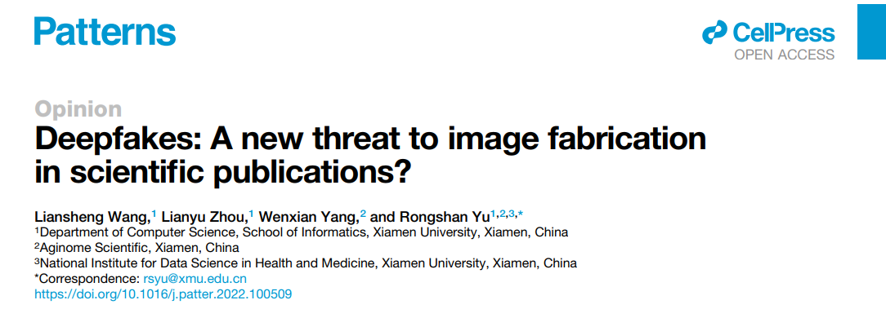
AI
Challenges to RI
Based on large number of existing images, convincing “deepfakes” can be created in scientific contexts as well
Wang et al. (2022) trained an AI model to generate western blots (from 3000 authentic images) and images of oesophageal cancer on gastroscope images from cancer-free locations of intestine (from 50 positive and 50 negative locations)
https://doi.org/10.1016/j.patter.2022.100509

Slide 20
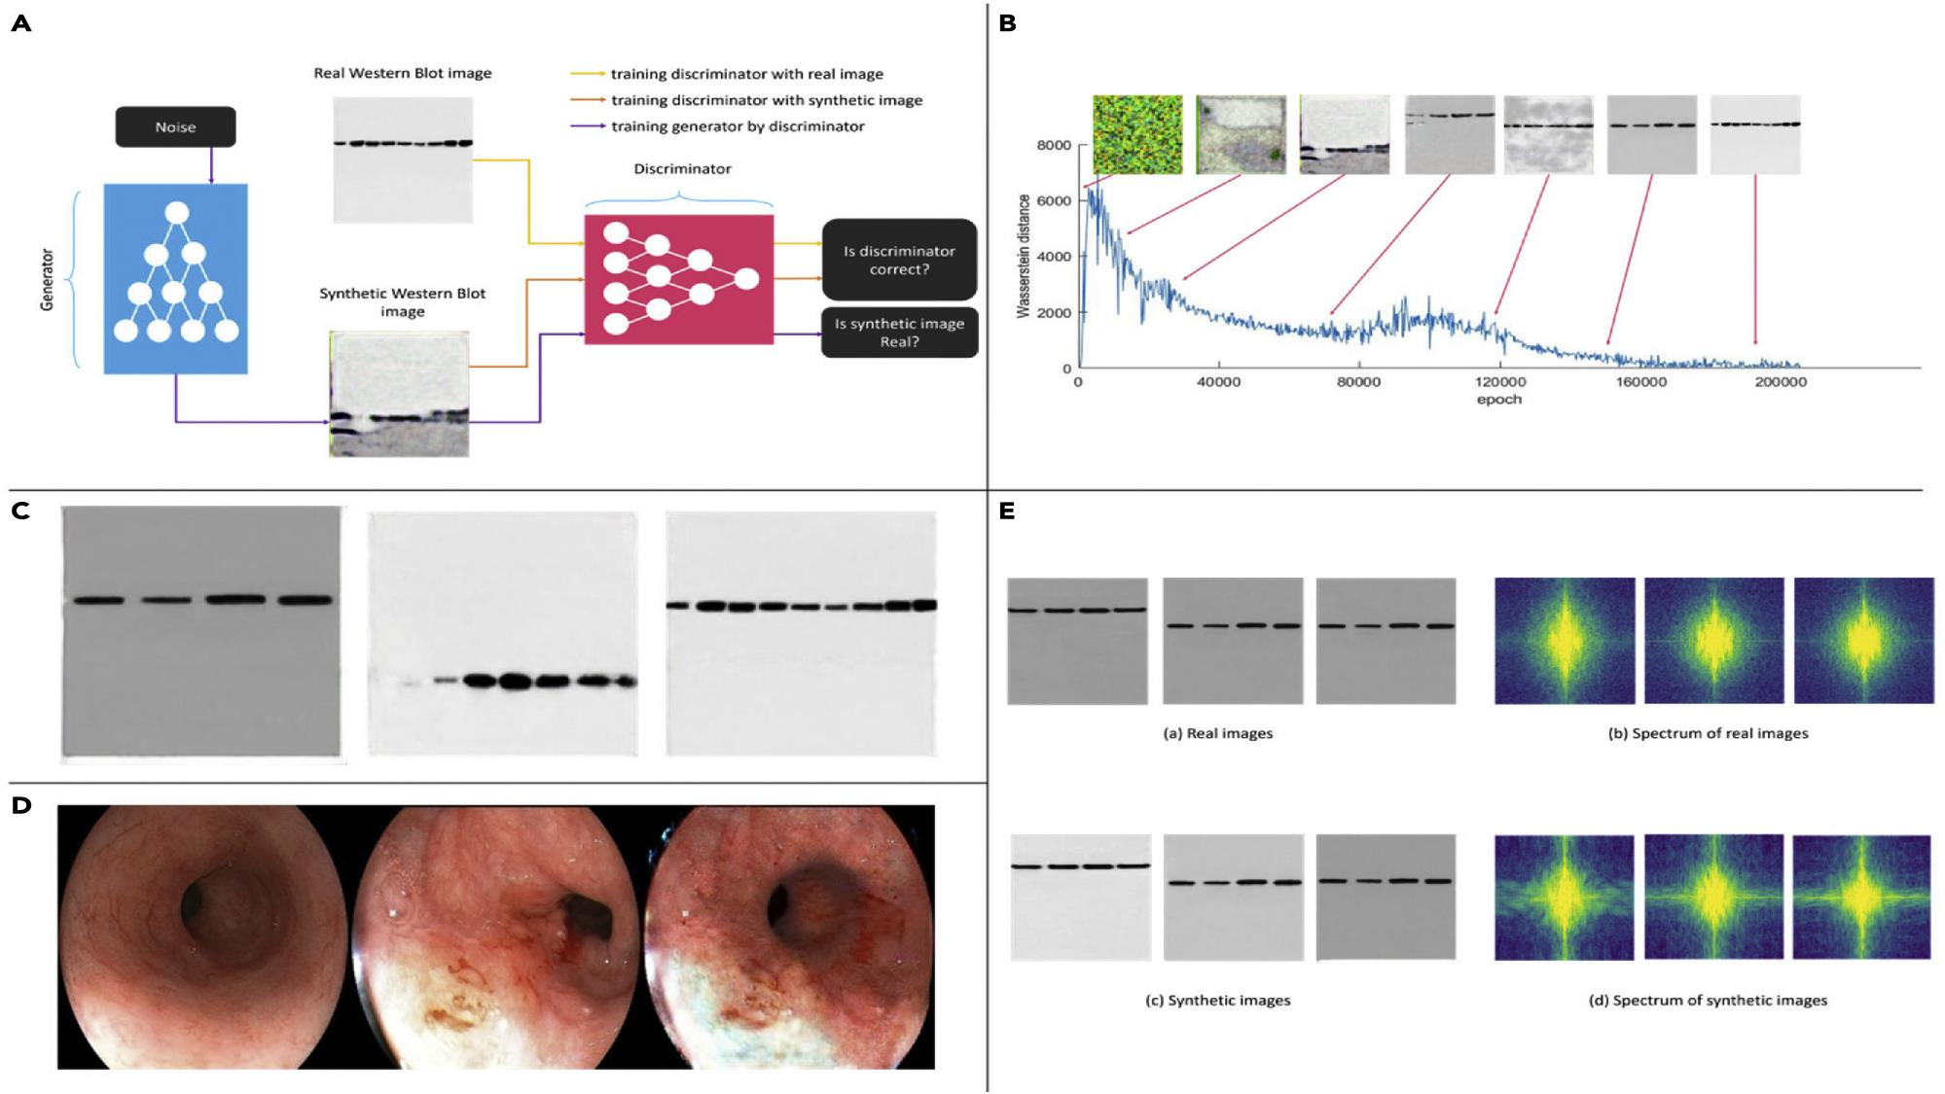
Challenges to RI
Based on large number of existing images, convincing “deepfakes” can be created in scientific contexts as well
Wang et al. (2022) trained an AI model to generate western blots (from 3000 authentic images) and images of oesophageal cancer on gastroscope images from cancer-free locations of intestine (from 50 positive and 50 negative locations)

Slide 21
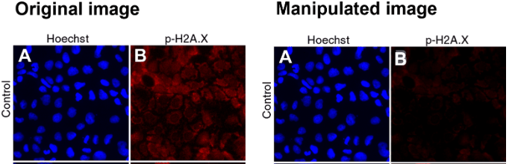
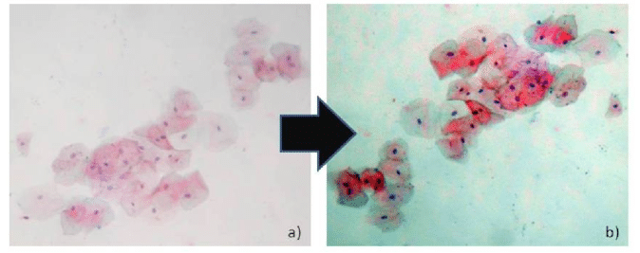
Image manipulation
Image Manipulation and Research Misconduct:
  Purposeful image manipulation to distort scientific experiment results is categorized as severe research misconduct.
  Manipulations encompass various techniques, such as cropping, color adjustment, selective enhancement, and duplication.
Figure taken from FigShare (https://doi.org/10.1371/journal.pone.0042720.g004)
Chowdhry et al. Int J Pathol Clin Res 2019, 5:095

Slide 22
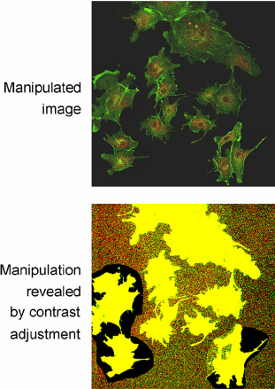

Image manipulation
Prevalence of image manipulation:
  Recent studies have shed light on the higher prevalence of this phenomenon in the scientific community.
  The extent of image manipulation in science is greater than previously perceived.
  ~4% of the surveyed papers contained some form of image duplication or manipulation (Bik et al, 2016).
Rossner and Yamada (2004)
https://www.stm-assoc.org/stm-integrity-hub/

Slide 23

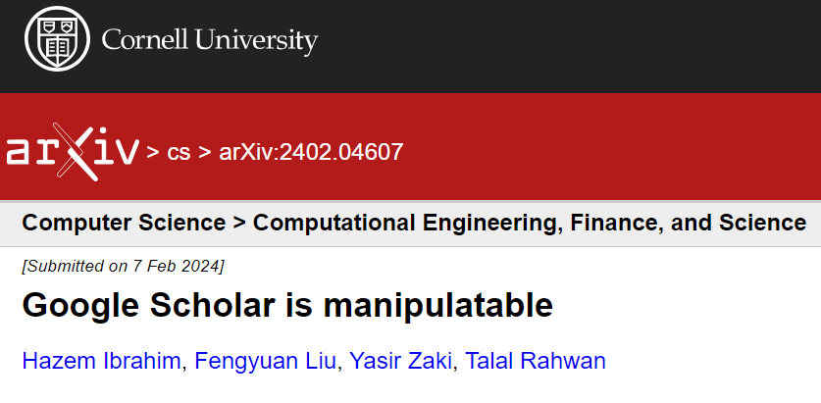
Papermills
Challenges to RI
The process by which manufactured manuscripts are submitted to a journal for a fee on behalf of researchers with the purpose of providing an easy publication for them, or to offer authorship for sale
COPE & STM. Paper Mills — Research report from COPE & STM — English. https://doi.org/10.24318/jtbG8IHL ©2022 Committee on Publication Ethics (CC BY-NC-ND 4.0) Version 1: June 2022
https://www.stm-assoc.org/stm-integrity-hub/

Slide 24
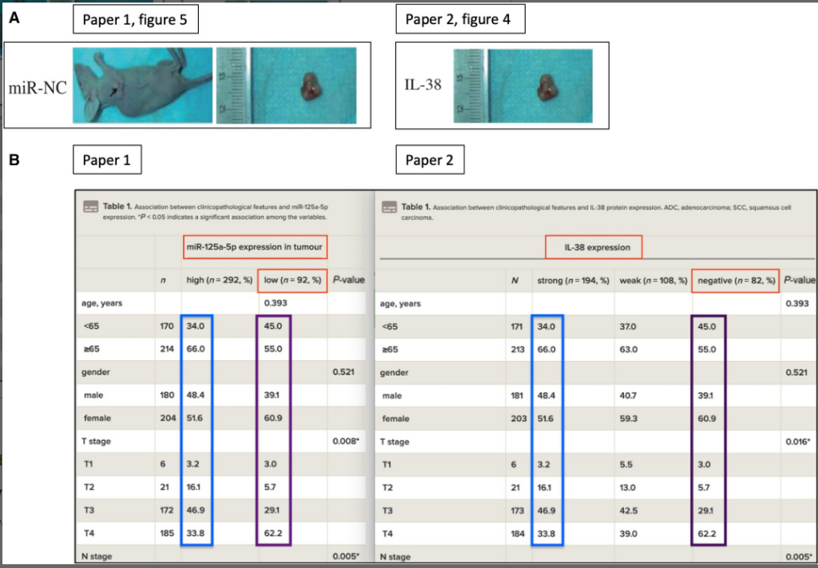
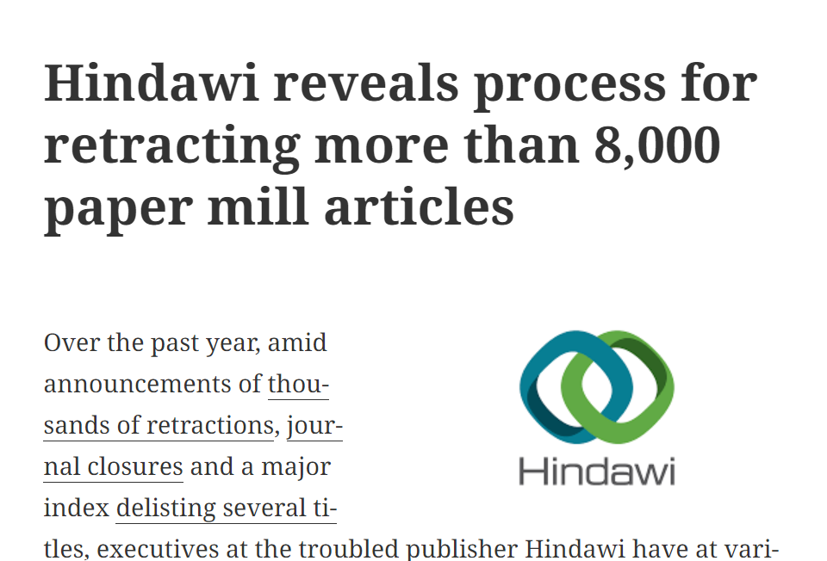
Papermills
Challenges to RI
Christopher J. The raw thruth about paper mills. FEBS Letters. 2021;595(13):1751-7.
https://doi.org/10.1002/1873-3468.14143
https://retractionwatch.com/2023/12/19/hindawi-reveals-process-for-retracting-more-than-8000-paper-mill-articles/

Slide 25
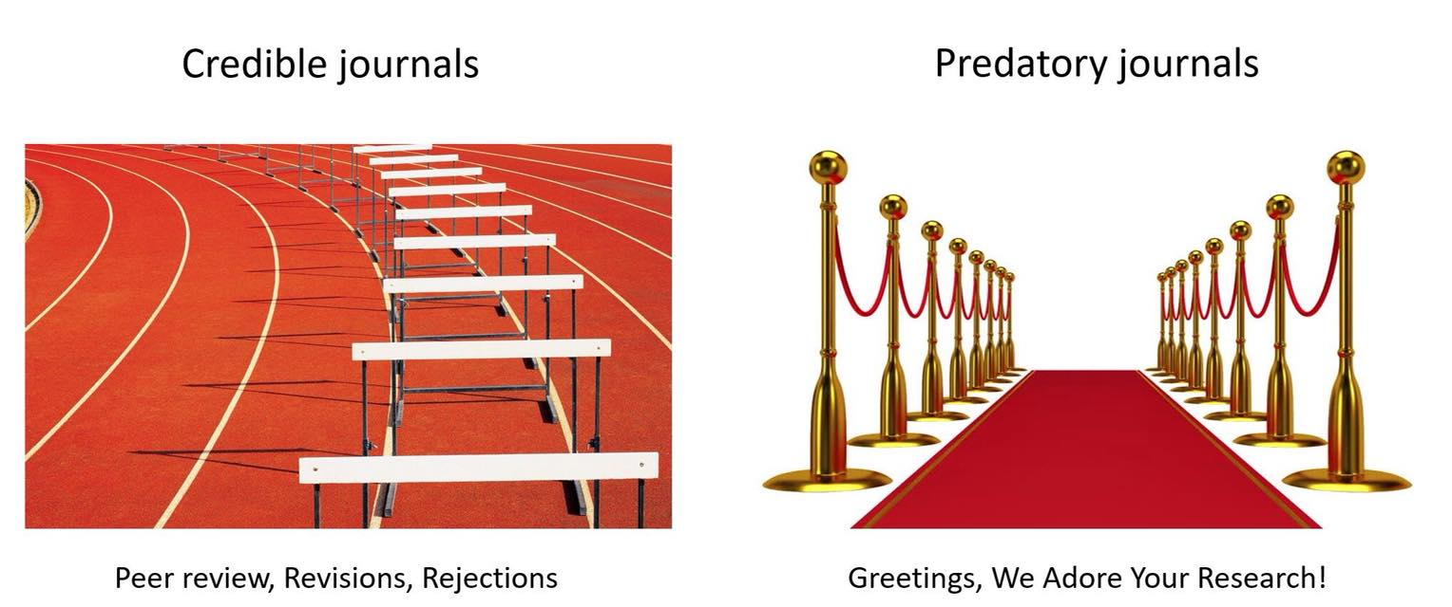
Predatory journals
Challenges to RI
https://twitter.com/AcademicsSay

Slide 26
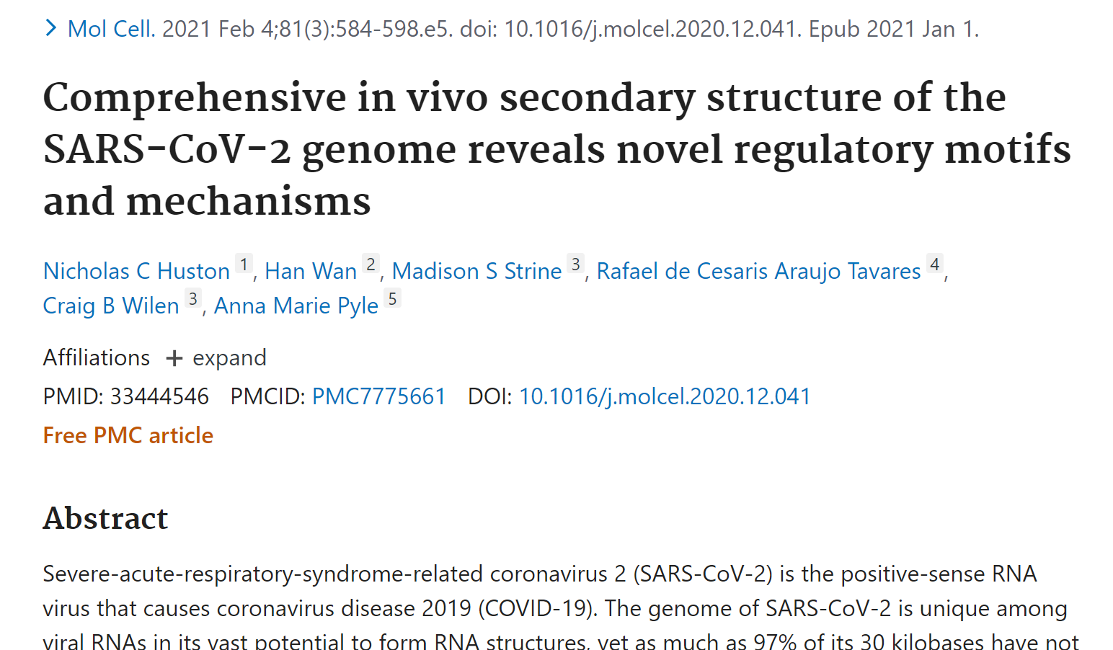
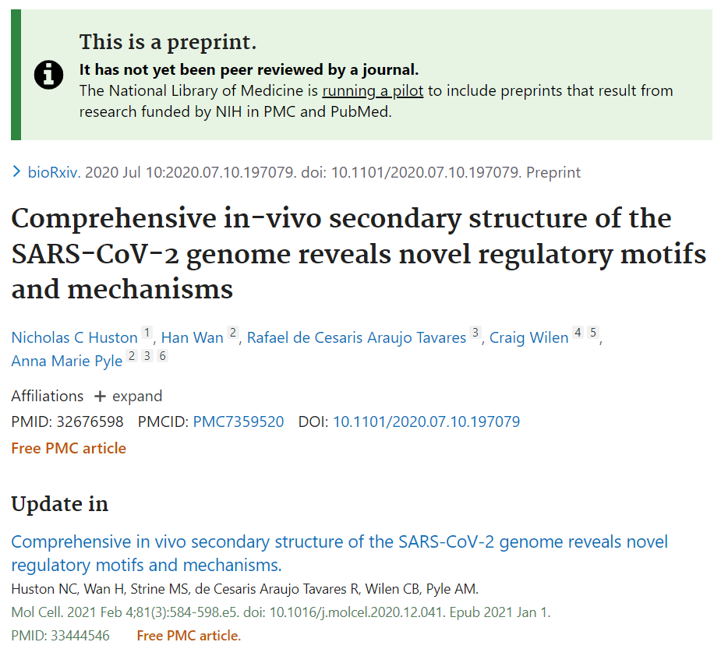
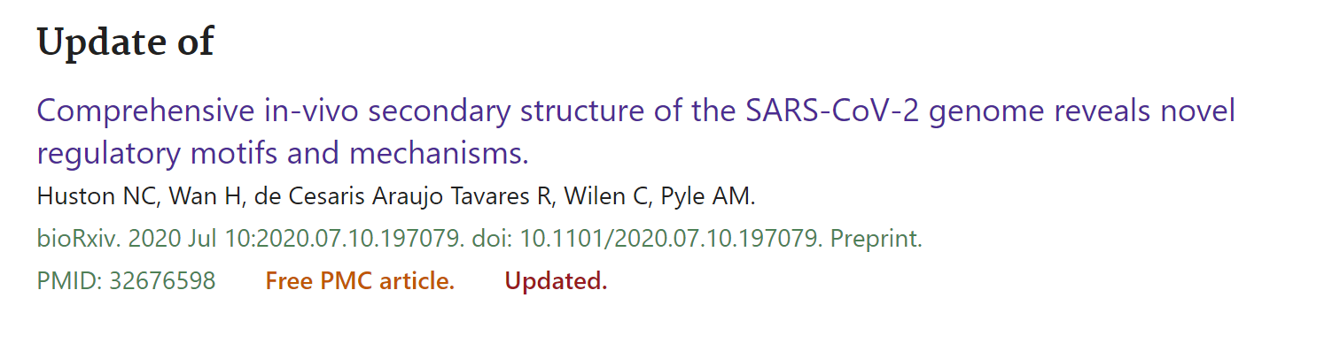
Preprints

Slide 27

Preprints
Inform the journal and provide a link to the preprint.
Indicate in the text of the manuscript, perhaps in the introduction, that a preprint is available and how reviewers can access that preprint.
Ensure that preprints are amended to point readers to subsequent versions of the work
Do not post in the preprint archive the published article nor interim versions
When citing a preprint in submitted manuscripts or published articles, the citation should clearly indicate that the reference is a preprint.
When a preprint article has been subsequently published in a peer-reviewed journal, cite the subsequent published article rather than the preprint article whenever appropriate.
Be cautious about referencing preprints that were posted and never subsequently published in a peer-reviewed journal.

Slide 28
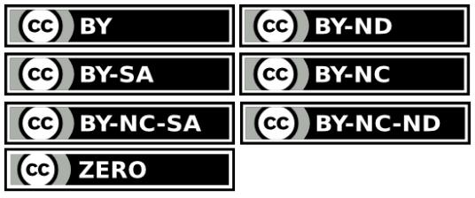
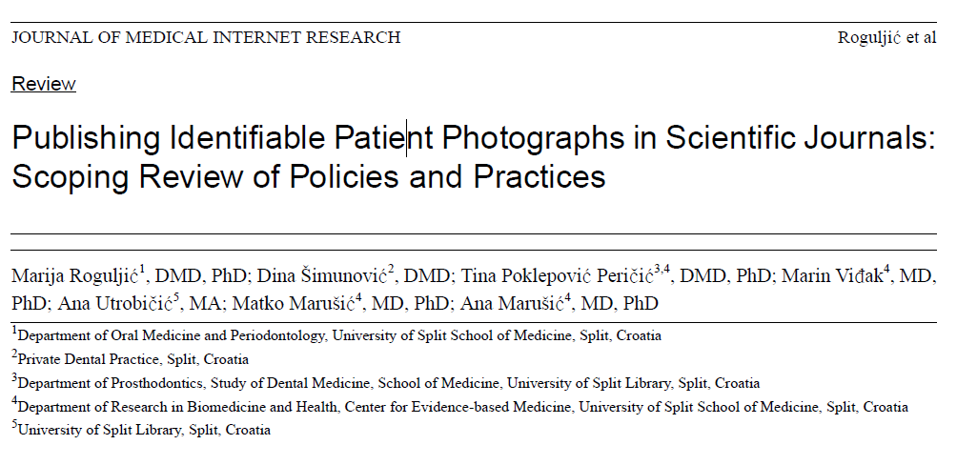
Creative commons licences
Challenges to RI
http://creativecommons.org/licenses/
Creative Commons develops, supports, and stewards legal and technical infrastructure that maximizes digital creativity, sharing, and innovation.
Challenge: identifying photographs
of individuals in medical literature

Slide 29






Reviewing and Assessment
Challenges to RI
Single blind
Double blind
Consultative
Results free review
Open peer review
Post-publication
Physical Review, 1936
Notes:
Figure 2. A brief timeline of the evolution of peer review: The revolution.
See text for more details on individual initiatives. The interactive data visualization is available at https://dgraziotin.shinyapps.io/peerreviewtimeline, and the source code and data are available at https://doi.org/10.6084/m9.figshare.5117260
Tennant JP, Dugan JM, Graziotin D et al.. A multi-disciplinary perspective on emergent and future innovations in peer review [version 2]. F1000Research 2017, 6:1151 (doi: 10.12688/f1000research.12037.2)

Slide 30
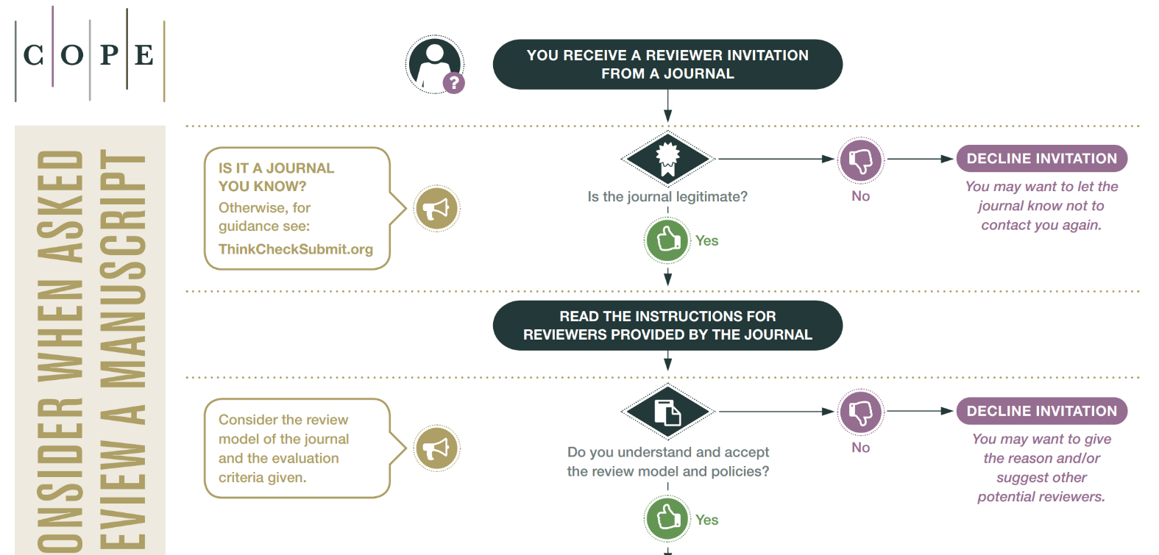
Reviewing and Assessment
Challenges to RI
https://publicationethics.org/files/What-to-consider-when-asked-to-PR.pdf

Slide 31




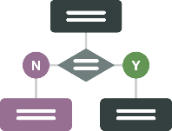





COPE ACTIVITIES & RESOURCES
100+ Forums (members only) held since 1997; 648 cases
with advice on COPE’s website
Flowcharts: step by step guides
Guidelines: formal policy
documents
Community discussions and discussion documents on emerging issues
Webinars and videos of COPE speakers at events
COPE seminars (members only) held globally
Joint founder of Principles of Transparency and Best Practice in Scholarly Publishing
eLearning (members only)
Journal Audit (members only)

Slide 32











COPE CORE PRACTICES
Policies and core practices required to reach the highest standards in publication ethics:
Allegations of misconduct
Authorship and contributorship
Complaints and appeals
Conflicts of interest/ Competing interests
Data and reproducibility
Ethical
oversight
Intellectual property
Journal management
Peer review processes
Post-publication discussions and corrections

Slide 33

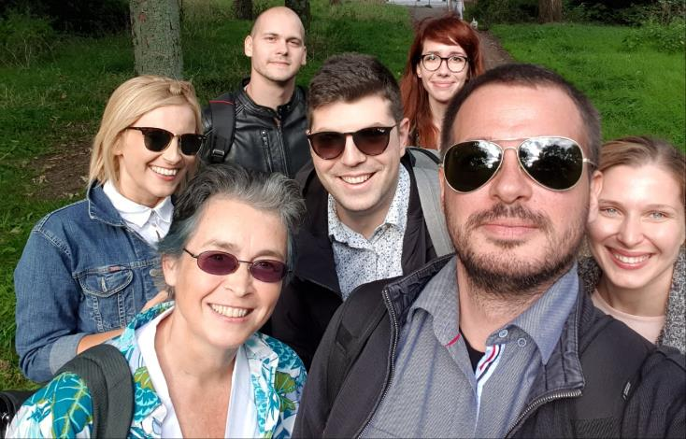

Instead of a conclusion
An open-access textbook on RI for early career researchers, written by early career researchers
https://link.springer.com/book/10.1007/978-3-031-22412-6

Slide 34




https://embassy.science/wiki/Main_Page
https://www.irise-project.eu/
https://tier2-project.eu/
https://osiris4r.eu/

Slide 35



Thank you!

