Slide 1
The role of the EU in the development of EOSC: State of Play & Challenges Ahead
Croatia National Tripartite Event Zagreb, 19 April 2024
Yannis Rodopoulos
Legal & Policy officer
Open Science & Research Infrastructures
DG RTD, European Commission

Slide 2
The role of the EU in the development of EOSC: State of Play & Challenges Ahead
Yesterday
The emergence of EOSC in the context of a broader EU policy on Open Science
Today
Towards the creation of EOSC Federation:
The deployment of the EOSC EU node
Tomorrow
EOSC post-2027: Scenarios under discussion

Slide 3
EOSC in the context of a broader EU policy on Open Science
What is EOSC ?
A process
Accelerate Open Science, FAIR data management and use of digital methods and services
Stimulate co-operation in science and research, new insights and innovations, higher research productivity and improved reproducibility in science.
An open, trusted, federation of infrastructure
Access existing Research Infrastructures in Europe;
Enable circa 2 million European researchers to store, share, process, analyze, and reuse research digital objects (e.g. data, publications and software)
An evolving ecosystem
Bringing together the European Commission, the governments and the many R&I stakeholders involved in the European Research Area
Co-created across European, national, and institutional levels

Slide 4
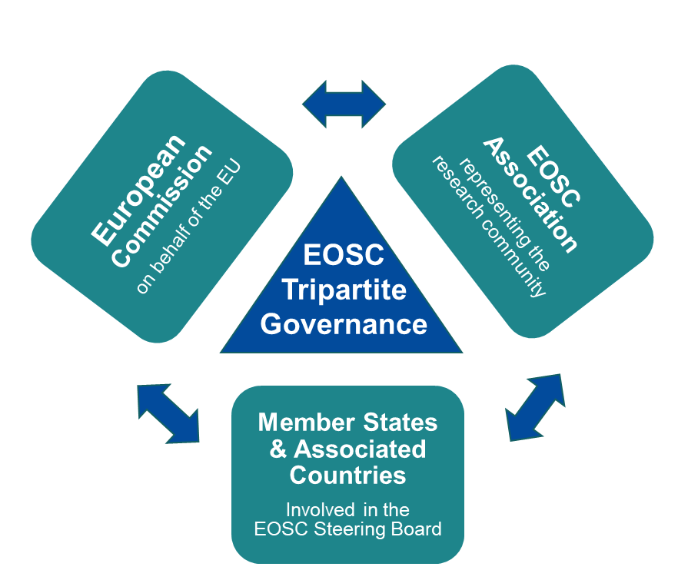
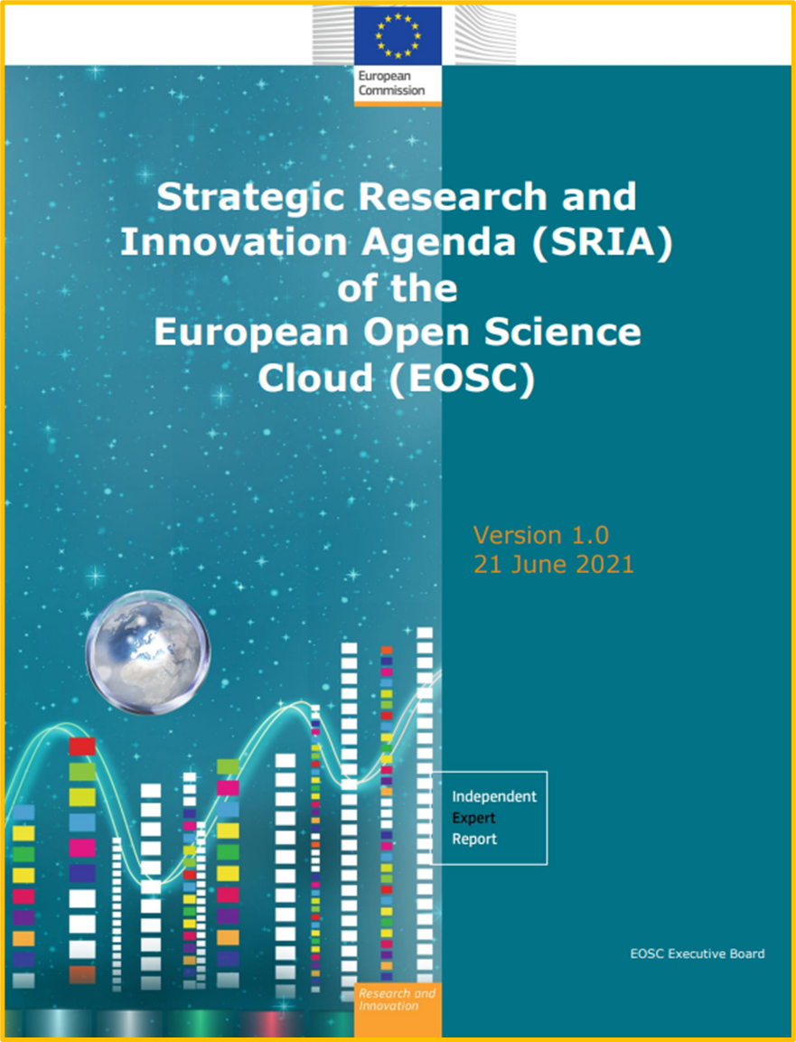
EOSC in the context of a broader EU policy on Open Science

Slide 5
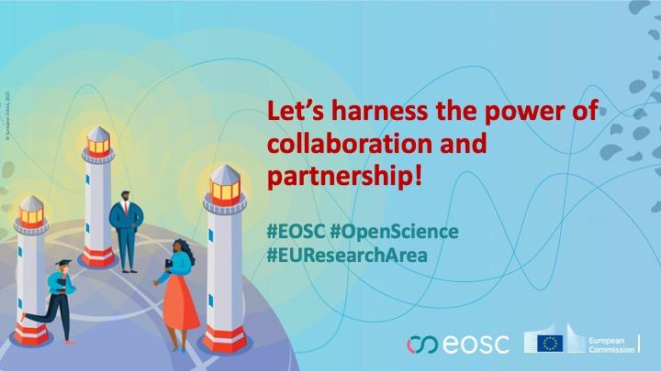
EOSC in the context of a broader EU policy on Open Science
2015 | Council Conclusions on ‘open, data-intensive and networked research as a driver for faster and wider innovation’
2016 | Council Conclusions on ‘the Transition Towards an Open Science System’
2017 | EOSC Declaration (#1): The European Open Science Cloud – New research and innovation opportunities
2018 | Council conclusions on ‘European Open Science Cloud (EOSC)’
2020 | EOSC declaration (#3) by the German Presidency of the EU “Opening the Door to a World of FAIR Research Digital Objects – On the Threshold to the European Open Science Cloud”

Slide 6
EOSC in the context of a broader EU policy on Open Science
2020 | Commission Communication on ‘A new ERA for Research & Innovation’
2021 | Council Recommendation on ‘A Pact for Research and Innovation in Europe’
2021 | Council Conclusions on the ‘Future governance of the European Research Area’
2022 | Council Conclusions on ‘Research assessment and implementation of Open Science’
2023 | Council Conclusions on ‘High-quality, transparent, open, trustworthy and equitable scholarly publishing’

Slide 7
EOSC in the context of a broader EU policy on Open Science
“A central pillar of this strategy is the creation of a European Knowledge Commons – a centralised, digital platform providing access to publicly funded research, data sets, and educational resources. This empowers citizens, researchers, and businesses alike, allowing them to tap into a wealth of knowledge for innovation and societal progress. To remove barriers to knowledge sharing, the EU must harmonise cross-border data flow mechanisms, particularly interoperability and data protection regulations, and invest in robust digital infrastructure. This facilitates the secure and efficient transfer of non-personal data vital to research and innovation within the EU, supporting the development of European data spaces in key sectors - the chapter on health will focus on the European Health Data Space (EHDS) - to promote data sharing and use for the benefit of the economy and society, and strengthen cybersecurity through regulations, standards, and practices that protect critical infrastructures and citizens' data.”

Slide 8
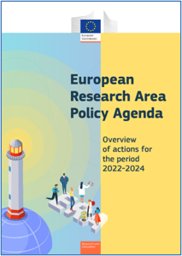
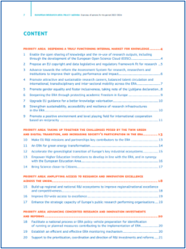
EOSC in the context of a broader EU policy on Open Science
ERA ACTION 1​
Enable the open sharing of knowledge and the re-use of research outputs, including through the development of the European Science Cloud (EOSC)​
​
OUTCOMES​
Deploy Open Science Principles and identify Open Science best practices​
Deploy the core components and services of EOSC and federate existing data infrastructures in Europe, working towards the interoperability of research data​
Establish a monitoring mechanism to collect data and benchmark investments, policies, digital research outputs, open science skills and infrastructure capacities related to EOSC​

Slide 9
EOSC in the context of a broader EU policy on Open Science
Embracing open science as the modus operandi of research
Developing the enablers
Incentives and rewards to adopt open science practices, e.g. initiative for Reforming Research Assessment
Legislative and regulatory framework for practicing open science
An EU data, copyright and digital legislative framework fit for research
Horizon Europe provisions on Open Access and Open Science practices
Open research infrastructures and skills e.g.
European Open Science Cloud (EOSC)
Open Research Europe publishing service¹
EU Open Research Repository²
Support for skills & education for practicing open science
Improving the practice
Providing full and immediate open access to scientific publications, research data, models, algorithms, software, protocols, notebooks, workflows, and all other research outputs
Research output management - publications, data, and other outputs - in line with FAIR principles
Early and open sharing of research, e.g.
Pre-registration, registered reports, data deposition in shared repositories, pre-prints
Ensuring verifiability and reproducibility of research outputs
Open collaboration within science and with other knowledge producers/users, incl. citizens, civil society and end users

Slide 10
EOSC in the context of a broader EU policy on Open Science
Developing skills and competencies for researchers
Skills4EOSC ‘Skills for the European Open Science commons: creating a training ecosystem for Open and FAIR science’ is funded by the European Commission Horizon Europe programme (GA 101058527). Coordinated by Consortium GARR and supported by 44 partners in 18 European countries, Skills4EOSC will set up a pan-European network of competence centres to speed up the training of European researchers and harmonise the training of new professional figures for scientific data management.
The project officially started on the 1st of September 2022. Over the next three years, it will work to provide Open Science Commons and create an EOSC-ready skilled European workforce, connecting existing Competence Centres in open science and scientific data management. The aim is to develop common methodologies, activities and training resources to unify the current training landscape into a collaborative and reliable ecosystem and to provide dedicated community-specific support to leverage the potential of EOSC for open and data-intensive research.

Slide 11
Towards the creation of EOSC Federation: The deployment of the EOSC EU node
EOSC EU Node Value Proposition
Facilitate the creation of the “Web of FAIR data and interoperable services” (aka. EOSC Federation) under the Open Science Policy
Put a “seed in the ground” by operationalizing the first recognised EOSC Node at the European level for the initial 3 years
Offer “core services” for scientific research infrastructures to federate (single-sign-on, catalogues, knowledge graph, application workflow, monitoring, accounting, helpdesk) and common “horizontal services” for end-users to benefit from (compute, containers, data transfer, notebooks, file sharing, open research data)
Define the pathway and blueprint (EOSC Interoperability Framework) for other potential EOSC Node operators to join the federation

Slide 12
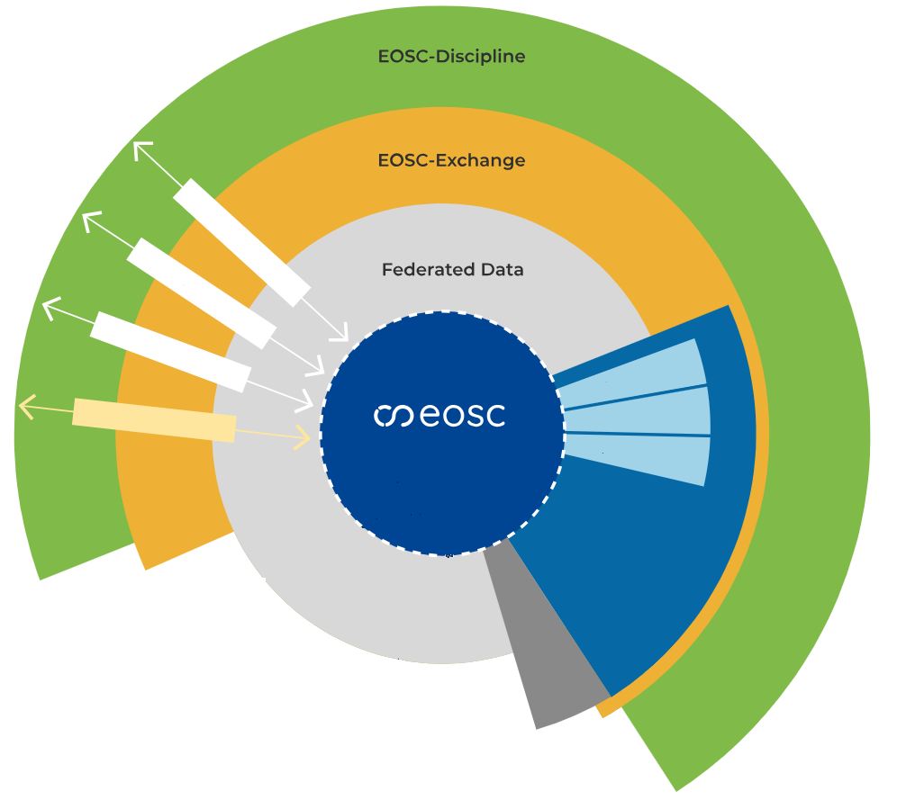
Towards the creation of EOSC Federation: The deployment of the EOSC EU node
Data
Publications
Software
Open Research Europe
Services
Cellar/CORDIS
Core
data.europa.eu
Horizontal Services
EOSC EU Node
Public Procurement Action
EuroHPC

Slide 13
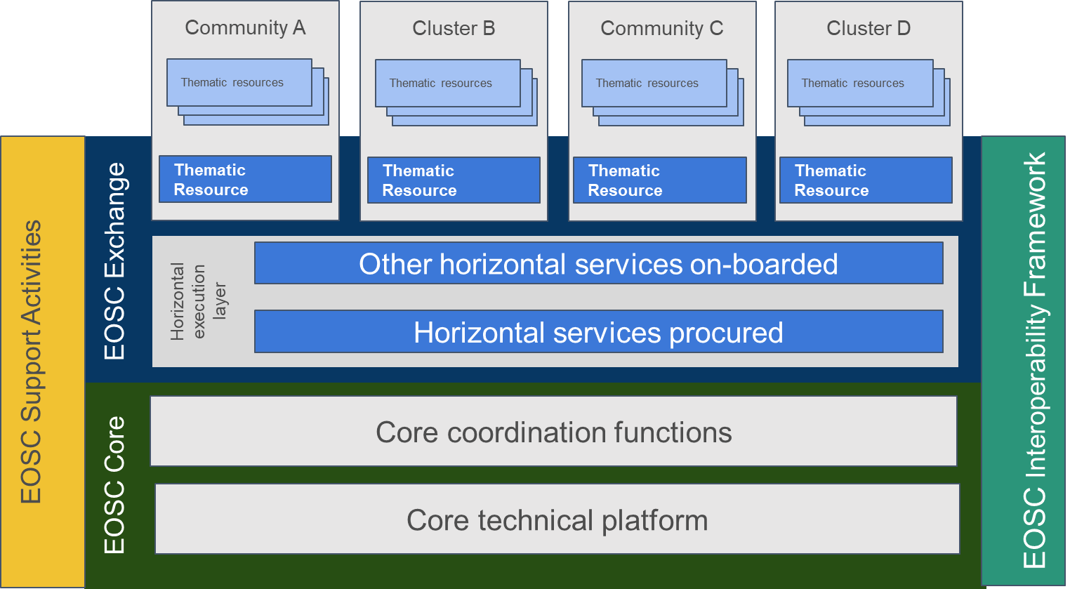
Towards the creation of EOSC Federation: The deployment of the EOSC EU node
USERS
European
EC Public Administration Services
EOSC EU Node
Horizontal Services
EOSC Node X
National
Regional
EOSC Node A
EOSC Node B
EOSC Platform Concept
National Resources
Thematic Cluster
Simpl Agent Proxy
Thematic Resources
Institutional
Institutional Resources
Industry Resources
Common European Data Spaces
EOSC Federated “System of Systems”

Slide 14
Towards the creation of EOSC Federation: The deployment of the EOSC EU node
EOSC EU Node Planned Timeline and Milestones
Planning and architecting of service components
Compliances and approvals (EC IT Governance)
Definition of policies (RoP, AUP, AP)
Production launch of the EOSC EU Node web front-office
Full integration testing of core and exchange services
Integration of EC services (ORE, ODP, CORDIS/Cellar)
Onboarding of flagships to EOSC EU Node
Handover of relevant EOSC Portal functionalities (specs, software, IPO, etc.)
Managing expectations of all stakeholders (providers, users, etc.)
Deployments and staging of core/exchange functionalities
Gradual services roll-out
Quality Assurance Management
Pre-production and production testing
First user experiences
Operations business as usual
EOSC Symposium 2024
EOSC Future extension
Phase-in Period
Takeover
Services design and deployment
Services integration and pre-production testing
Production testing
Production service
Signatures
Start
Launch
14 February 2024
31 March 2024
14 May 2024
14 August 2024
21 October 2024
17 November 2023

Slide 15
EOSC post-2027: Scenarios under discussion

Slide 16
Thank you
© European Union 2024
Unless otherwise noted the reuse of this presentation is authorised under the CC BY 4.0 license. For any use or reproduction of elements that are not owned by the EU, permission may need to be sought directly from the respective right holders.
Notes:
Update/add/delete parts of the copy right notice where appropriate.
More information: https://myintracomm.ec.europa.eu/corp/intellectual-property/Documents/2019_Reuse-guidelines%28CC-BY%29.pdf

