Slide 1
The EOSC Association - building the Federation
Bob JONES
EOSC Association board of directors
Croatia National Tripartite Event, 19 April 2024

Slide 2
The Voice of the Community

Slide 3
The Purpose of the EOSC Association
Incorporation, 29 July 2020
to provide a single voice for the advocacy and representation of the broader EOSC stakeholder community;
(2) to promote the alignment of European Union research policy and priorities with activities coordinated by the Association;
(3) to enable seamless access to data through interoperable services that address the entire research data life cycle.

Slide 4
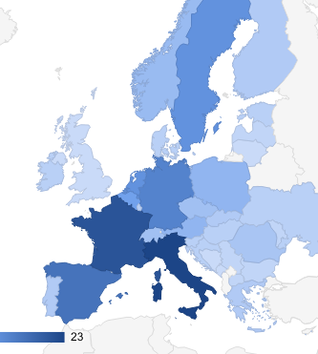
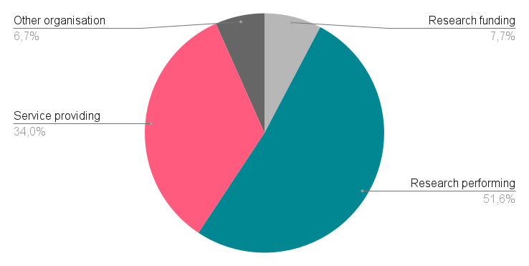
163 Members and 89 Observers
A strong memberbase

Slide 5
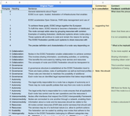
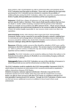
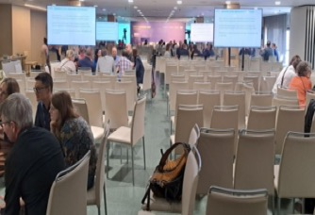
Evolution of Node Concept in 2023
Spring
July
September
October
November
Introduction EOSC EU Node and concept of nodes by EC
Meetings with Mandated Organisations and ESFRI RI Working Group to prepare September workshops, 03./04.07
Community Workshops MOs & ESFRI RI WG (08./15.09.)
Unconference EOSC Symposium (21.09.)
Publication of Draft Position Paper on the EOSC Federation and the role of Nodes (13.10.) &
Consultation
Publication of revised version of Draft Position Paper (12.11.)
&
Consultation

Slide 6
The EOSC Federation and the role of Nodes
Main points in the position paper
https://eosc.eu/wp-content/uploads/2023/11/20231112-Short-paper-on-the-EOSC-Federation-draft-v3.pdf
EOSC Federation
is a federation of distributed systems (‘system of systems’)
enables collaboration to achieve common goals and users to access additional resources beyond their usual environment
has policies and rules defined by the legal entity governing the EOSC Federation
consists of multiple “Nodes“
can be scaled by adding more Nodes
EOSC Nodes
contain resources adding value to the Federation
act as the legal representative that can interact with EOSC’s governance structure
offer interfaces that comply with the EOSC Interoperability Framework
control their own operations and resources and ensure that policies are followed within the Node
may vary in their local policies, the resources to which they provide access and the infrastructure on which they are built
Initiatives (European, national, regional, institutional or thematic) may join the EOSC Federation and become EOSC Nodes when they meet the requirements listed above

Slide 7
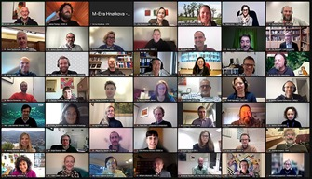
Evolution of Node Concept in 2024
January
February
March
April
May
16/17 January: 2 Community webinars
Integration of community feedback & drafting of table of contents for EOSC Federation Handbook
Discussion of EOSC Federation Handbook concept with EC and EOSC-SB Policy Group
Presentation of “Minimum requirements of Nodes” draft at European Tripartite Event, 16 April
15 May:
online workshop with potential Candidate Nodes

Slide 8
EOSC Federation Handbook co-creation
Aim – prepare a handbook for the EOSC Federation of Nodes which covers the essential aspects of the purpose of the federation, what a node is, how to join, rules of governance, value proposition and rules of participation
Who – driven by the EOSC-A and encouraging all interested parties (EC, Member states/ACs, RIs, EOSC-A members, etc.) who want to participate in the co-creation of the Handbook
Process – the document will be written collaboratively with open consultations, meetings, sprints
Contributing events during 2024, including:
Tripartite events preparing for the post 2027 governance
EOSC-A General Assembly consultation sessions with members (May)
Milestones in the deployment of the EOSC EU Node
EOSC Symposium presentation and review of Handbook (October)

Slide 9
EOSC Federation Handbook (draft outline)
Purpose
Goals & purpose of EOSC federation
Operational structure and responsibilities
Federating Entity
Nodes
Use Cases
Governance and legal framework
Governance structure
Legal framework
Policies (Rules of Participation, Access Policy, Acceptable Usage Policy, ELSI, IP, etc.)
Communication and External Relations
Risk management
EOSC platform
FAIR Data & Services (Core, Exchange)
Interoperability (EOSC Interoperability Framework)
Links to external entities (e.g. other data spaces, EuroHPC, etc.)
Scientific services (discovery)
Training
Technical Operations

Slide 10
EOSC Federation Handbook - ongoing work
Open and Collaborative Work Plan
tripartite
candidate nodes
Actors
Tripartite governance
EOSC-A membership
Candidate nodes
RIs/Science clusters
E-infras
EOSC related EC funded projects
etc.
Science Clusters
e-infras
RIs
EOSC-A members
core writing
team
EOSC Federation Handbook

Slide 11
Return on investment for EOSC Nodes
Visibility – EOSC Nodes will gain wider visibility for their data and services, offered through EOSC’s portals and search capabilities, encouraging secondary re-use of data, increased impact for data and service providers.
Cross domain - cross domain research will be fostered by joining the EOSC Federation, as well as exploitation of research outcomes by industry and the public sector by being part of the EU Data Spaces. The EOSC Federation will form a data space that will link with multiple Common European Data Spaces being deployed as part of the EU Strategy for Data.
Common services - joining the EOSC Federation will provide access to common federating services e.g. AAI, data transfer, monitoring, and accounting, etc.
Training - common training for data stewards and researchers.
Financial support - making data and services available to a wider community has a cost for nodes. Joining the EOSC Federation may open the possibility for future financial support to address the additional costs incurred through increased usage of data and services. The exact form of this funding i.e. if it is funded through services or externally, will depend on the future funding of the EOSC and how the Federation evolves.

Slide 12
Requirements for ‘Candidate EOSC Nodes’
It is foreseen to start with an initial group of approximately 10 candidate nodes (like National nodes (nodes in a certain country / nation), Thematic nodes, RI nodes, E-Infra nodes, etc) and then progressively expand the federation and evolve the requirements based on the experience gathered.
Capacity, financial and other means:
The legal entity representing the candidate EOSC Node should have the authority to sign an agreement with the EOSC Association.
The candidate EOSC Node should have sufficient financial means to ensure its operation through to the end of 2027 and ideally 5 years or more.
The candidate EOSC Node should have sufficient capacity and expertise to be able to ensure the data and services it includes can be operated to a production level.
The candidate EOSC Node should abide by the operating procedures of the federation including those concerning cybersecurity.
Data and Services should be at least Findable and Accessible (FAIR) for registered EOSC users while rivalrous services (such as compute and storage) should be available to multiple users in non-trivial volumes.

Slide 13
Next Steps
Development the Handbook and deployment of candidate nodes will happen in parallel
A list of potential candidate nodes is being compiled
send an email to Ute Gunsenheimer ute.gunsenheimer@eosc.eu to be included
Online meeting planned for 15 May with all interested parties where more details of minimal requirements for a candidate node will be presented
Potential candidate nodes formally express their interest following the meeting
Recommend the first set of candidate nodes to the Tripartite for endorsement
the first set of ~10 candidate nodes (National, Thematic, RIs, e-Infra, etc.) is expected to start deployment activities in 2024
progressively expand the federation and evolve the Handbook based on the experience gained

