Slide 1
HRZZ's Position on Open Science - Step Forward
Dr. sc. Dejana Carić

Slide 2
Croatian Science Foundation in numbers
Established in 2001 (funding competitive scientific, developmental and innovation projects)
614 ongoing projects
Currently 3 Calls in evaluation
3 Open calls: IP-2024-05
MOBDOK-2023
MAPS-Multilateral Academic Projects

Slide 3
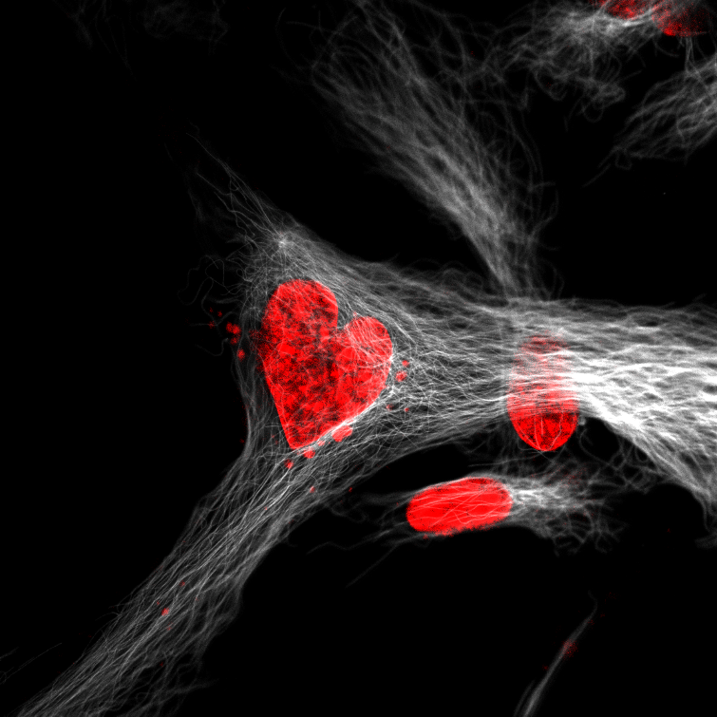
Open science partners
SRCE, Centre for Scientific Information Ruđer Boskovic Institute; CROSSDA
Open Science Group Science Europa
CoNOSC
Croatian Open Science Cloud - HR-OOZ Initiative
Best Scientific Photo Competition in 2021. Broken hart
Author: Iva M. Tolić

Slide 4
Where we were last year
Research Data Management Plan – DMP in Dabar
Article Publishing Charges (APCs)
Best Scientific Photo Competition in 2021. Waiting for the right opportunity
Author: Krešimir Kavčić
HRZZ's Position on Open Science - Step Forward

Slide 5
Open access publications in UIP-2017-05 and IP-2018-10
UIP-2017-05
Project funding duration | 5 years
Program Budget: | 13.642.083,47 euro
Financed projects | 75
Scientific publication | 670
Open access | 69%
APC | 239.377,43 euro
IP-2018-01
Project funding duration | 4 years
Program budget: | 16.576.739,69 euro
Financed projects | 140
Scientific publication | 1723
Open access | 58%
APC | 100.420,91 euro

Slide 6
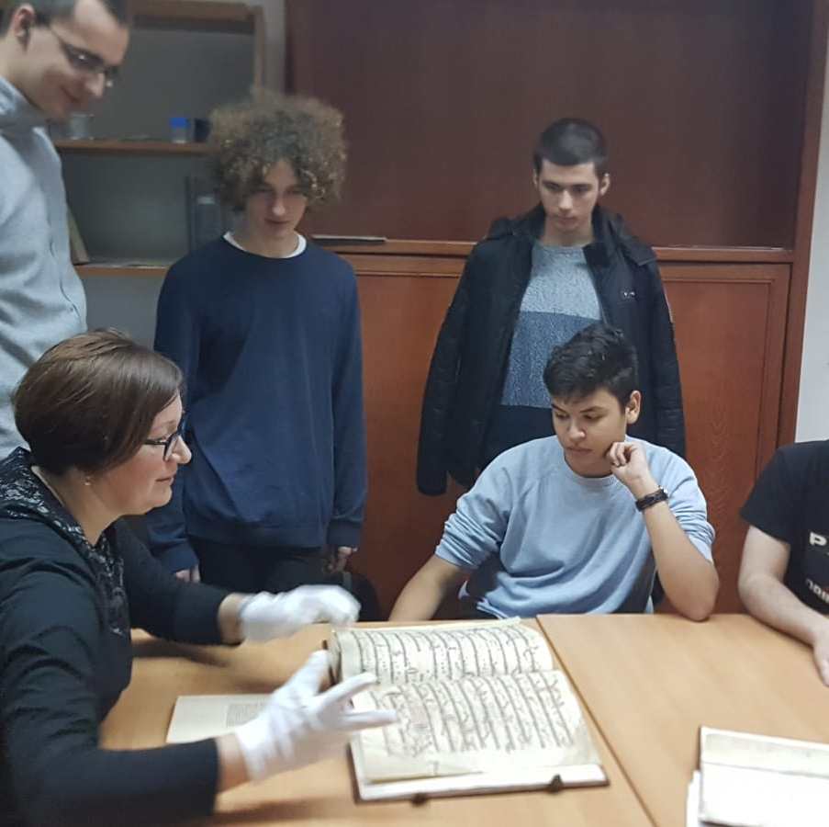
What’s new
Best Scientific Photo Competition in 2021.
The Cromuscodex70 project and work with young people.
Author: Hana Breko Kustura
29th July 2023
Regulation on the conditions and the grant award procedure for the achievement of the Foundation's purpose
17th October 2023
Strategic plan - Croatian Science Foundation for the period 2023 – 2027

Slide 7
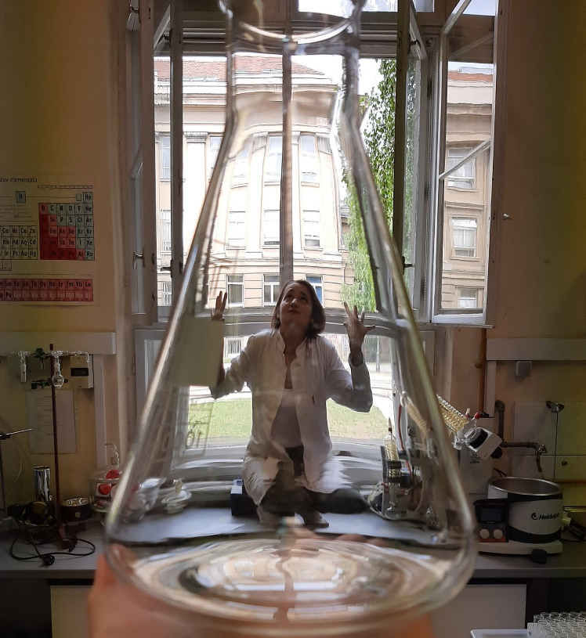
Regulation on the conditions and the grant award procedure for the achievement of the foundation's purpose
Research Data Management Plan
Archive results of the project in CroRIS (CROSBI)
Provides open access to full texts of publications
Archive data in a repository with FAIR principles whenever possible
Best Scientific Photo Competition in 2021. Stuck at work.
Author: Silvija Maračić

Slide 8
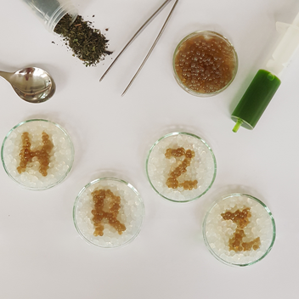
Strategic plan Croatian Science Foundation 2023-2027
Strengthening scientific excellence and innovation
Strengthening the capacity and international recognition of HRZZ
Strengthening the role of science in the economy, society and among citizens
Best Scientific Photo Competition in 2021.
Bally spelling book. Author: Ena Cegledi

Slide 9
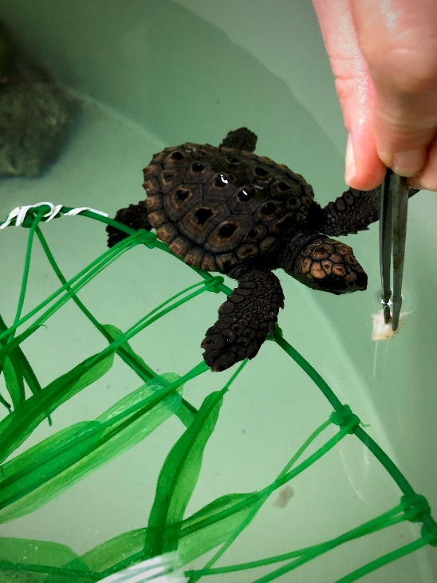
Strategic plan Croatian Science Foundation 2023-2027
Guidelines for publications in open access for HRZZ projects and programs
Open access to Research Results /Archive all publications in repositories
(publications, data, software, models, methods, theories, algorithms, protocols, e-exhibitions, contributions to policies, etc)
Open access to digital scientific information
Open access publications
Open access books
PhD thesis in Repositories
Data sets in Repositories
Data Management Plan
Strengthening scientific excellence and innovation
Strengthening the capacity and international recognition of HRZZ
Strengthening the role of science in the economy, society and among citizens.
Best Scientific Photo Competition in 2021. Koko and lunch. Author: Klara Filek
HRZZ's Position on Open Science - Step Forward

Slide 10
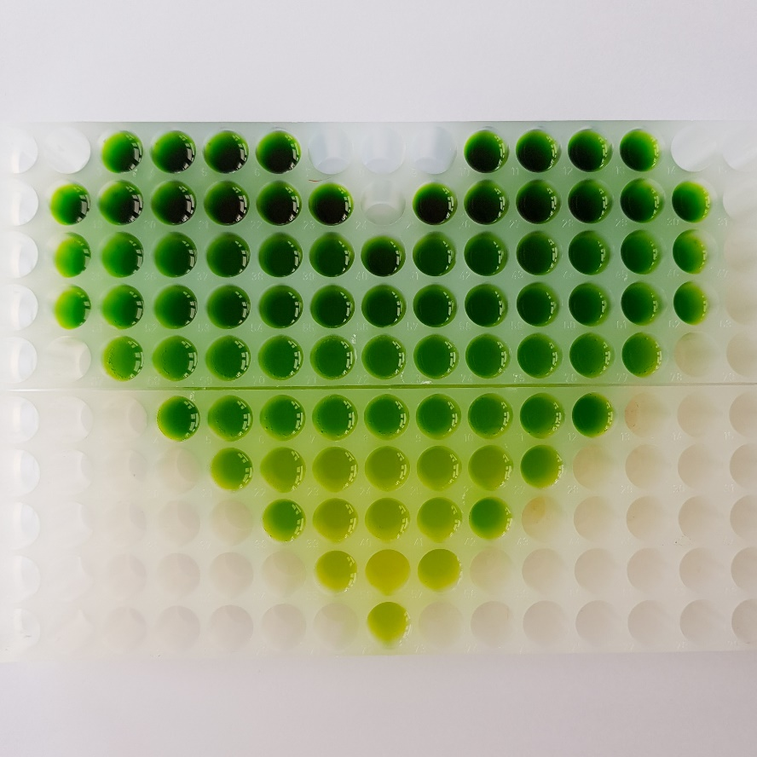
Follow us:
@hrzz_science
Hrvatska zaklada za znanost
(Croatian Science Foundation)
Best Scientific Photo Competition in 2021. Love in a green way. Author: Ena Cegledi
HRZZ's Position on Open Science - Step Forward

Slide 11
HRZZ's Position on Open Science - Step Forward
Dr. sc. Dejana Carić

