Slide 1


Skills development through YUFE pilot project "Full Open Science (FOS)"
Lecturer: Jana Krišković Baždarić, senior librarian
Center for Open Science and Scientific Information Management
University of Rijeka Library

Slide 2
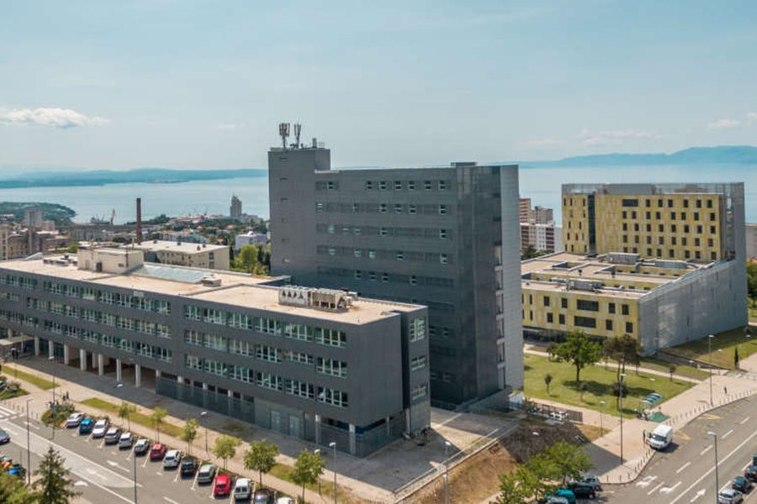
UNIRI AND OPEN SCIENCE
UNIRI supports the progress of science and the dissemination of knowledge for the benefit of society and adopts the practices of open, reusable and responsible research
UNIRI bases its development and direction on relevant national and European Union documents
UNIRI firmly supports the position that scientific information and research data arisen as a product of scientific activities financed by public funds must have open access

Slide 3



UNIRI AND OPEN SCIENCE - documents
Open Science Policy UNIRI
University of Rijeka Declaration "European Open Science„
Decision on the obligation to store papers in the repository
Decision and instructions for the implementation
of the Open Science Policy
Signatory of DORA
Signatory of CoARA

Slide 4


OPEN SCIENCE POLICY UNIRI
Open science is in the public interest
The principle of openness
The principle of quality
The principle of accessibility

Slide 5

CENTRE FOR OPEN SCIENCE
The Centre for Open Science and Scientific Information Management works within the University of Rijeka Library to support the implementation of the UNIRI Open Science Policy
It organizes workshops and educational programs
It provides support for the implementation of open science practices
It informes about current events in the field of open science
It monitors implementation of the Open Science Policy
It organizes Open Science Cafe’s - short online meetings on topic
of open science
Library’s website on open science

Slide 6


EU PROJECTS - UNIRI

Slide 7
YUFERING
YUFERING -Transforming Research and Innovation through Europe-wide Knowledge Transfer
Project duration: January 1, 2021 - December 31, 2023.
UNIRI participation: WP5 Open Science (OS): establishing the New Normal
YUFE Open Science Strategy and look for a post-COVID-19 approach that states Open Science as “the new normal” in YUFE Universities
Objectives:
Identify the barriers and challenges for Open Science implementation in YUFE at the researcher and institutional level
Create OS policy commons for YUFE, as well as share individual practices and policies
Generate a set of practices and pilots (PCI, Practical Commitments for Implementation) particularly in the research assessment and new indicators (NGM), mainly that would be part of the new Open Science Registry
Co-creation of a YUFE Open Education Training Suite on Open Science.

Slide 8
YUFERING WORK PACKAGES
WP1: Management and Coordination
WP2: The YUFE model towards a community engagement-based reserach & innovation agenda
WP3: YUFE as a catalyst for flipped knowledge transfer and deployment in society
WP4: Transforming recognition, reward and circulation of talnts and teams across Europe
WP5: Open Science (OS): establishing the New Normal
5.1 Open Science Practice and Policy Commons for YUFE partners
5.2 Testing indicators for Open Science performance/evaluation
5.3. Open Science bottom-up implementation: Full Open Science (FOS) Pilot
5.4. Co-create a training and engaging scheme for YUFE researchers about Open Science
WP6: Dissemination, Exploitation & Communication (DEC)

Slide 9
FOS - FULL OPEN SCIENCE
The Full Open Science (FOS) pilot project at YUFE aims to promote Open Science as a “cultural change” in the partner institutions
The goal of the call was to encourage at least 30 research teams to commit to open access publications, open FAIR research data, citizen science, etc. Research teams had to achieve results during the period stated by the call in order to get a FOS label
This label can empower the teams as role-models and ambassadors within their institutions and therefore to foster Open Science among their colleagues
The participating researchers will benefit from an enhanced academic visibility as well as extra support by the university in unlocking their research outputs
The label can also strengthen their commitment with Open Science when participating in project calls for proposals

Slide 10
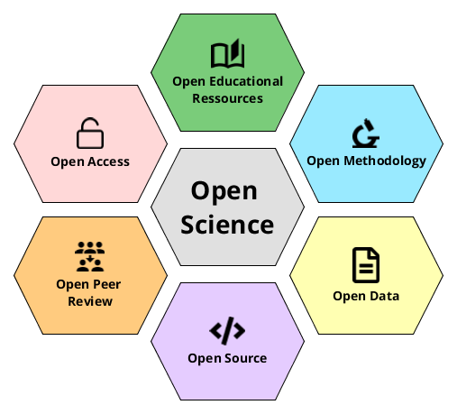
FOS CALL
Are you committed to Open Science?
Are you ready to share your publications and your research data?
Would you like that your institution support you and recognize this effort?
transform your research team in a FOS (Full Open Science) Team!

Slide 11

FOS CALL
To take part in the project, the research teams had to fill out the form
Basic information about the research team and the team leader and who to get in touch with
The leader of the Research Team was main contact for any development related to the call
Current assessment with the FOS criteria
Information on whether the teams needed training and in which area to achieve project criteria
It was not a requirement that the teams or team members fulfill the criteria in the participation application phase

Slide 12

FOS REQUIREMENTS AND CRITERIA
To become a FOS Research Team, it was necessary to fulfill the following criteria:
Compulsory (C): 2 out of 2
Optional (O): 3 out of 12
Outputs and basic requirements were reviewed by the Centre for Open Science, University of Rijeka Library team
All outputs (for example data, publications, code) had to be published from 2019 to 2021.

Slide 13
FOS CRITERIA
Compulsory Criteria
Compulsory Criteria
Compulsory Criteria
Dimensions | Criteria | Description
Basic requirements | Author persistent ID: ORCID | All the researchers of the team have an ORCID
Open publishing | Publications: available in open access | At least 60% of the publications of the team are available in open access

Slide 14
FOS CRITERIA
Optional Criteria
Dimensions | Criteria | Description
Basic requirements | PhD Theses in Open Access | At least 70% of the PhD researchers of the team have their thesis in open access
Basic requirements | Using open licenses | All the researchers of the team use open licenses in at least 50% (publications, data, notebooks, educational resources)
Open data | Research data: available in open access | 100% of the research data metadata available in open access At least 50% of the research data are available in open access
Open data | Following FAIR data principles | At least 80% of the research data in 5 comply with the FAIR Data Principles
Open research process | Pre-registrations | All the researchers of the team have at least one research study. This can be prior to, or during the FOS project

Slide 15
FOS CRITERIA
Optional Criteria
Dimensions | Criteria | Description
Open Research Process | Open notebooks/software/code | All the researchers of the team have at least 1 open notebooks/software/code
Open Research Process | Open peer review | At least 50% of the researchers participate in open peer review processes (as author or reviewer)
Teaching | Sharing Open Educational Resources (OER) | At least 50% of the researchers have at least 1 OER available in open access
Community engagement and outreach | Contributing to OS dissemination through events, training activities, social networks… | All the researchers of the team have at least 1 dissemination activity. This can be prior to, or during the FOS project
Community engagement and outreach | Citizen Science initiatives | At least 50% of the team is involved in 1 Citizen Science initiative, or applying some CS methodology in their projects. This can be prior to, or during the FOS project

Slide 16

FOS ACTIVITIES
Support and training
To unlock their scholarly outputs and therefore to meet the criteria of the call, Research Teams willing to become FOS Research Teams were supported by their university on topics like:
Open Science: concepts, principles and policies
Depositing in repositories and open access platforms
Advice on Intellectual Property Rights and Copyright

Slide 17

FOS ACTIVITIES UNIRI – CENTRE FOR OPEN SCIENCE
Open Science Cafe
How to choose relevant journal for my paper?
Implementation of the Open Science Policy - how to publish papers in the Dabar repository?
Open review
Open science from the researcher's perspective
Individual consultations and education
Lifelong learning program Information tools for researchers

Slide 18

FOS OBJECTIVES
As part of the YUFE Open Science Strategy, the FOS Call has contributed to:
Promoting a hands-on Open Science approach by researchers
Increase the number of publications, data, and educational resources in open access and promote community engagement and outreach practices
Connect researchers with libraries and open science infrastructures at YUFE universities
Engage researchers by strengthening the team's commitment to open science

Slide 19

FOS RESULTS UNIRI
5 research teams at the University of Rijeka received FOS (Full Open Science) marks. The teams met a number of compulsory and optional criteria for obtaining the Full Open Science Team designation
The results and basic requirements were reviewed by the team of the Center for Open Science at the Rijeka University Library, which led and supported the teams throughout the duration of the project
The teams are:
Faculty of Law Research Team; team representative Full professor Ivana Kunda, PhD
Faculty of Engineering Research Team; team representative Full professor Saša Zelenika, PhD
Faculty of Medicine Research Team; team representative Full professoer Marina Šantić, PhD
Faculty of Informatics and Digital Technologies Research Team; team representative Assist. prof. Vedran Miletić, PhD
Faculty of Informatics and Digital Technologies Research Team; team representative Assoc. prof. Marina Ivašić-Kos, Phd

Slide 20
END OF PROJECT
From May 2022 to August 2023, a Full Open Science (FOS) pilot has been carried out to foster Open Science practices across several research teams at the universities
These have been working towards open access to publications, FAIR research data, open licenses, citizen science, and open educational resources (OER), among other areas
FOS research teams are expected to become role models and ambassadors within their institutions
In September 2023, an online event was held to mark the end of the Full Open Science (FOS) pilot project as part of the YUFERING project
The goal of this online event was to showcase the YUFERING FOS pilot results, as well as to reserve some time for the partners to continue reflecting on how to promote OS awareness at their institutions
The first half of the event was public, whereas the second one was aimed only at the partners

Slide 21

UNIRI RESEARCH TEAM REPRESENTATIVES ON
OPEN SCIENCE

Slide 22

WHAT’S NEXT?
How to continue developing FOS project as a brand of YUFERING Open Science?
There is interest from other institutions outside YUFE
Further activities:
Open Science Cafes Open Science Cafés @UC3M - a series of online webinars that combine the World Café discussions with the online workshop for training
They are open to all the faculty and interested researchers (PhD students, as part of their specific transversal training in Open Science)

Slide 23
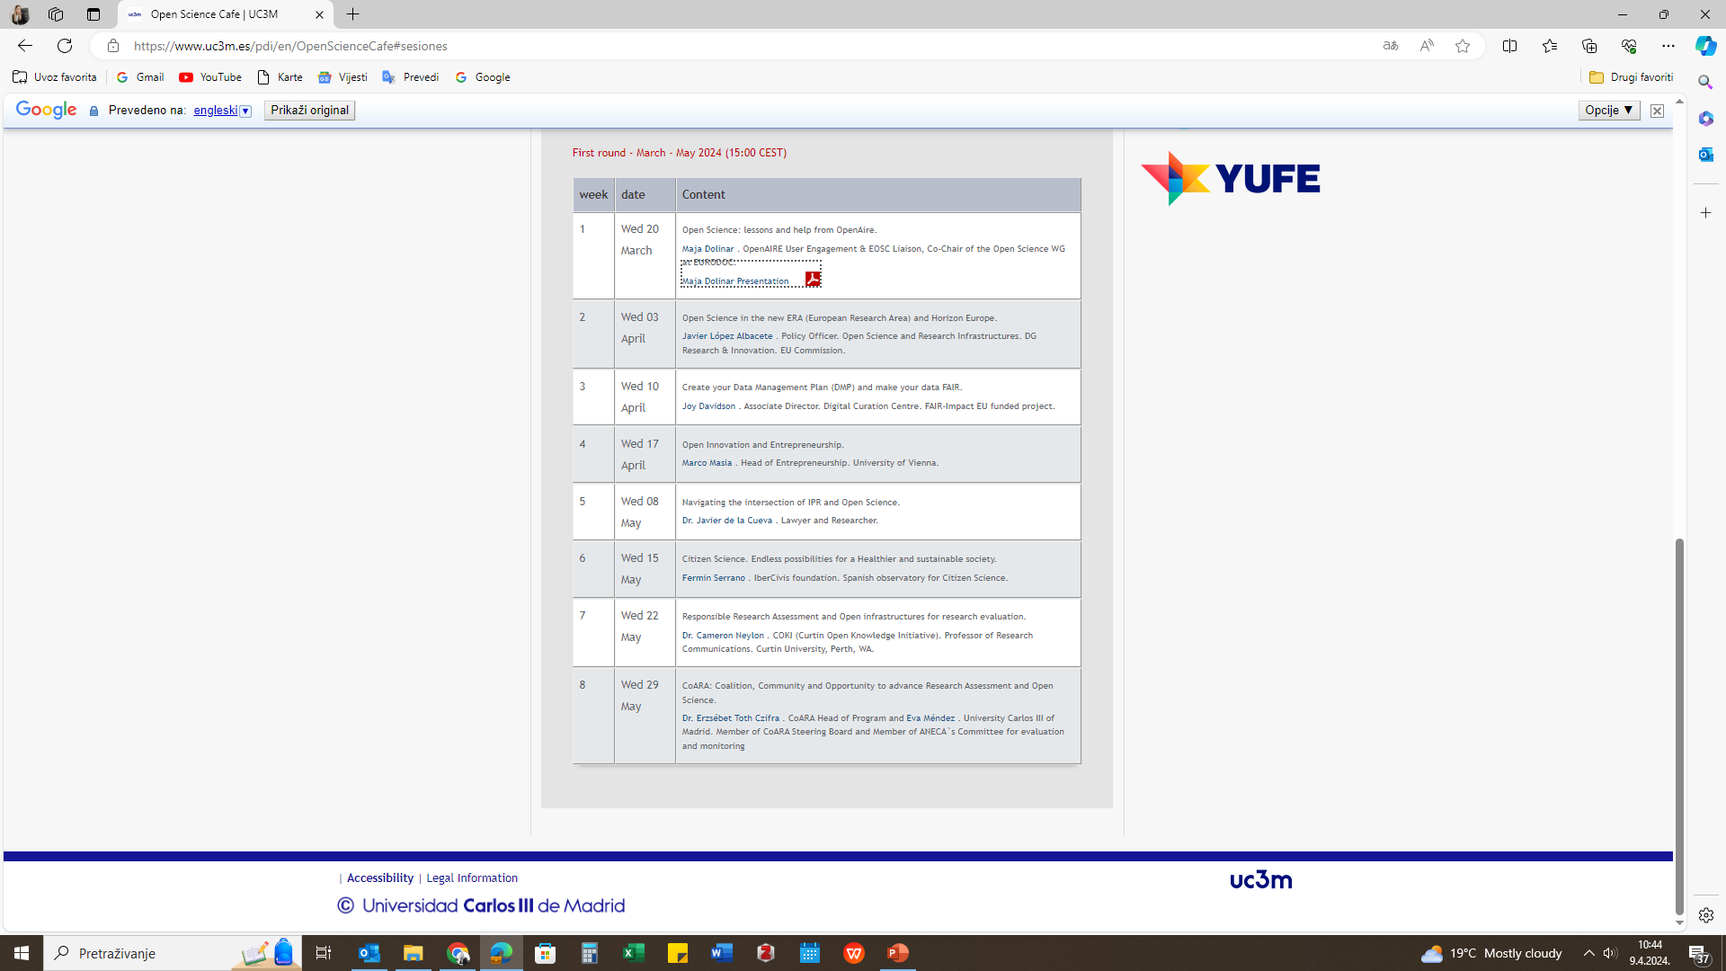
WHAT’S NEXT?
Save the dates! Topics:
The right to science and the debate on Intellectual Property
Citizen Science as a practice and transversal driving force for science with and for society
Responsible Research Assessment (RRA) and the need for evaluation reform (CoARA, DORA) with open infrastructures
1 hour session (30 min presentation by a well-known expert on the topic + 30 min of discussion)
In english, at 13:00 CEST, on Thursdays from May 20th until the end of June

Slide 24
Thank you for your attention!
Questions?
jana.kriskovic@svkri.uniri.hr
coz@svkri.uniri.hr

