Slide 1
Three Steps of Open Science Implementation in Slovenia
DEI 24, Srce, Zagreb, 19. 4. 2024
mag. Miro Pušnik, CTK

Slide 2
Three Steps of Open Science Implementation in Slovenia
Reform of the European Research Area (ERA)
Reform of the national legislation on scientific research and innovation according to the ERA reform
Implementing the principles of open science at the level of research organisations
↓
SPOZNAJ

Slide 3
Reform of the European Research Area (ERA)

Slide 4
Main Challenges and Priorities for Open Science in the Context of ERA Reform
Improving the Practice of Research and Innovation | Developing Proper Enablers
Openly accessible scholarly publications | Rewards and incentives to adopt open science practices, with appropriate metrics
Early and open sharing of all research outputs | Appropriate skills and education, including for research integrity
Responsible RDM | Open research infrastructures including the European Open Science Cloud (EOSC)
Reproducible results
Societal engagement and responsibility
Reference: Kostas Glinos, Open Science: the new normal for practicing Science? Available at: https://beopen-project.eu/storage/files/parti-1-os-the-new-normal-for-practicing-science-kglinos.pdf

Slide 5
Reform of the Legislation on Science in Slovenia

Slide 6
Scientific Research and Innovation Activities Act (November 2021)
In the context of research co-funded by at least 50% public funding, the funder must request and the researchers must provide open access to all peer-reviewed scientific publications, to research data and to any other research results.
The evaluation and assessment of researchers, research organisations, research programmes and projects should promote open science.
Scientific journals of publishers based in the Republic of Slovenia and abroad, which contain peer-reviewed articles and whose publication is fully financed by state resources, must ensure open access to their content.
https://pisrs.si/pregledPredpisa?id=ZAKO7733&d-49683-s=1&d-49683-p=1&d-49683-o=2

Slide 7
Decree on the Implementation of Scientific Research Work in Accordance with the Principles of Open Science (June 2023)
The Decree is the implementing act of the Scientific Research and Innovation Activities Act. It lays out the implementation arrangements for regulators (Slovenian Research and Innovation Agency, Slovenian Quality Assurance Agency for Higher Education), research organisations and researchers in greater detail.
https://pisrs.si/pregledPredpisa?id=URED8793

Slide 8
Main Parts of the Decree
Open access to scientific publications (requirements, implementation);
Open access to research data and other research results in the digital form (requirements, implementation);
Copyright management in accordance with the principles of open science (copyright management of scientific publications, research data and other research results);
Involvement of the interested public in scientific research (considering the needs of users and the wider community; citizen science);
Eligible costs of scientific research work in accordance with the principles of open science;
Evaluation and assessment of researchers, research organisations, research programmes and projects in accordance with the principles of open science (evaluation by funders, evaluation in public research organizations);
Open science infrastructure (national ecosystem for open science);

Slide 9
Institutional Implementation

Slide 10
Action Plan for Open Science
The Slovenian government adopted the Resolution on the Slovenian Scientific Research and Innovation Strategy 2030 (ReZrIS30), https://www.gov.si/assets/ministrstva/MIZS/Dokumenti/ZNANOST/Nacionalni-dokumenti/Resolution-on-the-Slovenian-Scientific-Research-and-Innovation-Strategy-2030.
Objective 6.2 in ReZrIS30 is Open Science for Improving the Quality, Efficiency and Responsiveness of Research.
The implementation of the action is laid out in the Action Plan for Open Science, https://www.gov.si/assets/ministrstva/MVZI/Znanost/Nacionalne-strategije-in-dokumenti/2023-Action-Plan-Open-Science-Slovenia.pdf.

Slide 11
6.2. Open Science for Improving the Quality, Efficiency and Responsiveness of Research (1/3)
1. Internationally Aligned National Open Science Ecosystem
Management and financing, coherence with international standards, integration into international networks and infrastructures
Preparation and adoption of governmental decree on open science, implementation of an RRF project SPOZNAJ to support public research organisations in adapting their operation according to the open science principles, establishment of the national Open Science Infrastructure Council to support the development of national open science infrastructure, development of services …
2. Evaluation of Scientific Research Activities in Accordance with the Open Science Principles
Introduction of modern approaches to evaluation of scientific research in accordance with open science
Changes and amendments to ARIS, NAKVIS, and public research organisations regulations; engagement in the ERA and EHEA activities related to the research assessment reform …

Slide 12
6.2. Open Science for Improving the Quality, Efficiency and Responsiveness of Research (2/3)
3. Compliance of Scientific Research Results with the FAIR Principles and Openess
Ensure the results of scientific research are consistent with the FAIR principles, provide full and immediate open access (subject to justified exceptions)
Publications: Incentives to support the implementation of open science, upgrades in the system for funding the purchasing of international scientific journals (support for transformative agreements, later on contracting agreements for diamond publishing, open access publishing in gold journals and open acces publishing platforms ...
Research data: selection/evaluation, DMP preparation support, development and maintenance of the data services ecosystem …
4. National Open Science Community
Establish the national Open Science Community to support implementation and monitoring of open science in Slovenia and the integration into ERA and beyond
Establishment of the Slovenian Open Science Community (SSOZ), permanent professional and administrative support to SSOZ with sustainable funding, national catalogue of open science trainings and services,…

Slide 13
6.2. Open Science for Improving the Quality, Efficiency and Responsiveness of Research (3/3)
5. Citizen Science
Promote development of citizen science and public involvement in scientific research
National Observatory of Citizen Science, establishment and operation of national citizen science network citizenscience.si, support to citizenscience within the national open science system, incentives to public research organisations to incorporate citizen science into the research process …
6. National open-access scientific publishing
Promote development of national scientific publishing to operate according to the principles of open science
National Contact Point for Scholarly Publishing, establishment of the Slovenian network of scientific publishers, implementation of diamond open access in national scientific publishing, strategy/guideline for national scientific/academic publishing ...

Slide 14
The SPOZNAJ Project

Slide 15
Basic Information
Project duration:
1 May 2023 - 30 June 2026
Total funding:
EUR 4.031.728,66
NOO: EUR 3 999 994,81
VAT: EUR 31 733,85
Consortium partners: 20 Slovenian public research organisations and the CTK
The SPOZNAJ project is co-funded by the Republic of Slovenia, the Ministry of Higher Education, Science and Innovation and the European Union - NextGenerationEU.

Slide 16
The SPOZNAJ Project – Basic Aims
The Central Technical Library at the University of Ljubljana (CTK) as the leading partner and 20 Slovenian public research organisations (out of 23) will work within the project to adapt their operations in accordance with the Scientific Research and Innovation Act, the Decree on the Implementation of Scientific Research Work in Accordance with the Principles of Open Science and related practices and principles of open science in ERA.
Establishment of cooperation and consequently effective synergies of joint action of the PROs in the field of open science and scientific communication.
The project is part of the Slovenian Action Plan for Open Science 2023-2030 (but is financially complementary).

Slide 17
The project addresses all aspects of open science:
sharing research in line with the FAIR principles,
policies/requirements of funders in Slovenia and in the ERA,
open science publications,
responsible research data management,
responsible criteria for evaluating scientific research work,
public engagement in scientific research,
early and open sharing of research, infrastructure for open science, e
ethical and copyright aspects of open science, etc.

Slide 18
Partners
Št. | Partner
1 | Centralna tehniška knjižnica Univerze v Ljubljani, vodilni partner
2 | Univerza v Ljubljani | 12 | Kemijski inštitut
3 | Univerza v Mariboru | 13 | Kmetijski inštitut Slovenije
4 | Univerza na Primorskem | 14 | Nacionalni inštitut za biologijo
5 | Fakulteta za informacijske študije v Novem mestu | 15 | Pedagoški inštitut
6 | Geološki zavod Slovenije | 16 | Rudolfovo - Znanstveno in tehnološko središče Novo mesto
7 | Gozdarski inštitut Slovenije | 17 | Urbanistični inštitut Republike Slovenije
8 | Institut "Jožef Stefan" | 18 | Zavod za gradbeništvo Slovenije
9 | Inštitut za hidravlične raziskave, Ljubljana | 19 | Znanstvenoraziskovalni center Slovenske akademije znanosti in umetnosti
10 | Inštitut za narodnostna vprašanja | 20 | Znanstveno-raziskovalno središče Koper
11 | Inštitut za novejšo zgodovino | 21 | Znanstveno in inovacijsko središče Pomurje
Not involved: Inštitut za ekonomska raziskovanja, Inštitut za kovinske materiale in tehnologije, Inštitut za matematiko, fiziko in mehaniko

Slide 19
Purpose of the Project
Exchange of information, experience and good practices
Synergy
Collaboration
Formal provisions
Organizational and technical structures
Personnel empowerment
General
public
Funders, govermental organizations, NGOs, other public services…
Research and higher education organizations that are not part of the consortium (including abroad)
At the level of the consortium partners
At the level of the consortium
Outside the consortium

Slide 20
Goals
Education and awareness
Personnel and infrastructure
Recruitment of new support staff Organizational changes Inter-institutional support group Institutional records of research and data Local servers Digital resources and tools
Formal provisions
Implementations of the adjustments
Evaluation of the adjustements
Adopted and supplemented legal acts Infrastructure adjustments Establishing support structures Staff empowerment
Development of a methodology for evaluating the success of adjustments Evaluation of project results regarding content, time and finances Comparison between the partners
Website, newsletter PR activities General presentations for partners and the general public Printed and online handbook Specialized training for data stewards
Rules on sharing research results according to the FAIR principles Rules on publishing in open access Rules on research data management Rules on the involvement of citizens in research work Rules for research assessment practices
Plans for adjustements

Slide 21
Work Packages
WP 1: Consortium management and coordination
WP 2: Raising awareness, promotion and communication of the activities of the consortium
WP 3: Conducting trainings on open science practices and on sharing research according to FAIR principles​
WP 4: Preparation and implementation of dedicated trainings for operation according to the principles of open science
WP 4.1 Defining profiles of support professionals and creating a catalogue of competencies
WP 4.2 Creation of the data professionals training program and creation of handbooks
WP 4.3 Implementation of the data professionals training
WP 4.4 Establishment of a group of supporting experts/coordinators to support the project partners' staff and other interested parties in training and implementation of open science.
WP 5: Preparation and distribution of an open science handbook with an emphasis on research data management
WP 6: Comprehensive adaptation of open science operations and evaluation of results of consortium partners​
WP 6.1 Analysis of business/organizational models of support structures to open science from the perspective of the needs of individual consortium partners and preparation of recommendations
WP 6.2 Open science adaptation plan and pilot introduction of major adjustments
WP 6.3 Preparation of internal organizational and other regulations, documents, policies
WP 6.4 Implementation of adjustments
WP 6.5 Evaluation of adjustments

Slide 22
The Data Professionals Training Program
General content on open science
The formal basis of data curation and data stewardship
Organisation of training courses for researchers
Ethics, integrity and legal aspects of open science
Open science infrastructure
The life cycle of research data
Planning RDM
Specific RDM topics for particular scientific fields
Tools for working with data
Workshops
Estimated 72 hours (four blocks of four days/six hours each).
Lecturers from within the consortium and from the outside, including from abroad.

Slide 23
Adjustments to Open Science
Analyses of the current situation
Self-evaluation
Open science adjustments plan and pilot introduction of major adjustments
Legal acts Infrastructure Staff empowerment
Evaluation of adjustments
Development of a methodology for evaluating the success of adjustments
Implementation of adjustments
Legal acts adopted Infrastructure adjustments finalized Supporting structures established

Slide 24
Done So Far
WP 1
WP 2
Website Newsletter PR activities Video archive Direct contacts with interested stakeholders 1st National Event In progress: permanent archiving of consortium materials in DiRROS
WP 3
WP 4
WP 5
Catalogue of competences for data professionals In progress: programme of specialised training for data professionals, recruitment of lecturers
Printed user handbook on open science in the final stages of preparation (review, proofreading), expected to be published in May 2024
Established the consortium Shared document storage and communication tools Up-to-date records Regular meetings (consortium and thematic) 1st Review Meeting Successful 1st semi-annual reporting
>25 project presentations to cons. partners' staff and external stakeholders >15 expert presentations for the general public (archived on Arnes Video), with SI and EN subtitles
WP 6
All consortium partners prepared an analysis of the situation at their institutions In progress: drafts of formal documents

Slide 25
Priorities in 2024
Specialised training for data professionals
Handbook on open science
Drafts of formal documents
Exhibition and interviews
2nd National Event
Expert presentatios for the general public

Slide 26
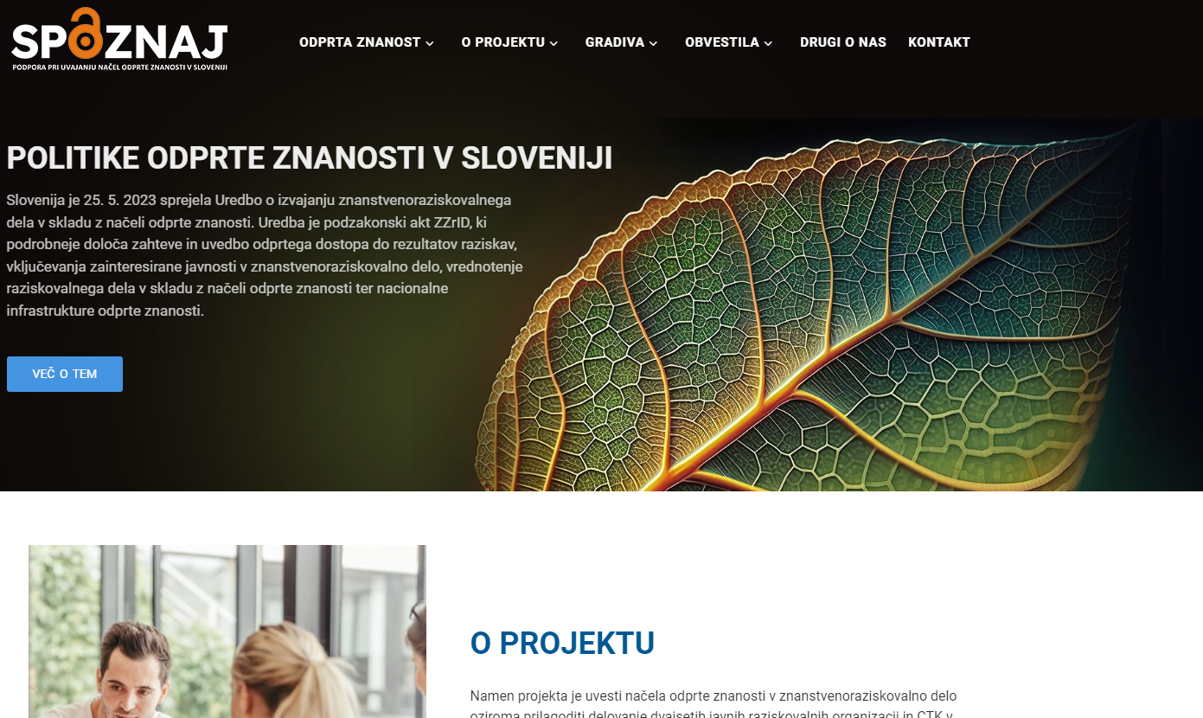
More Information
Project website:
https://projekt-spoznaj.si
Newsletter subscription (in English):
http://eepurl.com/iuwA5c
​

Slide 27
Centralna tehniška knjižnica Univerze v Ljubljani
Central Technical Library at the University of Ljubljana
Trg republike 3, SI-1000 Ljubljana
Slovenija / Slovenia
Thank you for your attention!

