Slide 1
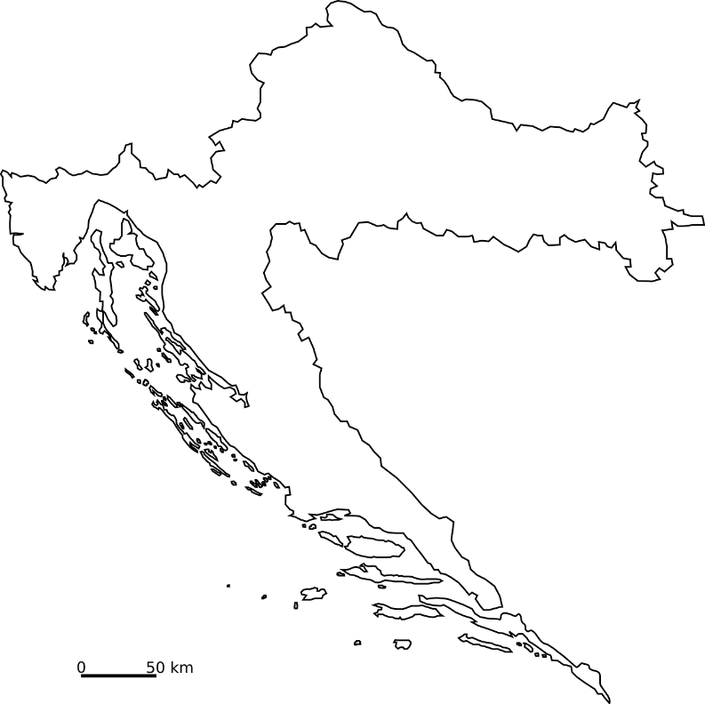
CROATIA OPEN SCIENCE
Policy overview
THE MINISTRY OF SCIENCE AND EDUCATION
Director General Hrvoje Meštrić, PhD
Srce DEI, 19 April 2024

Slide 2
Croatia’s open science overview
Croatia has a long history of supporting open science that can be traced back to 1997.
We have been a member of EOSC Association from the start in 2020.
Since then we have continued our progress in encouraging open science in Croatian research system.
In all our main policy documents we have recognized the importance of open science and its key role in achieving excellence and competitiveness.
It is still a new paradigm in science that requires a system and mindset change that takes time and it is our role to encourage and support it.
Researchers in Croatia are continually encouraged and assisted to share their data as they have free of charge access to the necessary infrastructure.

Slide 3
Policy overview
ERA ACTION
1
CROATIAN RI ROADMAP
OPEN SCIENCE GUIDELINES
EOCS
OECD
2020
04/2022
07/2022
02/2021
01/2022
2022
06/2023
12/2023
2024
NATIONAL DEVELOPMENT STRATEGY
NRRP
NEW ACT
CRORIS IMPLEMENTED
S3
PROGRAME AGREEMENTS

Slide 4
The National Development Strategy of the Republic of Croatia until 2030
STRATEGIC GOAL "Competitive and innovative economy"
Development of science and technology.
Diversify economy bx strengthening the national innovation system, and stimulating investment in research, development and innovation.
Strengthening scientific excellence and fostering open science by investing in research infrastructures and significant international projects.
Better linking the academic, research and business sectors.
National Recovery and Resilience Plan

Slide 5
The Organization for Economic Cooperation and Development (OECD)
January 2022 – the Accession discussion has started.
Two Recommendations regarding open data:
Recommendation of the Council Concerning Access to Research Data from Public Funding (OECD/LEGAL/0347).
OECD Recommendation of the Council on Enhancing Access to and Sharing of Data (OECD/LEGAL/0463).
In their reports, they recognize that Croatia has taken important legislative and policy actions to align itself with these.
National Recovery and Resilience Plan

Slide 6
National Recovery and Resilience Plan
COMPONENT 3.2: BOOSTING RESEARCH AND INNOVATION CAPACITY
Reform and strengthening of the research and development capacities of the public research sector by:
Improving the institutional funding to motivate scientific productivity, efficiency and knowledge transfer.
Increased investment in research infrastructure and organisational capacities of universities and scientific institutes.
Introducing a new enabling framework for the advancement and career development of researchers.
Introducing a more efficient institutional and programming framework for research and development funding schemes.
National Recovery and Resilience Plan
National Recovery and Resilience Plan

Slide 7
European Research Area Policy Agenda
ERA ACTION 1: Enable the open sharing of knowledge and the re-use of research outputs, including through the development of the EOSC.
Croatia recognized the value of this action and participates in it from the beginning.
Expected outcomes are:
Deploy Open Science principles and identify Open Science best practices.
Deploy the core components and services of EOSC and federate existing data infrastructures in Europe, working towards the interoperability of research data.
Establish a monitoring mechanism to collect data and benchmark investments, policies, digital research outputs, open science skills and infrastructure capacities related to EOSC.
National Recovery and Resilience Plan

Slide 8
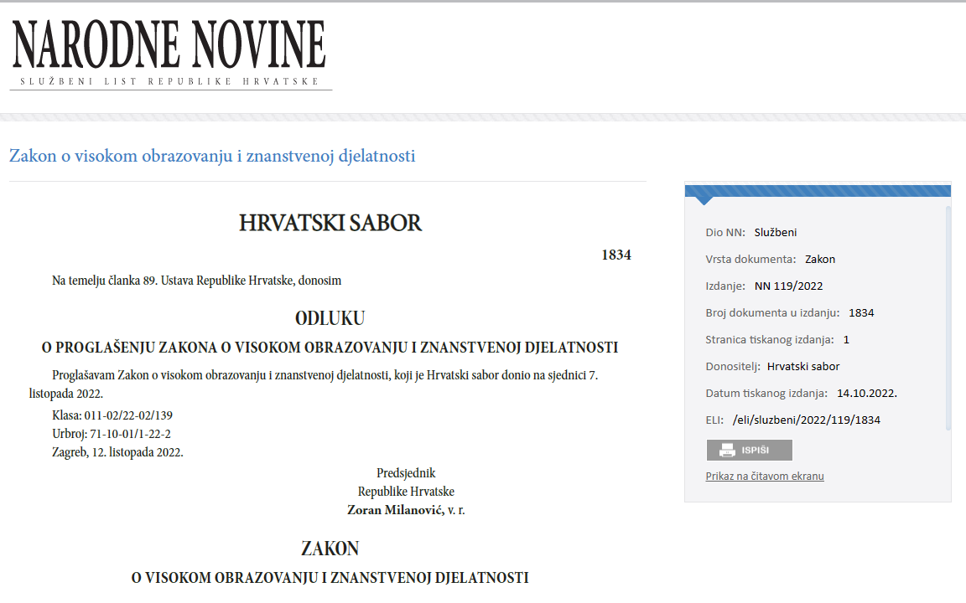
Act on Scientific Activity and Higher Education
One of basic principles for scientific activity.
Scientific research based on:
open and collaborative research process
open access to all products
research work (publications, research data, software)
open and interoperable research infrastructure
Prescribes the obligation of depositing doctoral dissertations, and bachelor and masters level thesis into the institutional and national repositories.

Slide 9
Science and Technology Foresight Project
As part of the Project a new national Research Information System of the Republic of Croatia (CroRIS) was put into production that:
Provides comprehensive, complete and accurate information on all research in the Croatia.
Enables and promotes open science in a way that it enables visibility, transparency and public availability of research projects and achieved results.
Opens space for connecting research and science with the economy in the Croatia and globally.
National Recovery and Resilience Plan

Slide 10
RESEARCHERS
PUBLICATIONS
EQUIPMENT
PATENTS
PROJECTS
INSTITUTIONS
.

Slide 11
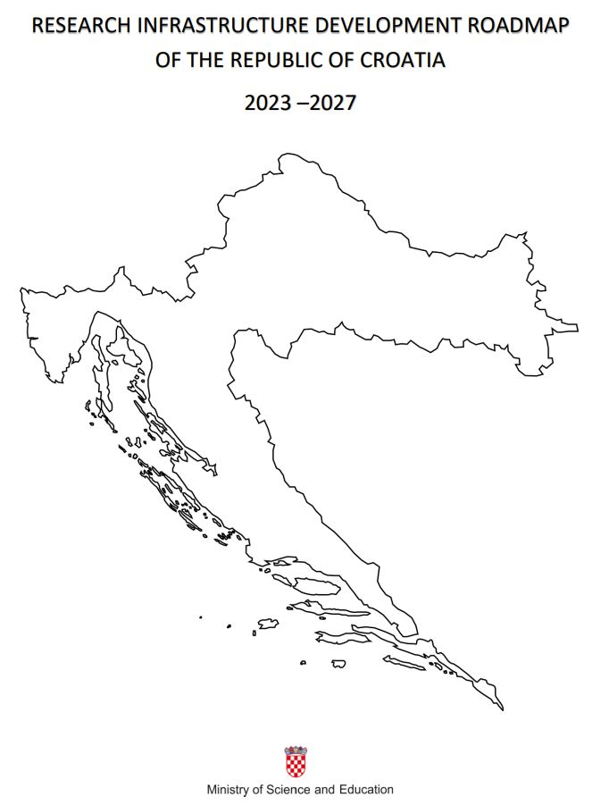
National Infrastructure Development Roadmap of the Republic of Croatia 2023 - 2027
supports the development of Open Science based on excellence and international competitiveness.
horizontal principles for Croatian research infrastructure:
promoting use of FAIR principles for research data and promoting the implementation of ORDM
priority for investment proposals which promote the principles of open science:
- use of FAIR principles for research data and services
- implementation ORDM
National Recovery and Resilience Plan
National Recovery and Resilience Plan

Slide 12
Programme funding agreements
They determine the total multi-annual financing of public research institutes and public higher education institutions from state budget funds.
25 public research institutes signed the agreements in December 2023.
Public research institutes independently selected ten or more specific goals and corresponding activities to achieve those goals over a four-year period.
Under the strategic objective 1, Enhancing Scientific Excellence, there is a specific objective “Contribution to open science” and more than half institutes chose that objective.

Slide 13
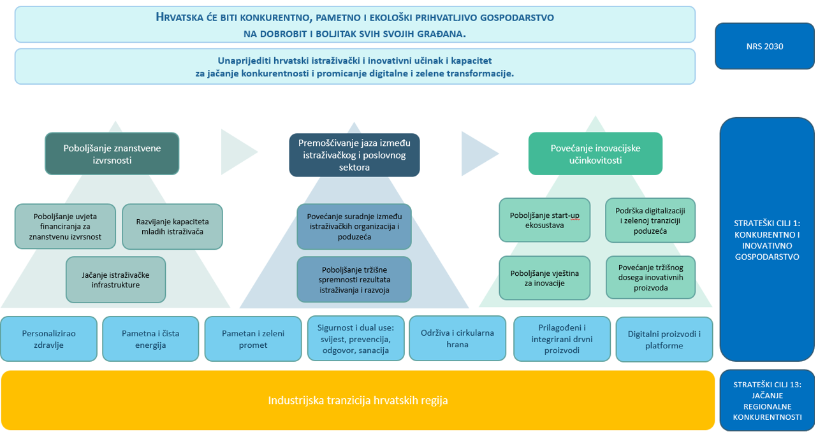
Smart Specialization Strategy until 2029 (S3)
The main purpose of the Croatian S3 is to transform the Croatian economy in order to increase its competitiveness by concentrating knowledge resources and linking them to a limited number of priorities.
Specific objective 1 is “Improving scientific excellence”.
Also recognizes the importance of open science.

Slide 14
National Guidelines for Open science
Are currently being finalised.
Objective is promoting basic values and principles of open science.
They will support even further implementation of open data and broaden its understanding while enabling:
More efficient research.
Better dissemination of knowledge.
Faster application of new knowledge in practice.

Slide 15
Thank you!

